Slide 1
Module 6
EMERGING TRENDS IN MARKETING

Slide 2
Module 6: Emerging Trends in Marketing:
Marketing Planning. Concepts of B2B marketing,
Service Marketing,
Digital and social media Marketing,
Green Marketing, Event Marketing,
Marketing Audit,
Sponsorship, Cause Related Marketing,
Marketing for Non-Profit Organizations,
Relationship marketing,
Marketing Strategies for Leaders, Challengers, Followers and Startups.
Social Responsibility of marketing,
Neuro Marketing, Sensory Marketing,
Societal marketing concept, premiumization.

Slide 3
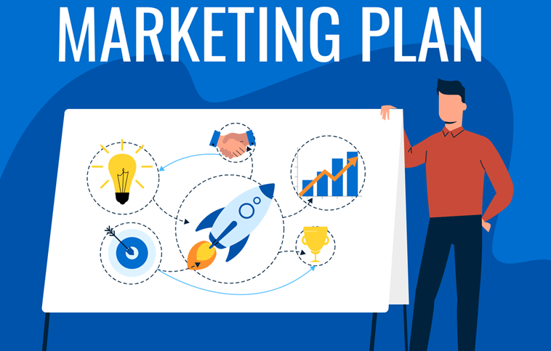

Slide 4
Marketing planning
Marketing planning is a process that allows to determine goals and develop marketing strategies and techniques to achieve these goals.
Marketing planning implies
Analyzing the existing situation, information and marketing opportunities
Forecast and start planning
Selecting target market(s)
Defining marketing objectives
Designing and developing a marketing strategy
Allocating resources to achieve these objectives

Slide 5
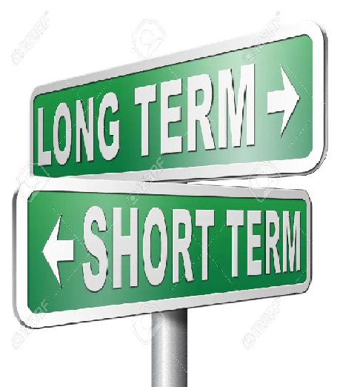
Types of marketing planning
Long-term marketing planning: Long-term marketing planning is marketing planning for more than one year.
It is the top management's responsibility.
Short-term marketing planning: Short-term marketing planning is marketing planning for less than a year, like bi-annual or annual plans.
It is the responsibility of the mid-management.

Slide 6
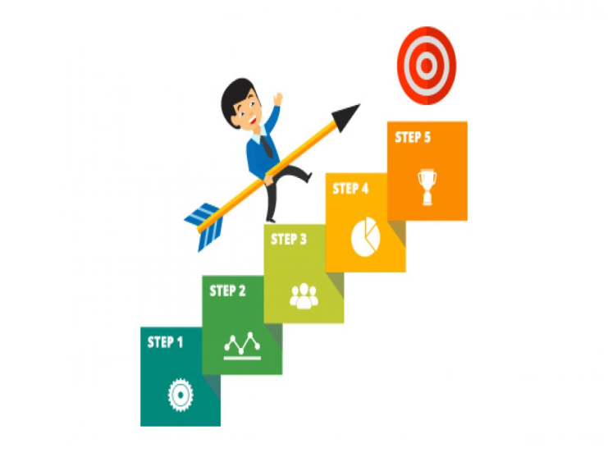
Steps in the marketing planning process
1. Understand the current business situation.
2. Understand your target client.
3. Position your brand
4. Define and refine your offer
5. Choose your marketing techniques
6. Adapt your tools and skills to your techniques
7. Write down your plan

Slide 7

BENEFITS OF MARKETING PLANNING
Marketing planning keeps you accountable
Marketing planning forces you to adapt
Marketing planning reduces risks
Marketing planning can be a competitive advantage
Marketing planning allows you to be proactive

Slide 8
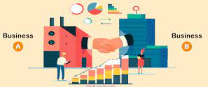
B2B Marketing
Business-to-business is a situation where one business makes a commercial transaction with another.
This typically occurs when: A business is sourcing materials for their production process for output, i.e. providing raw material to the other company that will produce output.

Slide 9
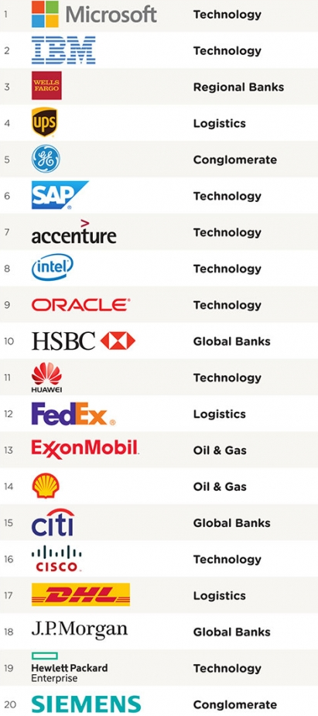

Slide 10
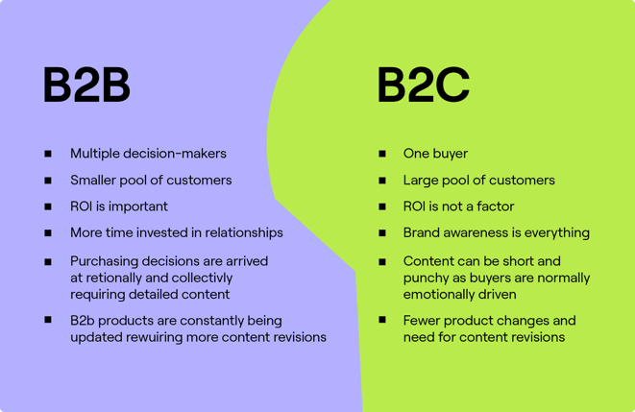
Concepts of B2B marketing

Slide 11
Service Marketing
Service marketing is the marketing and selling of intangible products (non-physical products). Services comprise all of those personal facilities which we require from time to time like; medical care, education, renting of living spaces and vehicles, hair cut, spas, musical concerts, dance classes, etc

Slide 12
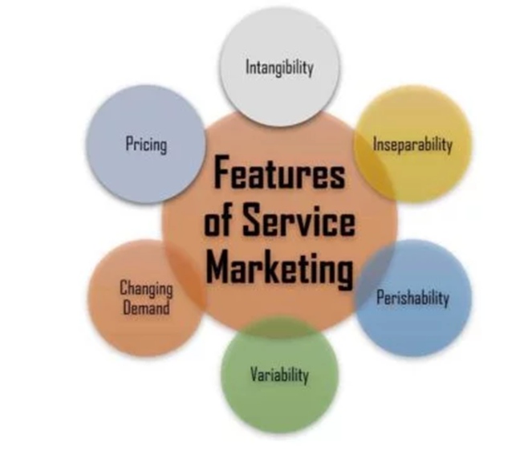
Features of Service Marketing

Slide 13
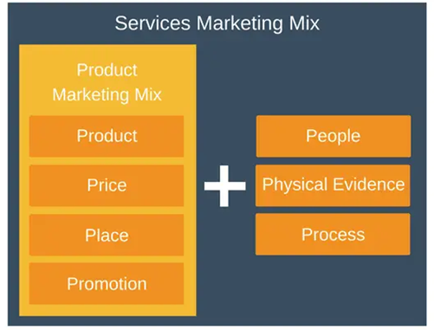
Services Marketing Mix

Slide 14
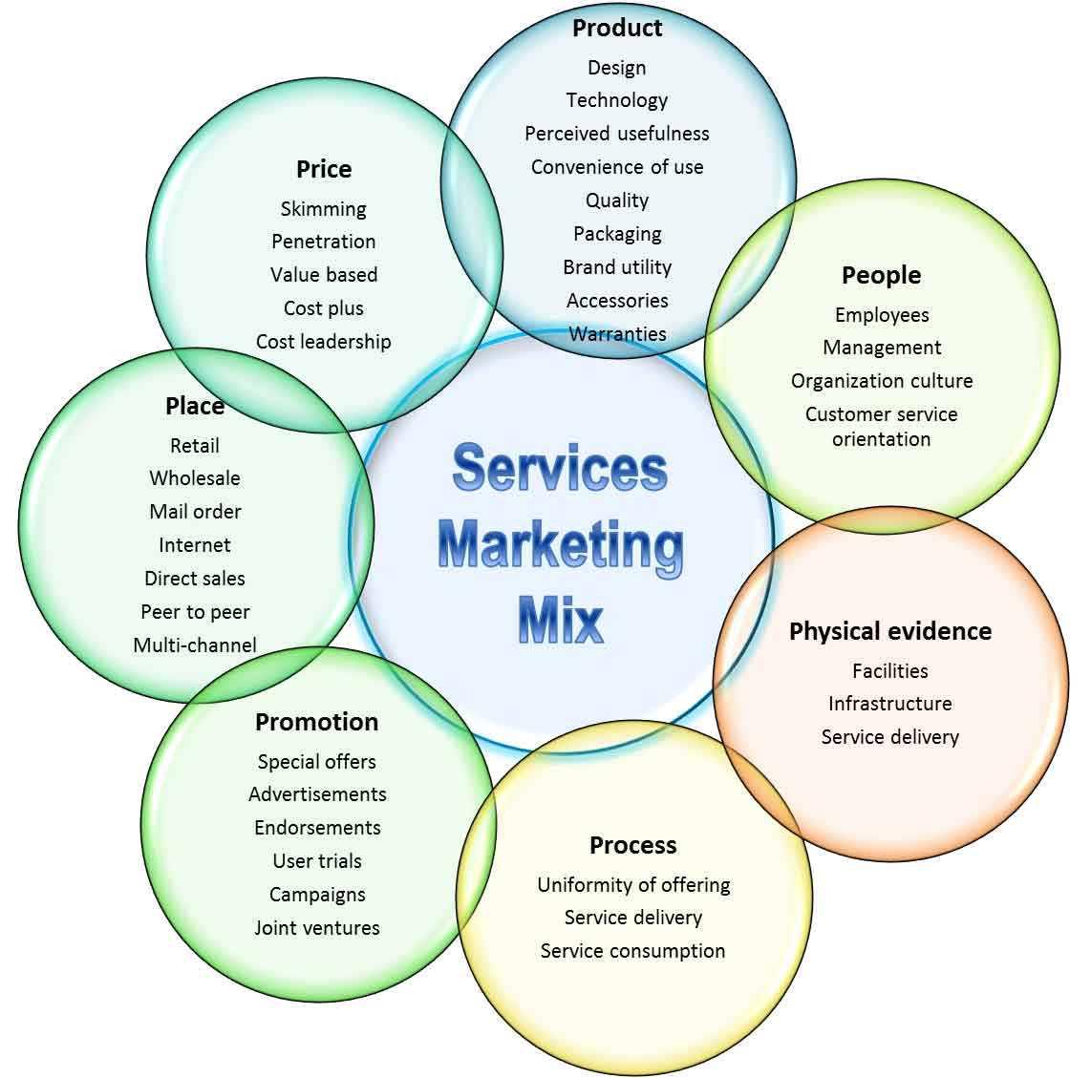

Slide 15
Digital and social media Marketing
Digital marketing comprises all marketing efforts that use the internet.
These include digital channels such as search engines, email, websites, social media, etc., that can be used to connect with current and prospective customers.

Slide 16
Digital marketing tools are
Organic social media marketing
Email marketing
Content creation tools
Paid social media marketing
Social media channels
Video hosting tools
Website analytics
SEO tools

Slide 17
Advantages of Digital Marketing & Social media marketing
Global Reach
Local Reach
Lower Cost
Easy to Learn
Effective Targeting
Multiple Strategies
Multiple Content Types
Increased Engagement
Analytics and Optimization

Slide 18


Slide 19
Green marketing
Green marketing is the marketing of products that are presumed to be environmentally safe.
It incorporates a broad range of activities, including product modification, changes to the production process, sustainable packaging, as well as modifying advertising.

Slide 20
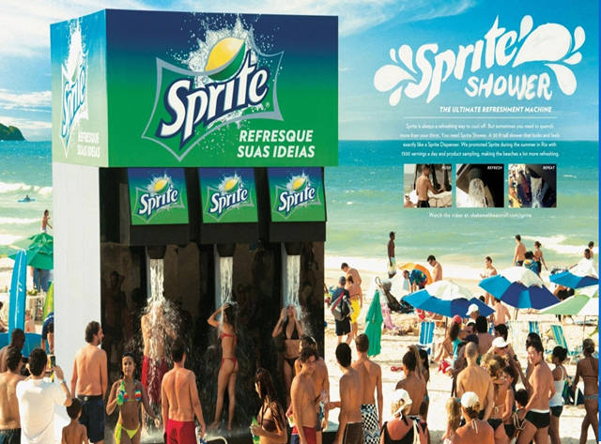
Event marketing

Slide 21
Event marketing
Event marketing is the experiential marketing of a brand, service, or product through memorable experiences or promotional events.
It typically involves direct interaction with a brand's representatives

Slide 22
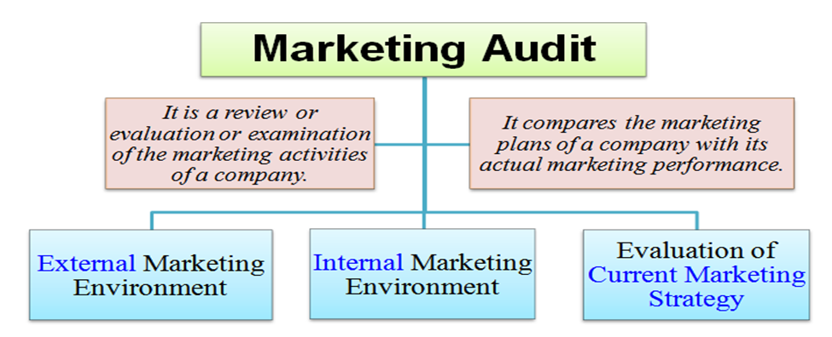

Slide 23
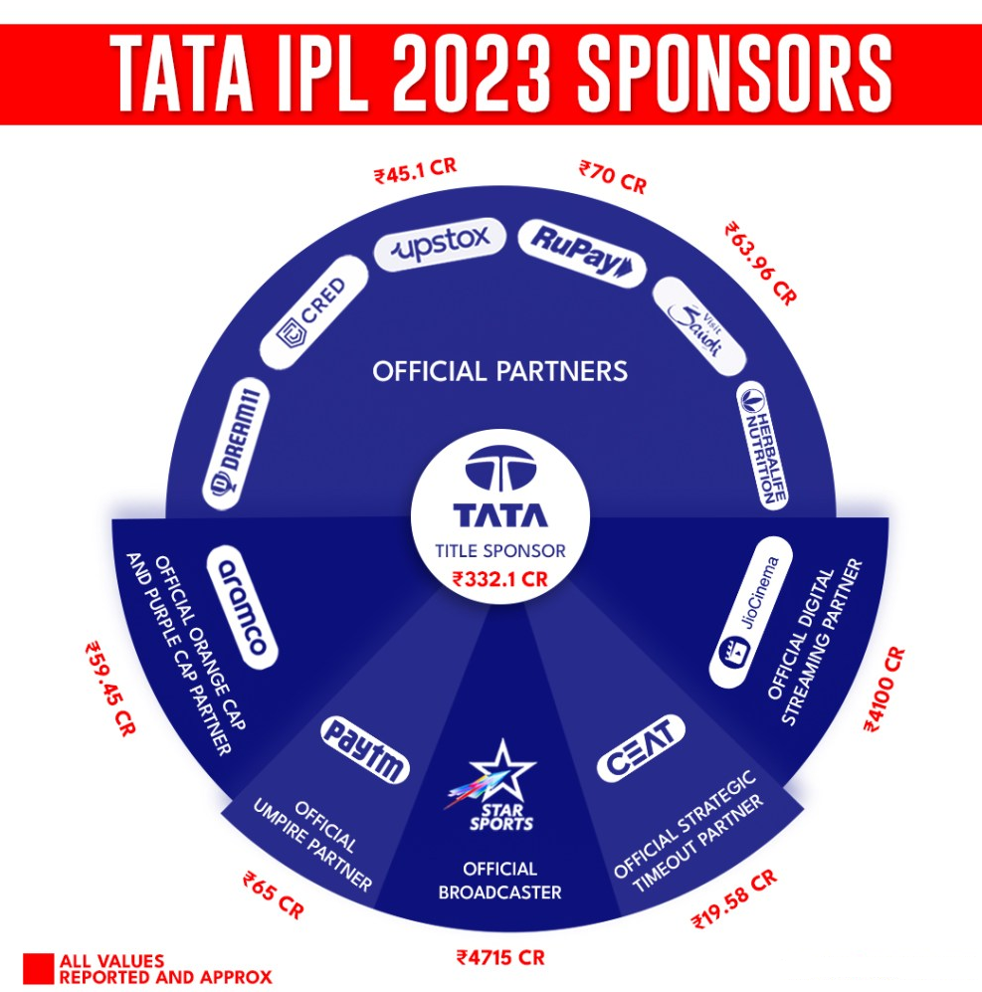
Sponsorship

Slide 24

Sponsorship advertising
Sponsorship advertising is a form of advertising where a company will sponsor some event or organization.
Examples include the sponsorship of sporting events, charity events, and athletic teams.

Slide 25
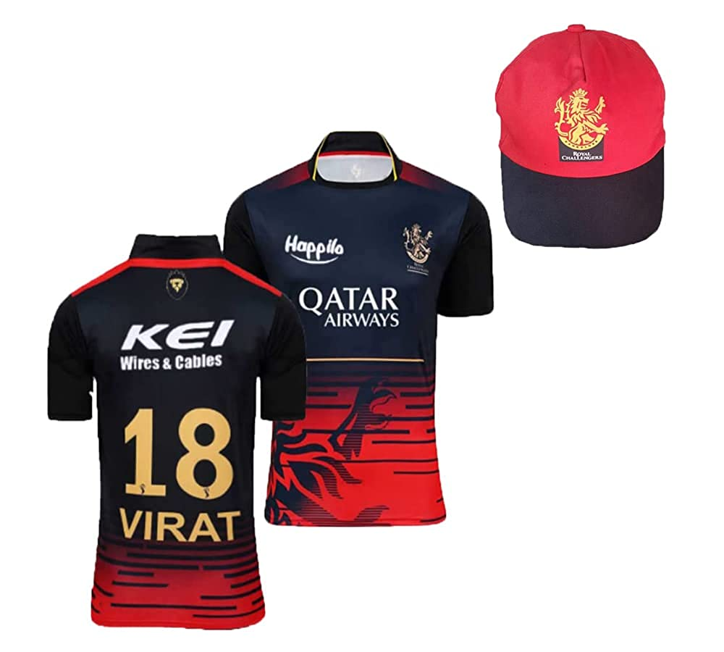

Slide 26
Cause related marketing
Cause-related marketing (CRM) is a mutually beneficial collaboration between a corporation and a nonprofit designed to promote the former's sales and the latter's cause.
As per one of the studies, it was revealed that 80% of consumers say that businesses must play a role in addressing societal issues.

Slide 27
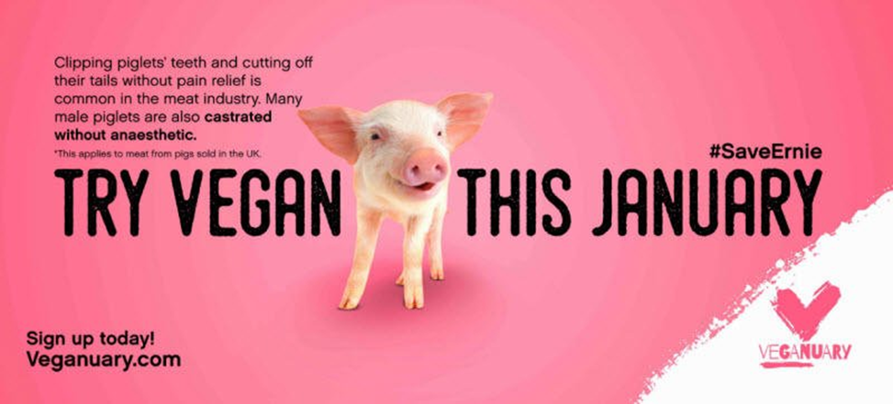
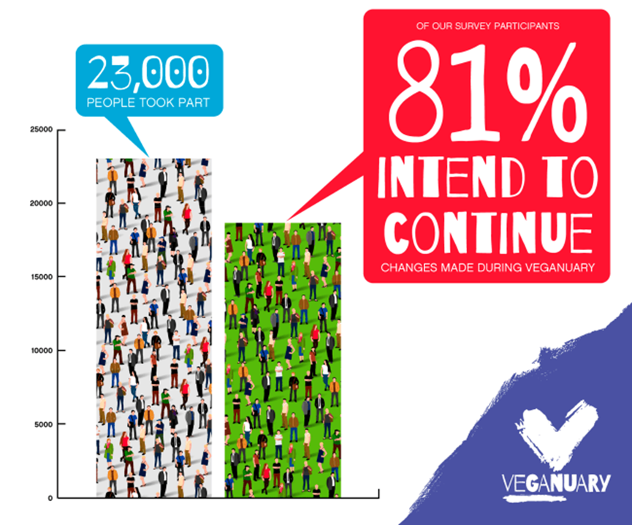

Slide 28
Marketing for Non-Profit Organizations
Not-for-Profit Organizations are the establishments that are for utilized for the welfare of the community and are set up as charitable associations which operate without any motive for profit.

Slide 29
Famous NGOs
Smile Foundation
Child Rights and You (CRY)
Nanhi Kali
HelpAge India
Infosys foundation

Slide 30
Relationship Marketing
Relationship Marketing is a strategy of Customer Relationship Management (CRM) that emphasizes customer retention, satisfaction, and lifetime customer value.
Its purpose is to market to current customers versus new customer acquisition through sales and advertising.

Slide 31
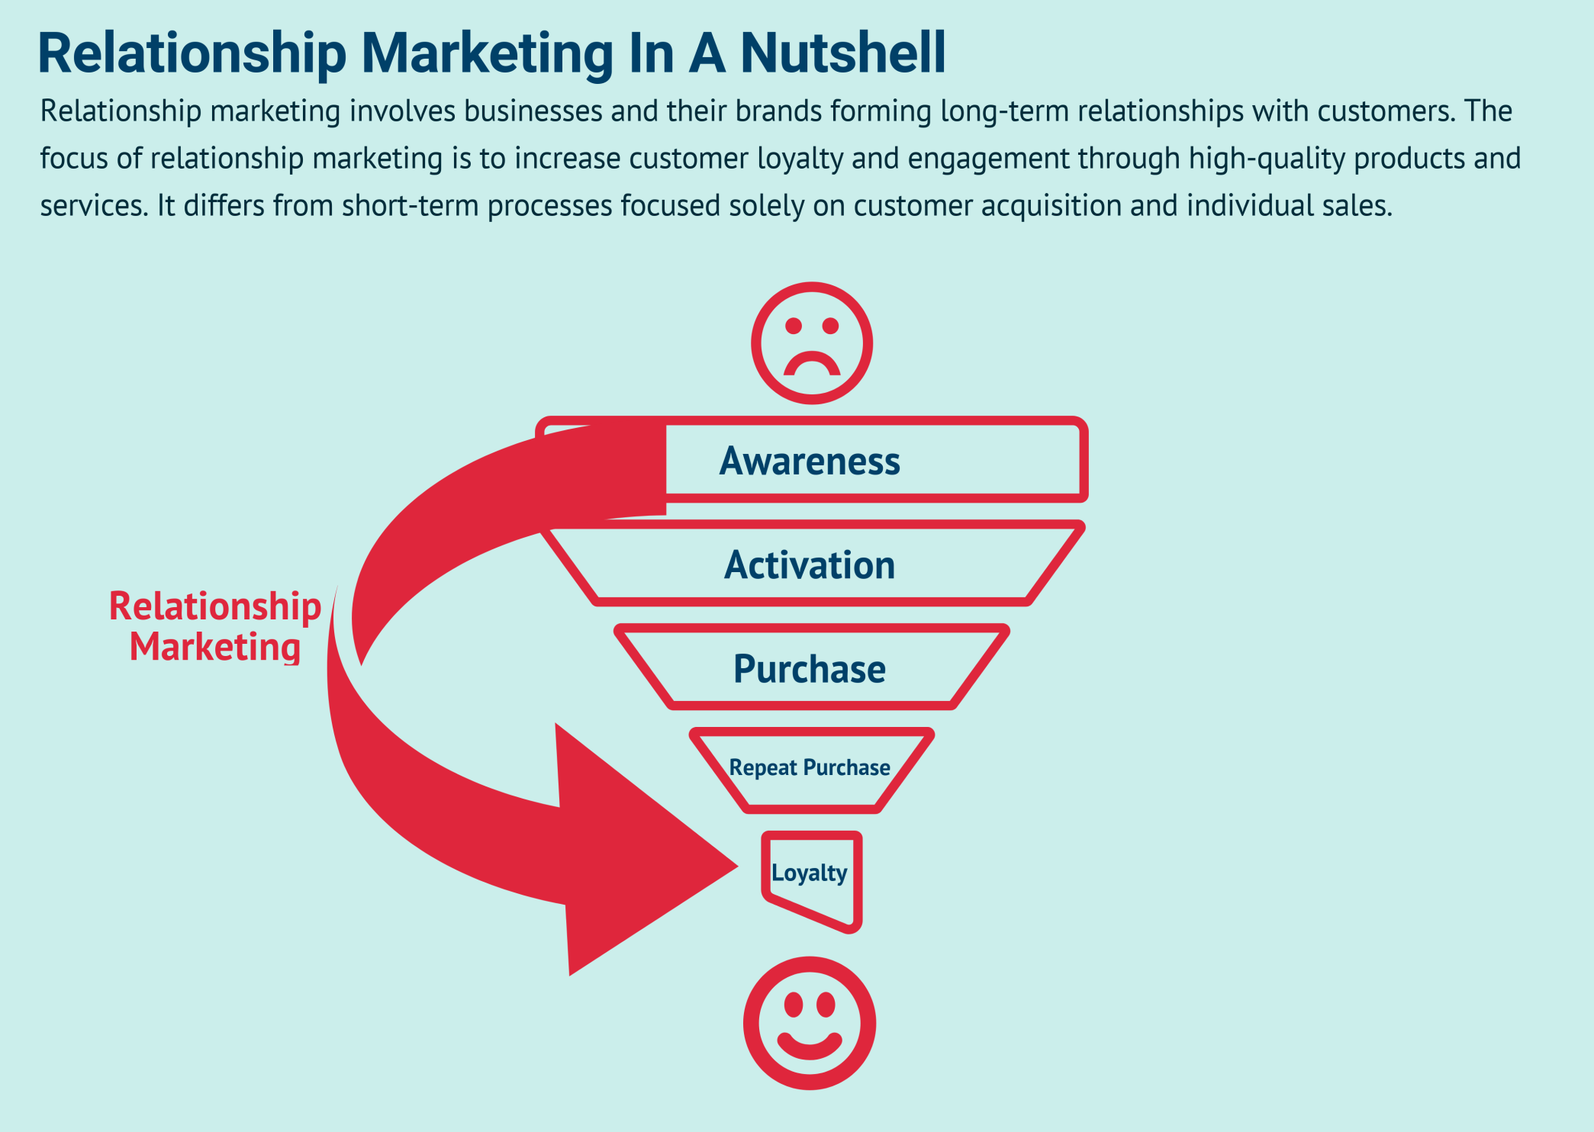

Slide 32
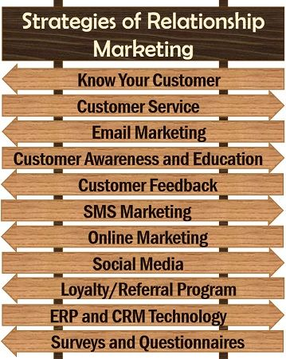

Slide 33
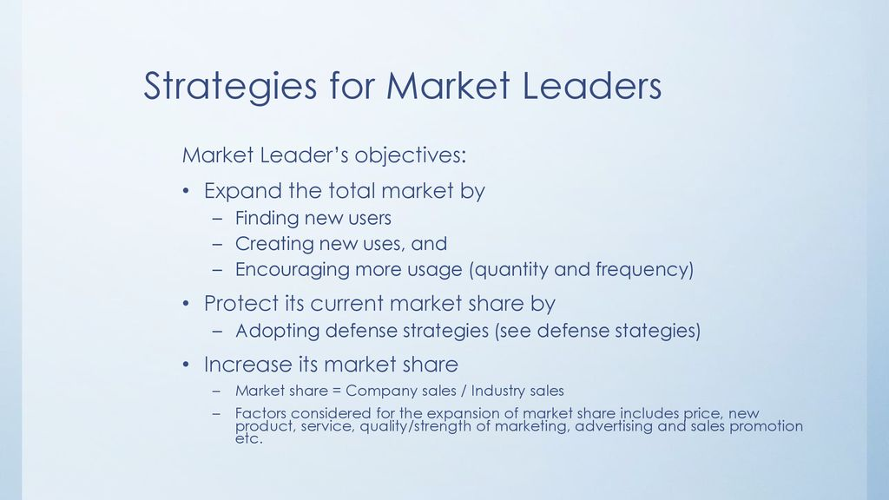

Slide 34
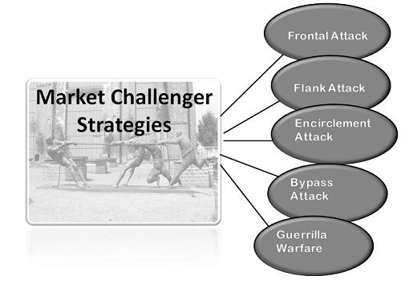

Slide 35
Frontal Attack: The principle of force says the side with greater resources will win.
Here the attacker matches the market leader's product, price, advertisement, and promotional activities.
Example: When McDonald's Launched Chatpata naan ( Veg and Non-Veg ) to tackle that Burger King Launched Chicken Keema.
Both have a strength to expand their product line and enter into a new market to accouterment their opponents.

Slide 36
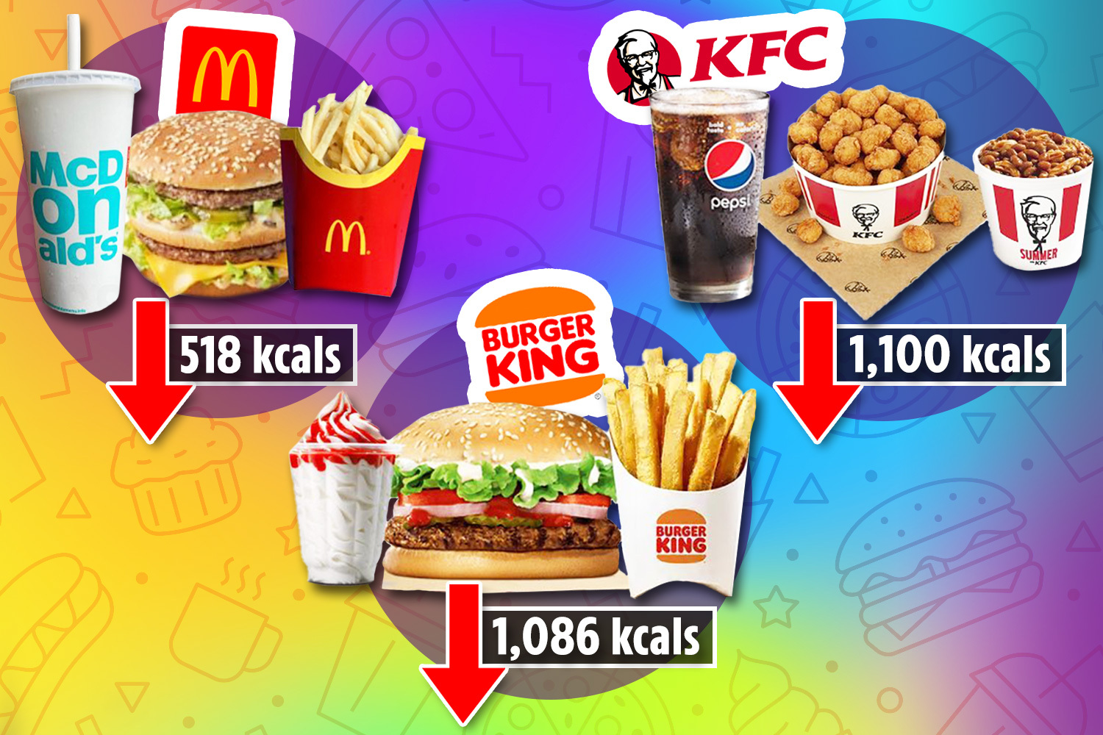

Slide 37
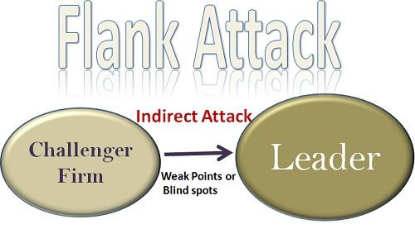

Slide 38
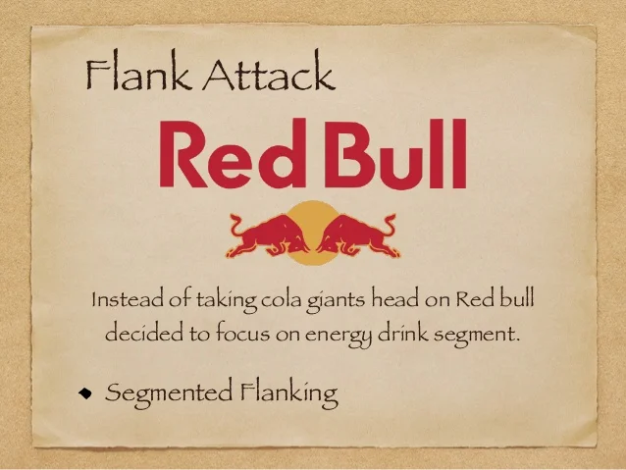

Slide 39
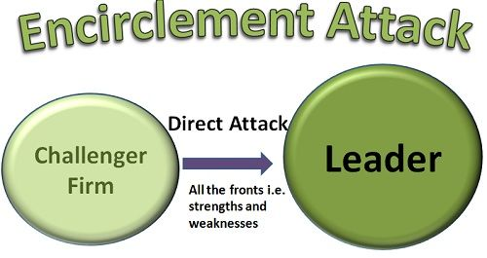

Slide 40
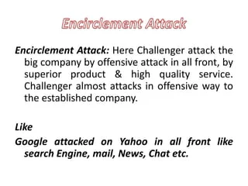

Slide 41
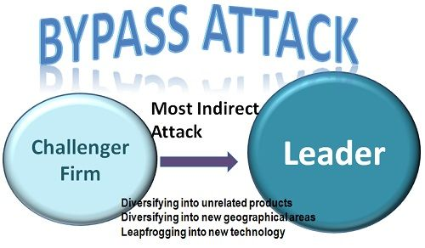

Slide 42
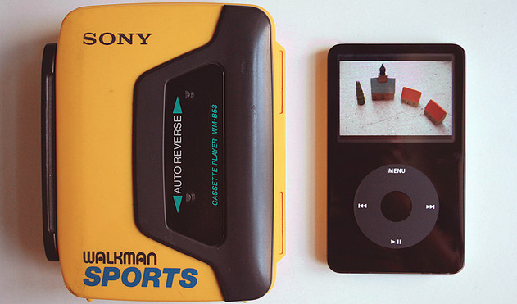

Slide 43
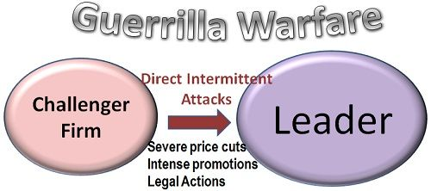

Slide 44
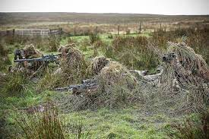

Slide 45
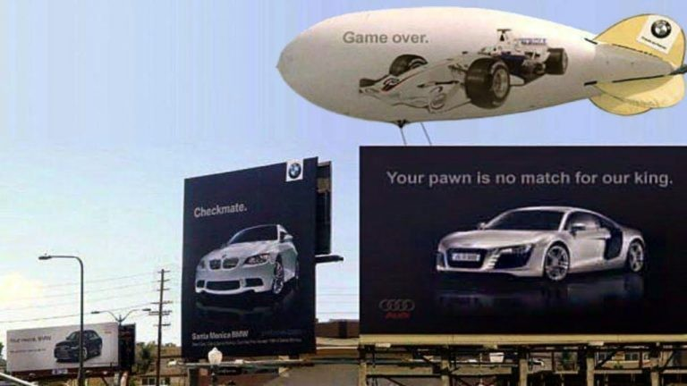

Slide 46
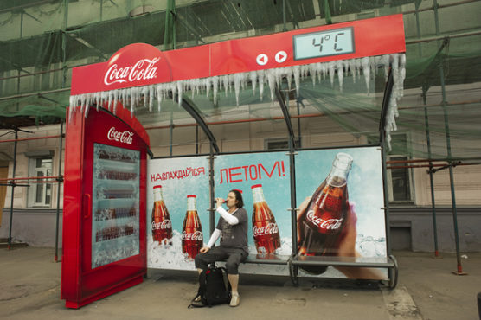
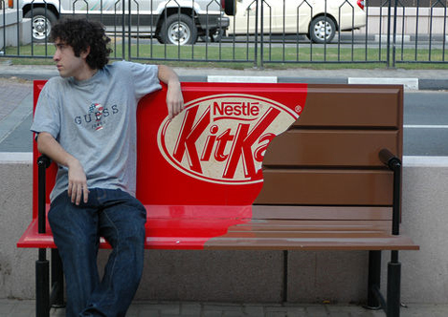

Slide 47
https://businessjargons.com/market-challenger-strategies.html

Slide 48
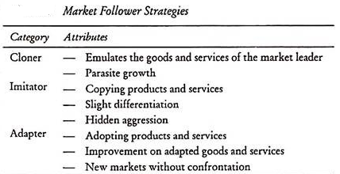

Slide 49
Marketing strategies for startups
Push notifications
Social media
Segmentation and Personalization
Content writing and blogging
Customer feedback loop.

Slide 50
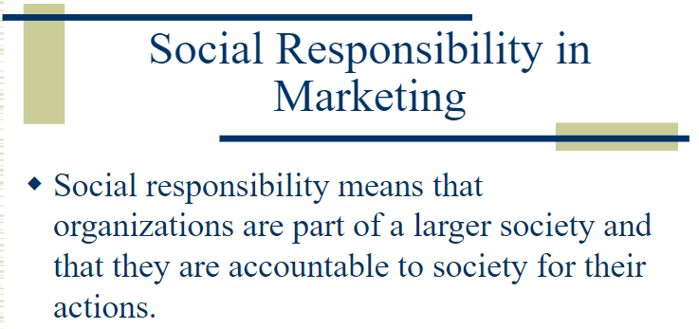

Slide 51
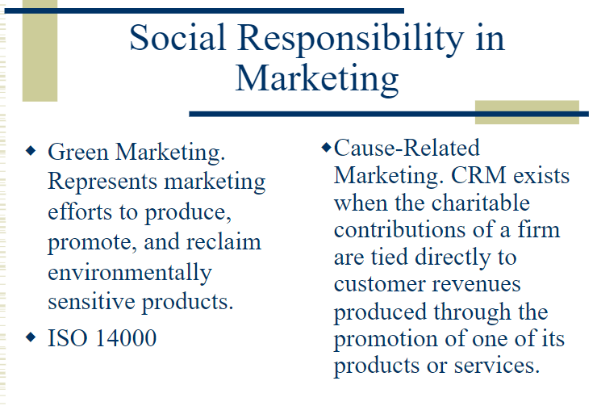

Slide 52
Neuromarketing
Neuromarketing is the study of how people's brains respond to advertising and other brand-related messages by scientifically monitoring brainwave activity, eye tracking and skin response.

Slide 53
Six hacks for Neuro marketing
Leverage sensual branding (senses, uniqueness)
Price /value perception (999.99)
Offer micro commitments (multiple touch points)
Leverage scarcity (fake scarcity)
Give simple ( as simple as possible / simply UX)
Empathy connect (ask, listen, connect)

Slide 54
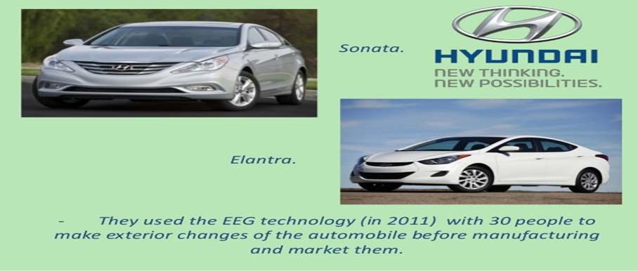

Slide 55
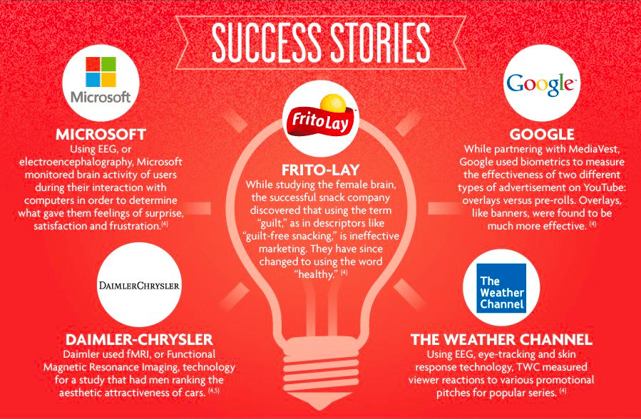

Slide 56
Pre-roll ads
https://www.wordstream.com/blog/ws/2019/10/31/pre-roll-ads
YouTube offers different types of advertising placements and ad types, and pre-roll ads are those that appear directly before the video you want to watch.
These short video ads can be up to two minutes long, but the sweet spot for most advertisers is between 15 and 25 seconds.
And because pre-roll ads don’t have a defined CTA, you’ll be charged on a CPV (cost per view) basis.

Slide 57
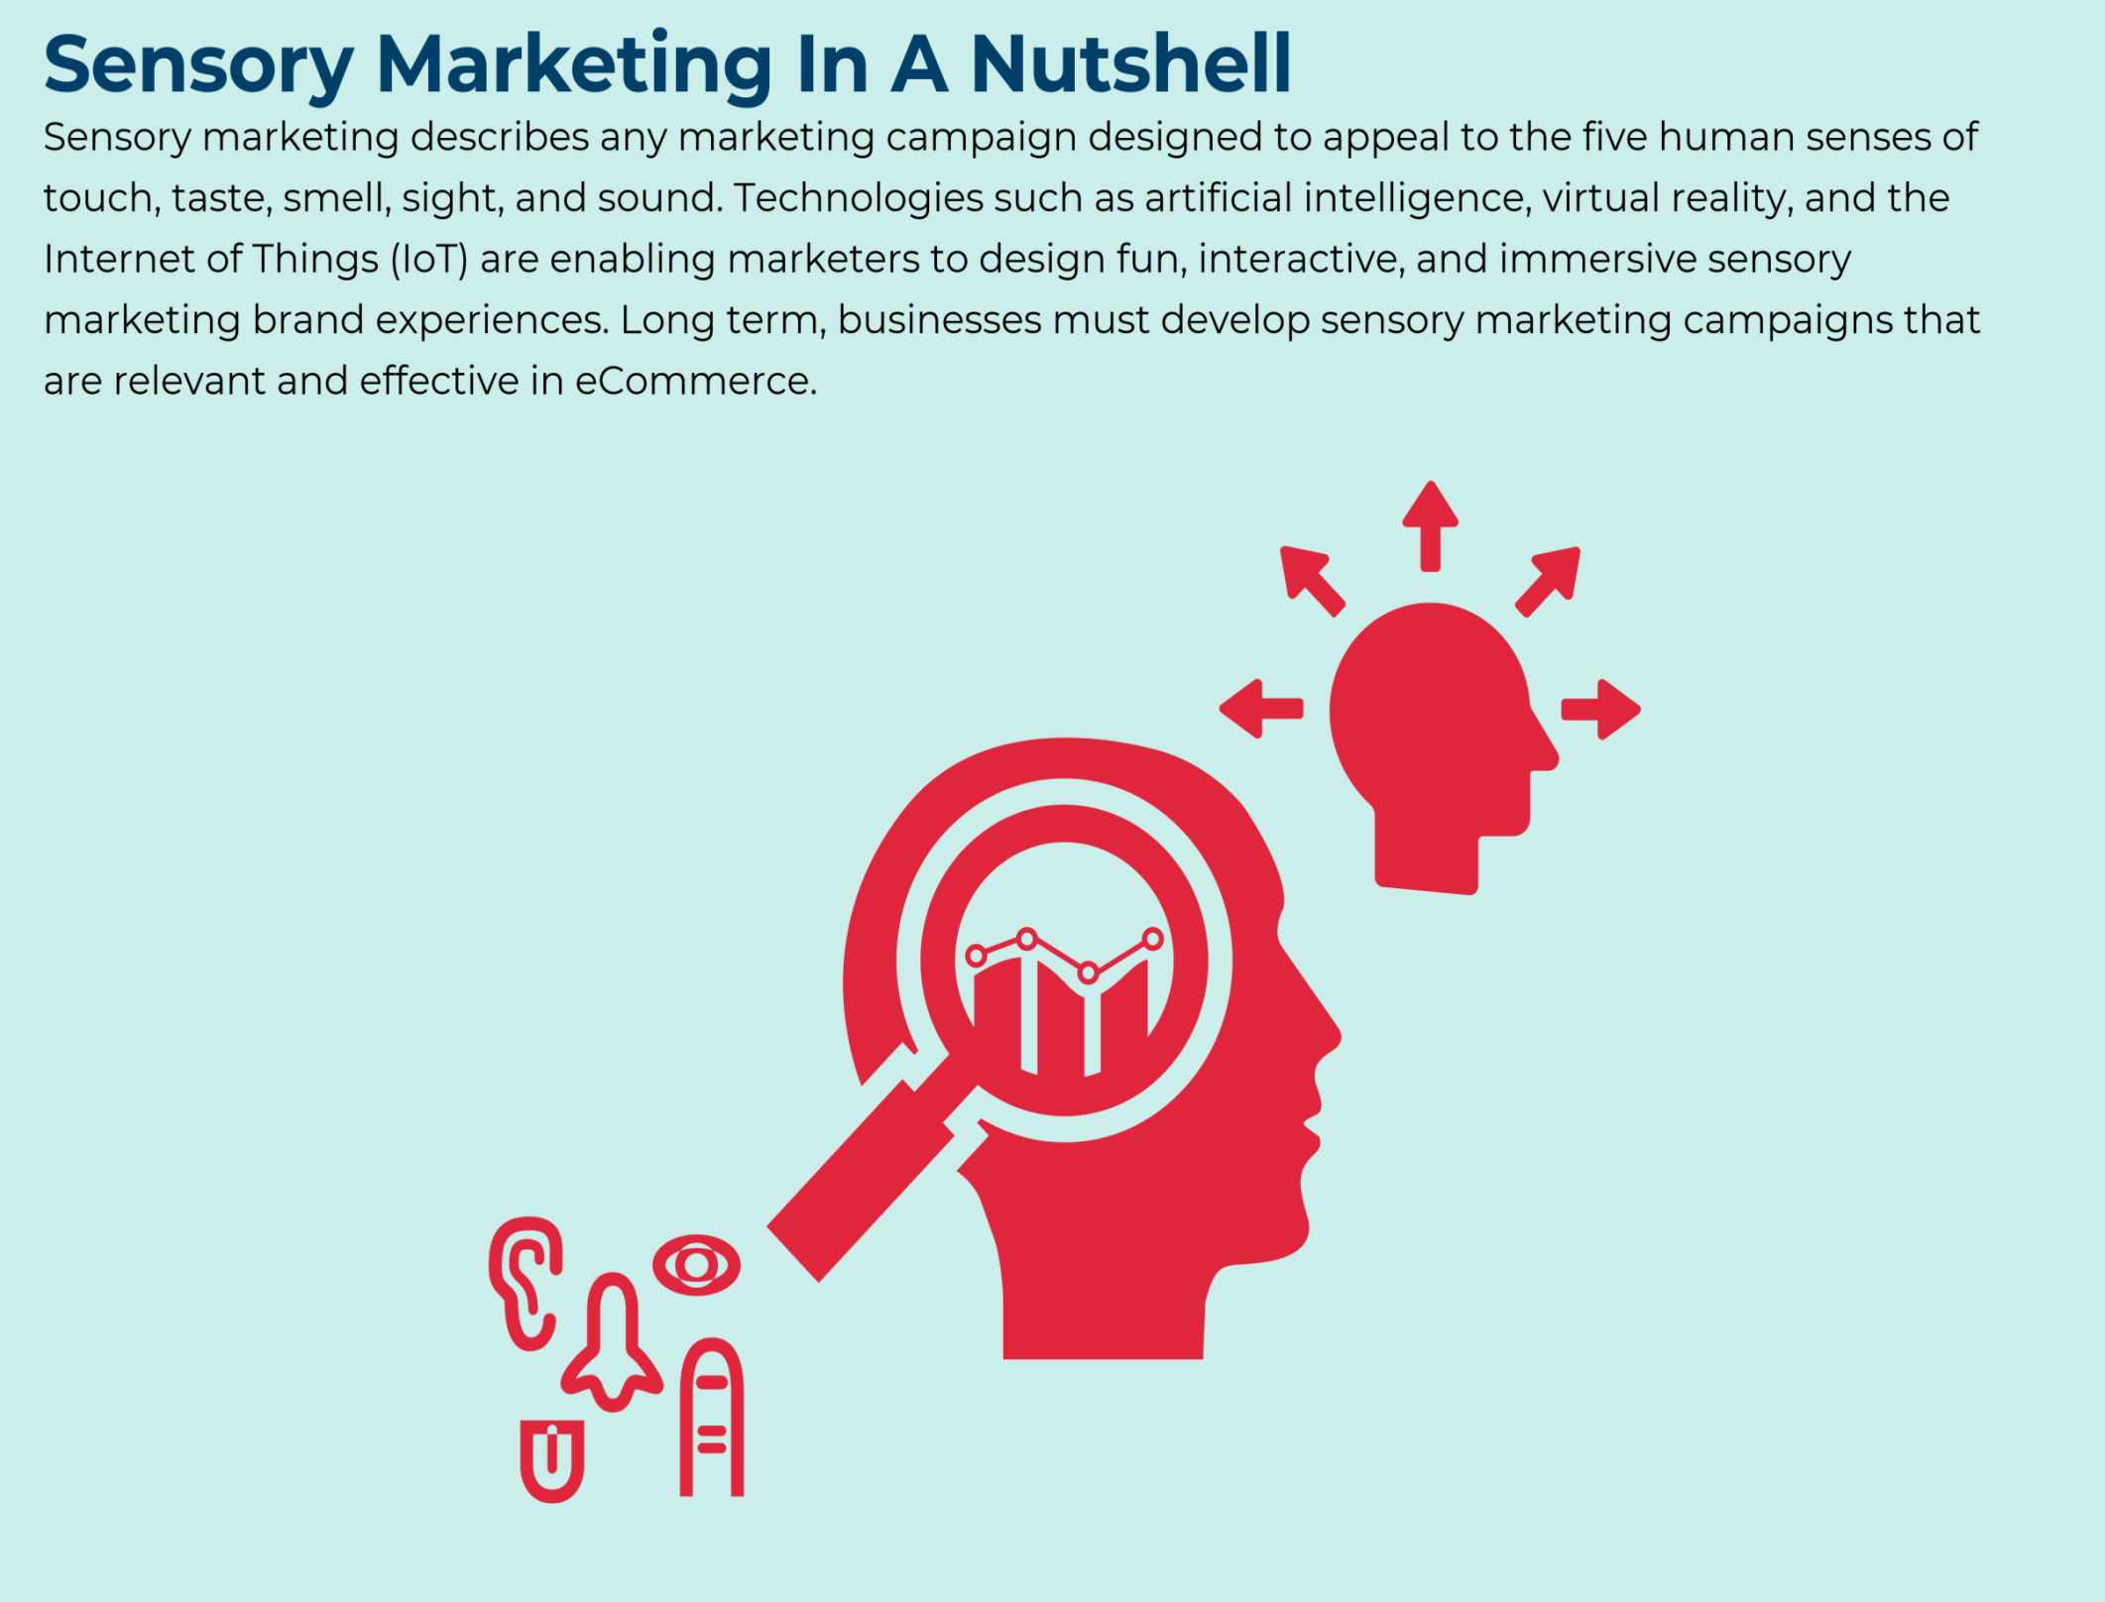

Slide 58

Sensory marketing

Slide 59

Wine

Slide 60
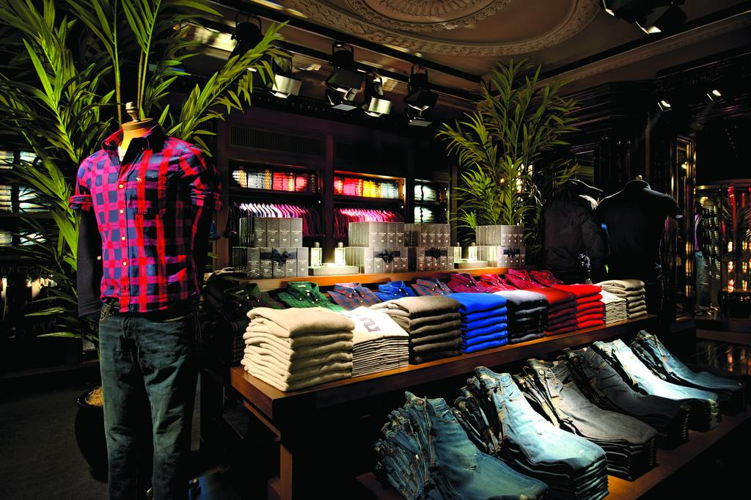
Scent and Garment

Slide 61

Ikea

Slide 62

Taste

Slide 63
Societal marketing
The societal marketing concept adopts the position that marketers have a greater social responsibility than simply satisfying customers and providing them with superior value.
Instead, marketing activities should strive to benefit society's overall well-being.

Slide 64
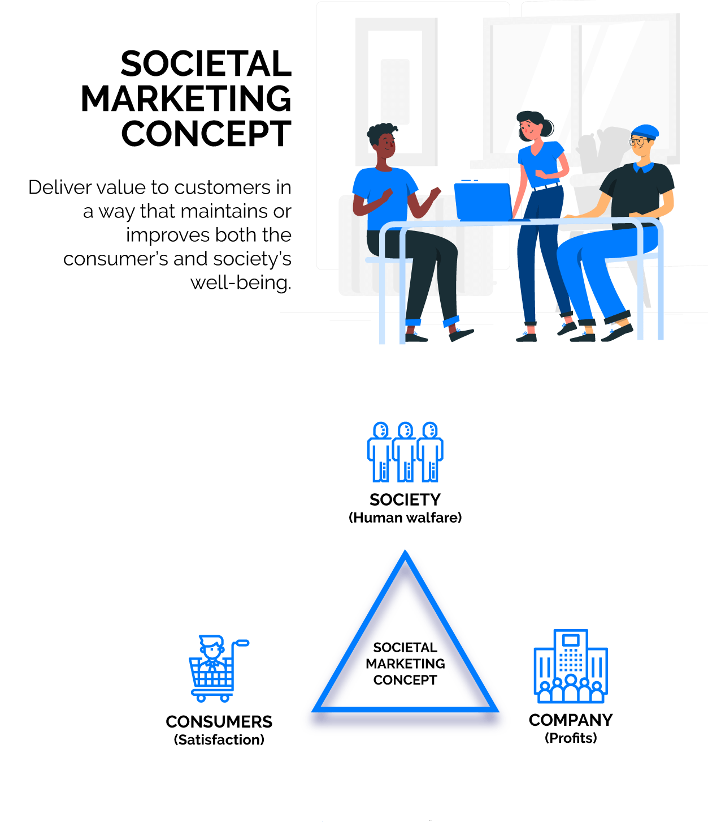

Slide 65
Coca-cola's desire to be socially responsible has lead the company to give over $126,000,000 in 2014 to initiatives such as active and healthy living, water stewardship programs, education, women's empowerment, humanitarian and disaster relief programs.
Encouraging use of reusable coffee cups, water bottles and metal straws. Eliminating plastic bags from retail and grocery stores.

Slide 66
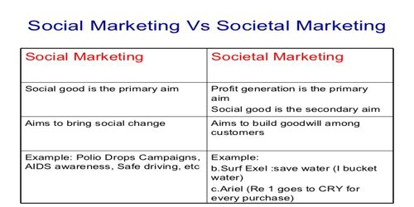

Slide 67
Premiumization
The action or process of attempting to make a brand or product appeal to consumers by emphasizing its superior quality and exclusivity.

Slide 68

Package premiumization

Slide 69
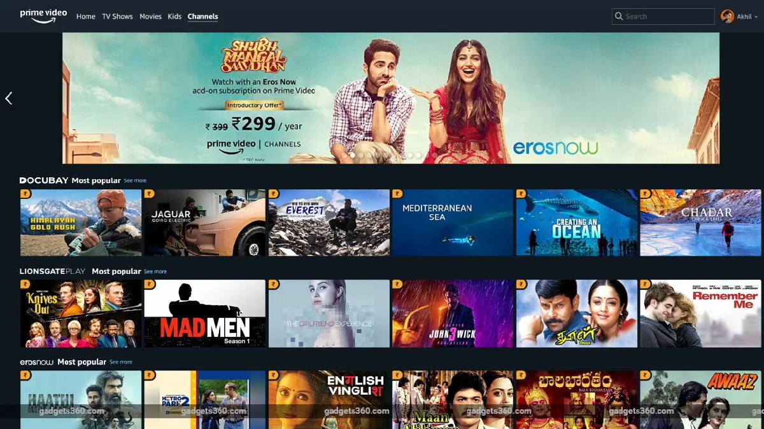

Slide 70
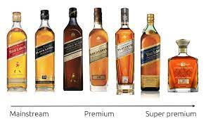

Slide 71


Slide 72


Slide 73
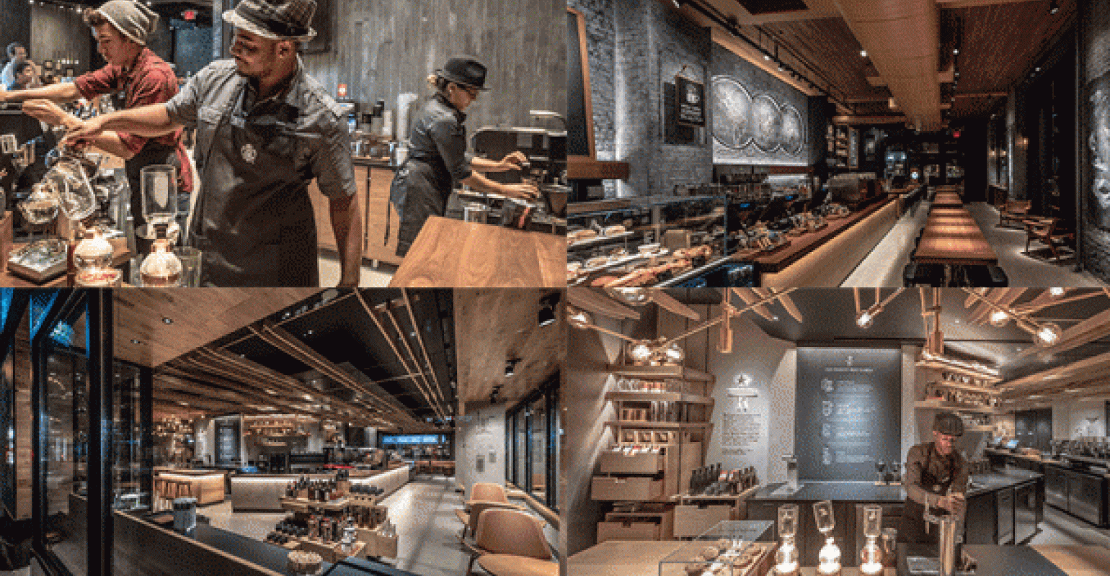
Starbucks

Slide 74
Web links and Video Lectures (e-Resources): • https://youtu.be/5fdx5Laavkc https://youtu.be/Ule8n6GgE1g https://youtu.be/ob5KWs3I3aY?t=131 https://youtu.be/U1VWUHLhmdk

