Slide 1
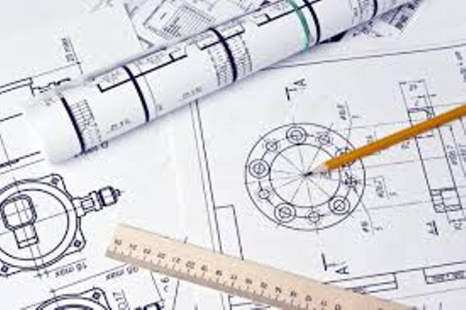
Computer aided Engineering Drawing
BCEDK103
Presentation by,
Dr. Abhishek M R
Associate Professor
Department of Mechanical Engineering
KSSEM, Bangalore - 560109

Slide 2
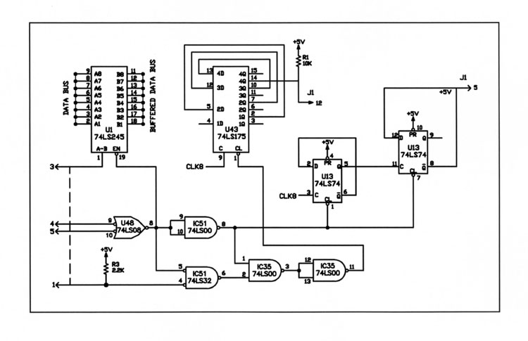
Electrical circuit

Slide 3
Describe the Circuit

Slide 4
Drawing is important for all branches of engineering.

Slide 5
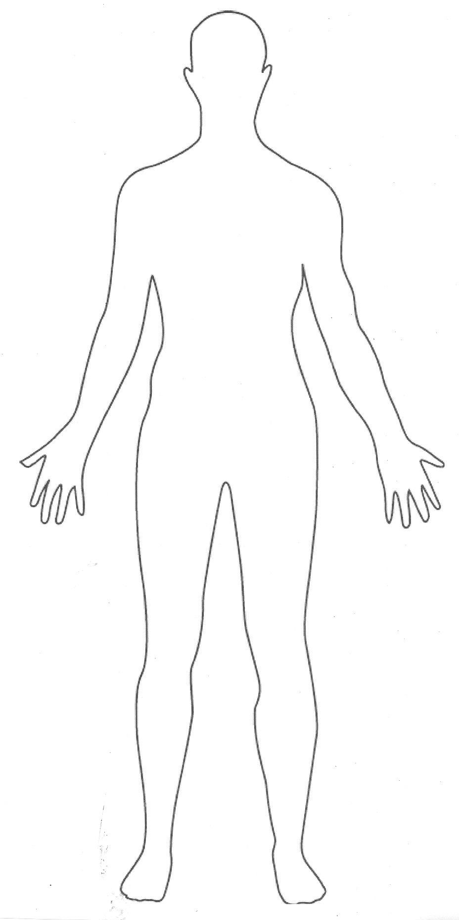
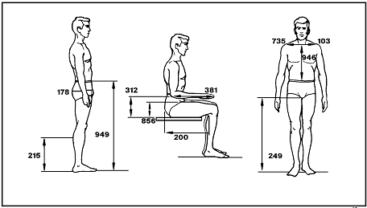
Definition of Engineering Graphics
Drawing | Engineering Graphics

Slide 6
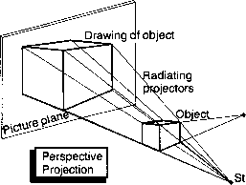
Projection

Slide 7
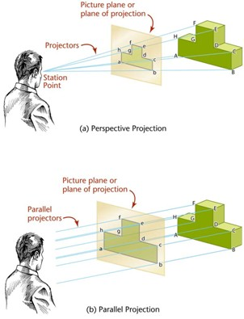
Types of Projection

Slide 8
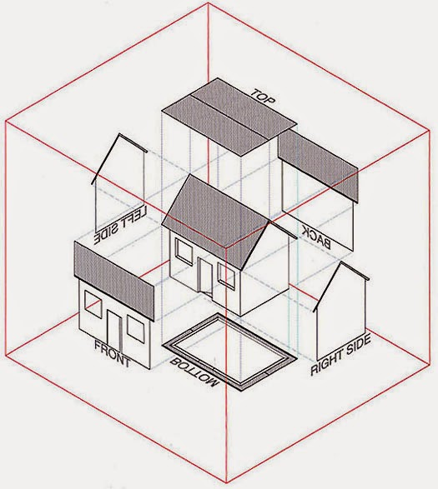
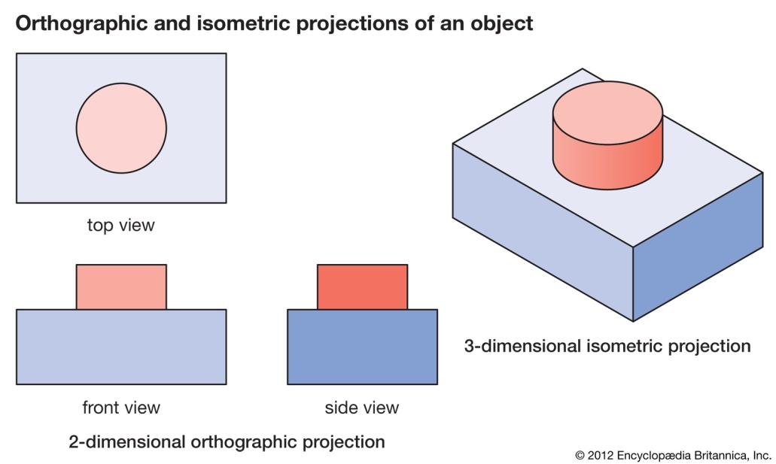
Orthographic Projection
Isometric Projection

Slide 9

Drawing Instruments

Slide 10
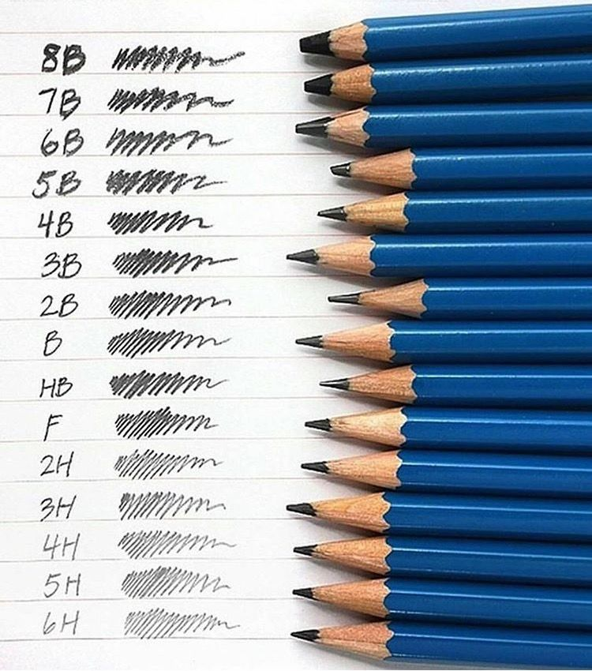
Types of Pencils

Slide 11
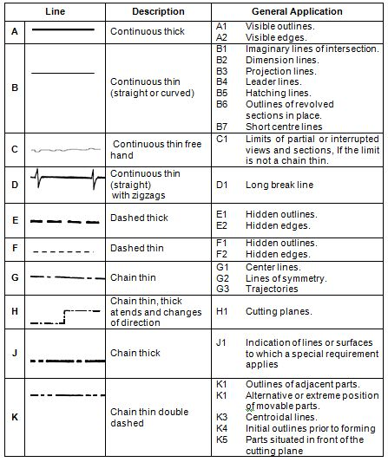
Line Conventions

Slide 12
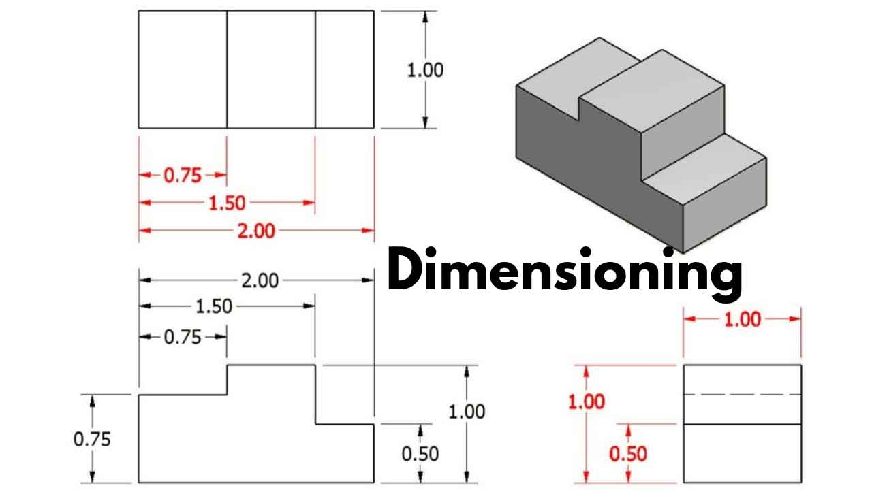
Dimensioning
Projection line
Dimensioning line
Dimension Value
Arrow
Shape Dimensioning
System of dimensioning
Unidirectional
Aligned

Slide 13
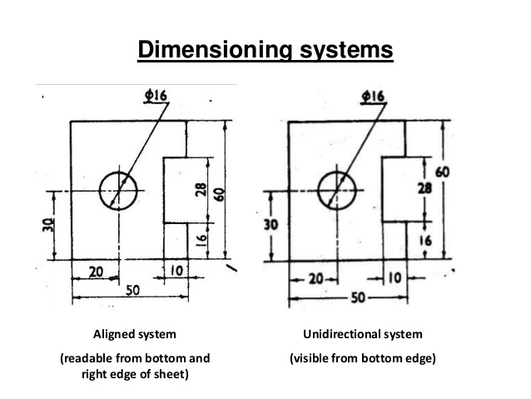

Slide 14
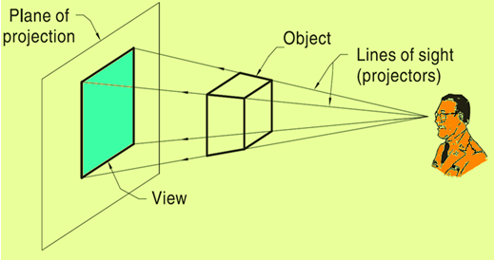
Plane of Projection

Slide 15
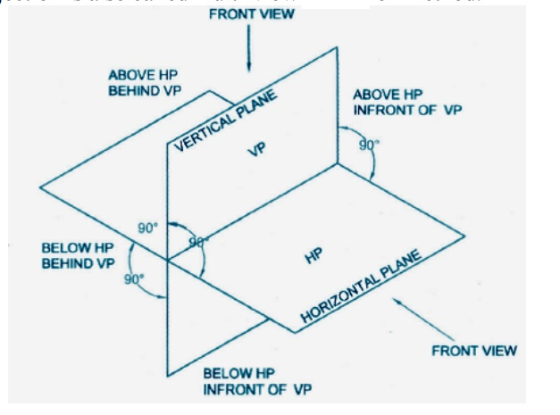
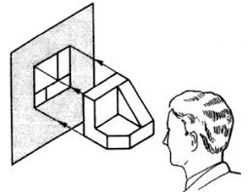

Slide 16
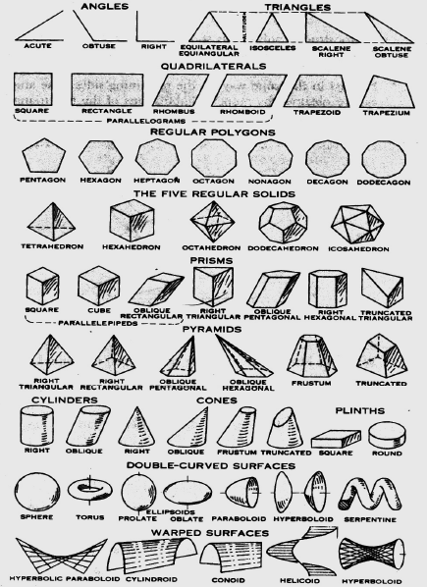

Slide 17
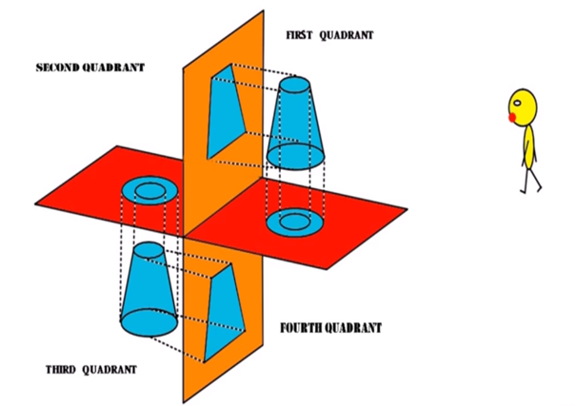

Slide 18
Reference links
https://www.youtube.com/watch?v=KjtAAVKie84 (Basics of Drawing)
https://www.youtube.com/watch?v=mcxUTNkSyp4 (1st and 3rd Angle Projection)
https://www.youtube.com/watch?v=NUxBqIuxKQc (2nd and 4th Angle Projection)

Slide 19


