Slide 1
Internet of Things
18CS81

Slide 2
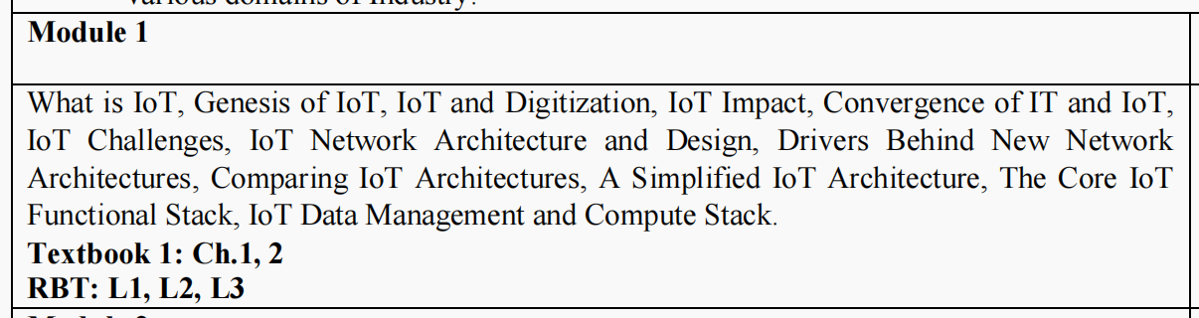

Slide 3
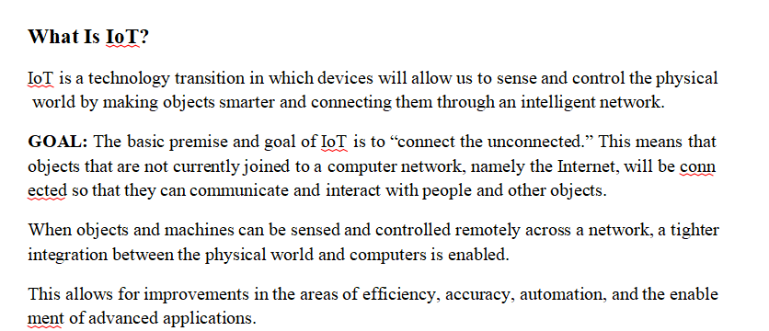

Slide 4
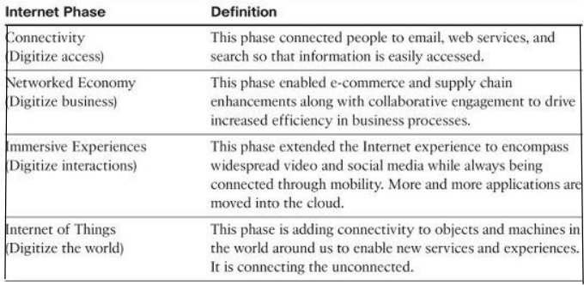
GENESIS OF IOT
4 Phases

Slide 5
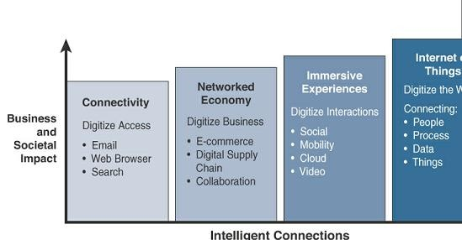

Slide 6
IOT AND DIGITIZATION
At a high level, IoT focuses on connecting “things,” such as objects and machines, to a computer network, such as the Internet. IoT is a well-understood term used across the industry as a whole.
On the other hand, digitization can mean different things to different people but generally encompasses the connection of “things” with the data they generate and the business insights that result.
Digitization, as defined in its simplest form, is the conversion of information into a digital format. Digitization has been happening in one form or another for several decades.
For example, the whole photography industry has been digitized. Pretty much everyone has digital cameras these days, either standalone devices or built into their mobile phones. Almost no one buys film and takes it to a retailer to get it developed.
The digitization of photography has completely changed our experience when it comes to capturing images.

Slide 7
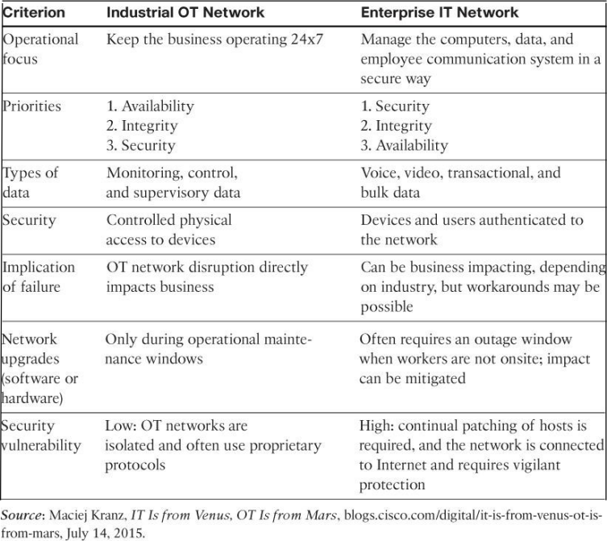
CONVERGENCE OF IT AND OT
Until recently, information technology (IT) and operational technology (OT) have for the most part lived in separate worlds.

Slide 8
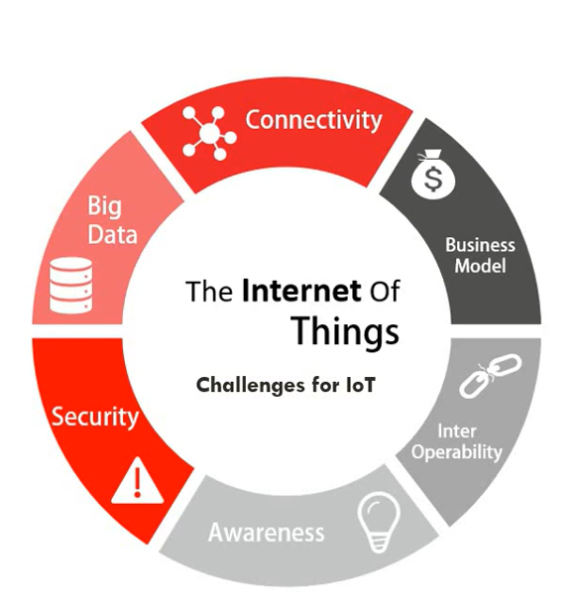
IOT CHALLENGES

Slide 9
IoT Network Architecture and Design
Drivers behind new network architectures
Comparing IoT Architectures.
A Simplified IoT Architecture
The Core IoT Functional Stack
IoT Data Management and Compute Stack

Slide 10
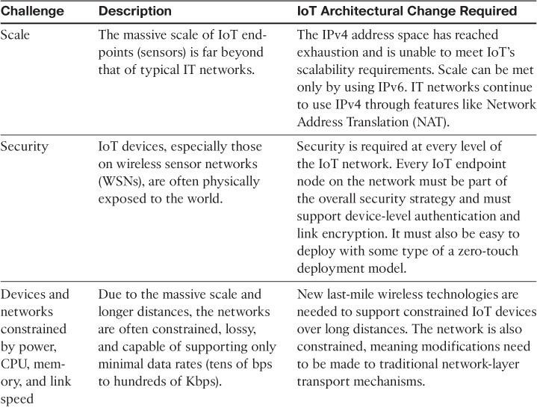
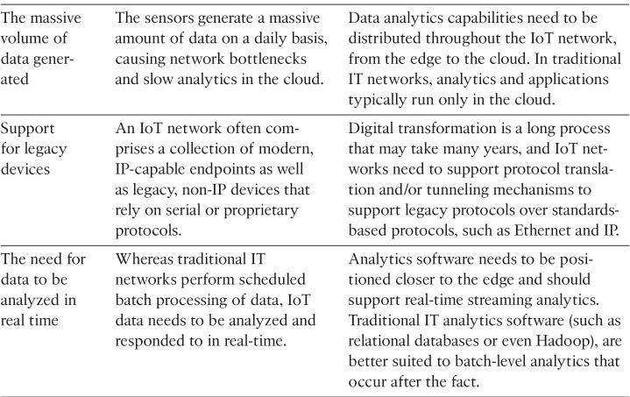
Drivers behind new network architectures

Slide 11
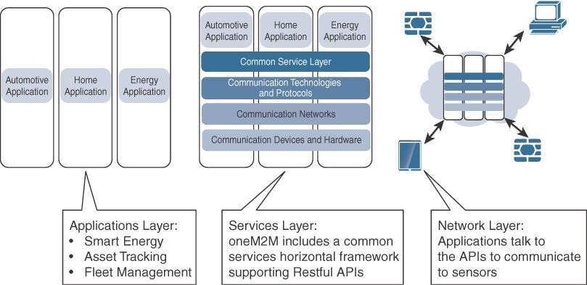
COMPARING IOT ARCHITECTURES
The one M2M IoT Standardized Architecture

Slide 12
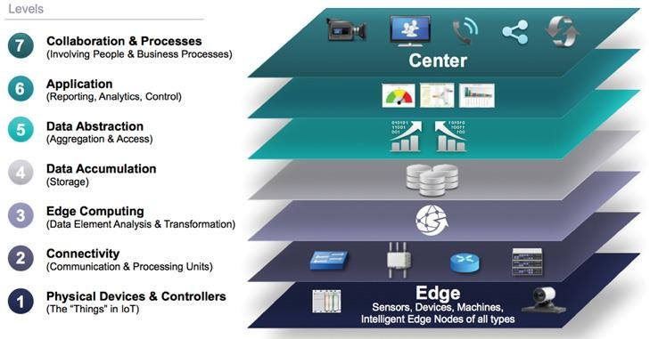
The IoT World Forum (IoTWF) Standardized Architecture

Slide 13
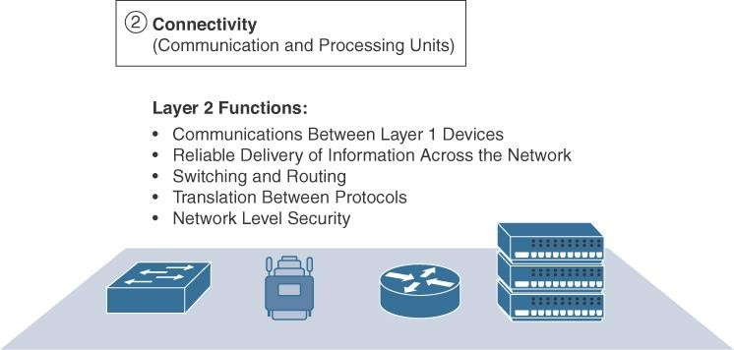
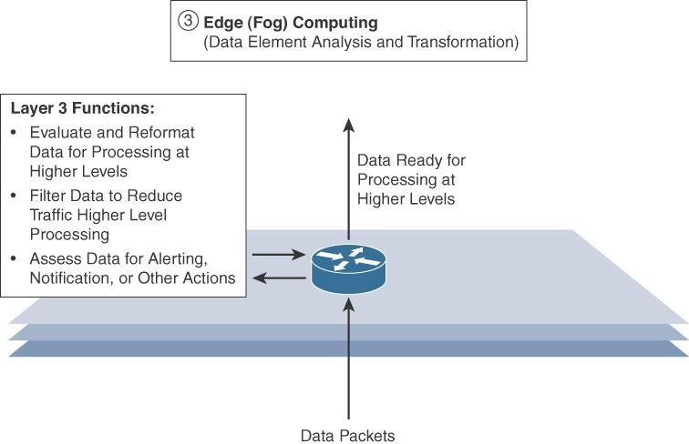
Layer 1: Physical Devices and Controllers Layer
Layer 2: Connectivity Layer
Layer 3: Edge Computing Layer

Slide 14
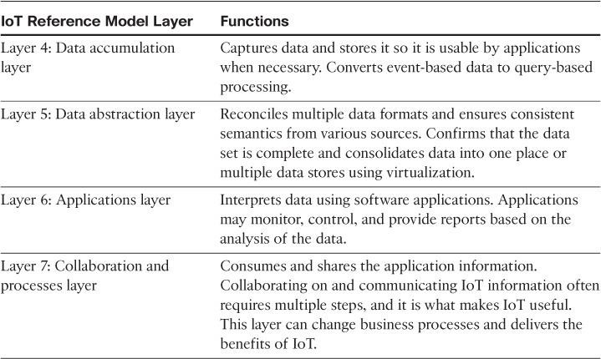

Slide 15
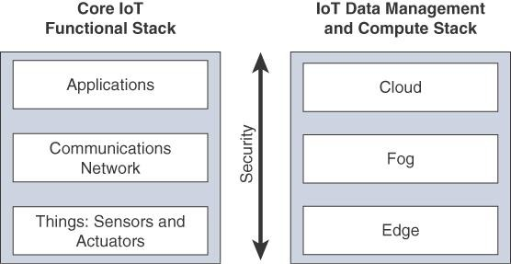
A SIMPLIFIED IOT ARCHITECTURE

Slide 16
Useful Links
https://www.youtube.com/watch?v=TrFaCBV7joY
https://www.youtube.com/watch?v=yEDc3i16F_o
https://www.youtube.com/watch?v=Wj-whlOt4So

