Slide 1

MODULE 3-AIR
Course: Conservation of Natural resources
Course code: 21CV654
Semester:VI
Dept. of Civil Engineering
K S SCHOOL OF ENGG. & MANAGEMENT
FACULTY HANDLED:
TEJASWINI M L
Asst. Professor

Slide 2
SYLLABUS
Introduction, composition, sources and classification of air pollutants, National Ambient Air quality standards (NAAQS), Air quality index, effects of air pollution on human health. Economic effects of air pollution. Control of air pollution by equipment, smoke and its control. Ozone depletion impacts, photochemical changes.

Slide 3
INTRODUCTION
Air is the invisible mixture of gases that surrounds Earth. Air contains important substances, such as oxygen and nitrogen, that most species need to survive.
The air is different as you move higher and higher into the atmosphere. The air gets "thinner" as elevation climbs because there are fewer air molecules up there.

Slide 4
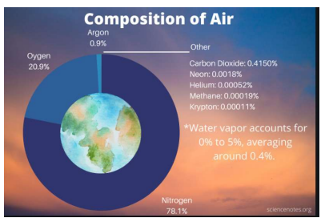
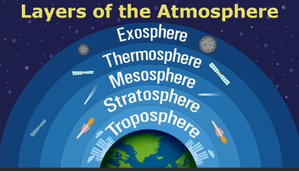
Composition of Air

Slide 5
Continuation….
The composition of air refers to the chemical composition of the troposphere. The troposphere is the lowest layer of the atmosphere, extending from the surface to about 12 km or 39000 ft. The troposphere contains about 80% of the mass of the Earth’s atmosphere. Nearly all of the atmosphere’s water vapor exists in this layer. Just three gases account for 99% of dry air: nitrogen, oxygen, and argon.

Slide 6
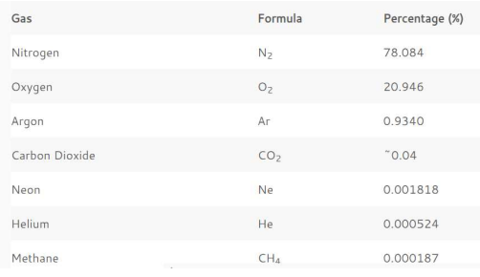
Continuation….

Slide 7
Air Pollution and Pollutants
Air pollution refers to any physical, chemical or biological change in the air. It is the contamination of air by harmful gases, dust and smoke which affects plants, animals and humans drastically.
Pollutants - a substance that pollutes something, especially water or the atmosphere.

Slide 8
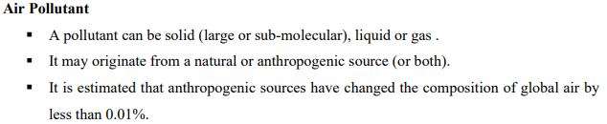
Continuation….
Pollutants are substances or materials which impact the environment and its creatures thereby hampering the quality of life. There are various types of pollutants present in the environment which have negative effects on the environment.

Slide 9
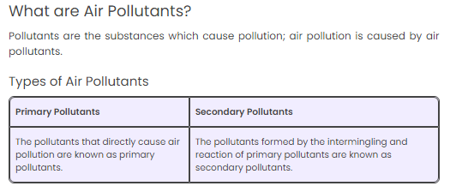
Classifications of Pollutants
According to origin

Slide 10
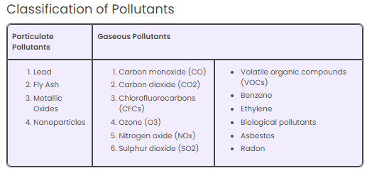
Continuation….
According to state of matter

Slide 11
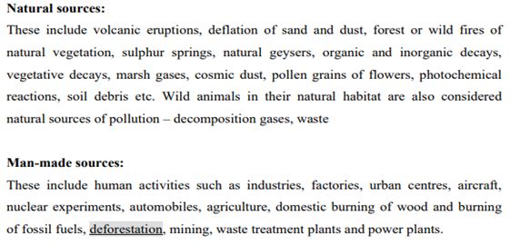
According to sources…

Slide 12
Sources of Air Pollution
Stationary Sources
A stationary source of air pollution refers to an emission source that does not move (i.e., power plants, chemical and manufacturing industries).
Often stationary sources are defined as large emitters who release relatively consistent qualities and quantities of pollutants.

Slide 13
POINT SOURCE
Point sources include- industrial and non industrial stationary equipment which are considered as significant sources of air pollution emissions.
A facility is considered to have significant emissions if it emits about one ton or more in a calendar year.

Slide 14
Area Source
The term AREA SOURCE is used to describe the many smaller stationary sources located together whose individual emissions may be low but whose collective emissions can be significant. Typically area sources are those that emit < 25 tons per year of any combination of hazardous air pollutants, or < 10 tons per year of any single hazardous air pollutant.
Examples :-
locomotives operating within a railyard
Open burning and forest fires

Slide 15
NAAQS
National Ambient Air Quality Standards (NAAQS) are standards for air quality that are set by the Central Pollution Control Board (CPCB) in the year 2009.
The CPCB draws this power from the Air (Prevention and Control of Pollution) Act, 1981. This is applicable all over the country.

Slide 16
Continuation…..
These standards are essential for the development of effective management of ambient air quality.
The first ambient air quality standards were developed in 1982 pursuant to the Air Act.
Later, in 1994 and 1998, these standards were revised. The latest revision to the NAAQS was done in 2009 and this is the latest version being followed.
The 2009 standards further lowered the maximum permissible limits for pollutants and made the standards uniform across the nation. Previously, industrial zones had less stringent standards as compared to residential areas.
The compliance of the NAAQS is monitored under the National Air Quality Monitoring Programme (NAMP). NAMP is implemented by the CPCB.

Slide 17
Continuation…..
The current standards (2009) comprise 12 pollutants as follows :
Particulate Matter 10 (PM10)
Particulate Matter 2.5 (PM2.5)
Nitrogen Dioxide (NO2)
Sulphur Dioxide (SO2)
Carbon Monoxide (CO)
Ozone (O3)
Ammonia (NH3)
Lead (Pb)
Benzene
Benzopyrene
Arsenic
Nickel

Slide 18
Air Quality Index (AQI)
The AQI was launched by the Prime Minister in April, 2015 starting with 14 cities and now extended to 71 cities in 17 states.
The AQI is a tool for the effective communication of air quality status to people in terms, which are easy to understand.
It transforms complex air quality data of various pollutants into a single number (index value), nomenclature and colour.

Slide 19
Continuation….
There are six AQI categories, namely, good, satisfactory, moderately polluted, poor, very poor, and severe.
The AQ sub-index and health breakpoints are evolved for eight pollutants (PM10, PM2.5, NO2, SO2, CO, O3, NH3, and Lead (Pb)) for which short-term (upto 24-hours) National Ambient Air Quality Standards are prescribed.

Slide 20
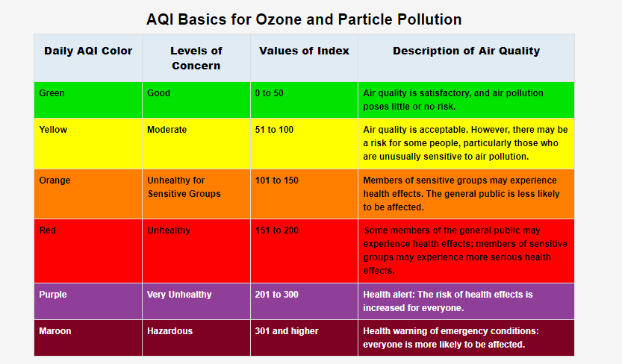

Slide 21
Effects of air pollution on human health
Tobacco smoke
Biological pollutants
Formaldehyde and Volatile organic compounds.
Lead.
Ozone and oxides of nitrogen
Carbon monoxide and Sulphur dioxide
SPM (suspended particulate matter).

Slide 22
Economic Effect of Air Pollution
The projected increase in concentrations of PM2.5 and ozone will in turn lead to substantial effects on the economy. According to the calculations in this report, global air pollution-related healthcare costs are projected to increase from USD 21 billion in 2015 to USD 176 billion 2005 in 2060.
The most dangerous consequences from outdoor air pollution are related to the number of premature deaths i.e., 3 million people in 2010 is estimated to 6-9 million annually in 2060.

Slide 23
Continuation…..
The annual global welfare costs associated with the premature deaths from outdoor air pollution, calculated using estimates of the individual willingness-to pay to reduce the risk of premature death, are projected to rise from USD 3 trillion in 2015 to USD 18-25 trillion in 2060.
In addition, the annual global welfare costs associated with pain and suffering from illness are projected to be around USD 2.2 trillion by 2060, up from around USD 300 billion in 2015, based on results from studies valuating the willingness to-pay to reduce health risks.

Slide 24
Air pollution control devices
Air pollution control devices are a series of devices that work to prevent a variety of different pollutants, both gaseous and solid, from entering the atmosphere primarily out ofindustrial smokestacks.
These control devices can be separated into two broad categories -
devices that control the amount of particulate matter escaping into the environment and
devices that control acidic gas emissions.

Slide 25
Continuation….
Specific machinery is used to remove particulate matter from flue gases. Much of this separation uses physical means of separation and not chemical separation techniques simply because particulate matter is large enough to be "caught" in this manner.
Below are some of the basic ways that particulate matter can be extracted.
1. Electrostatic Precipitators
2. Cyclone Separators
3. Fabric Filters

Slide 26
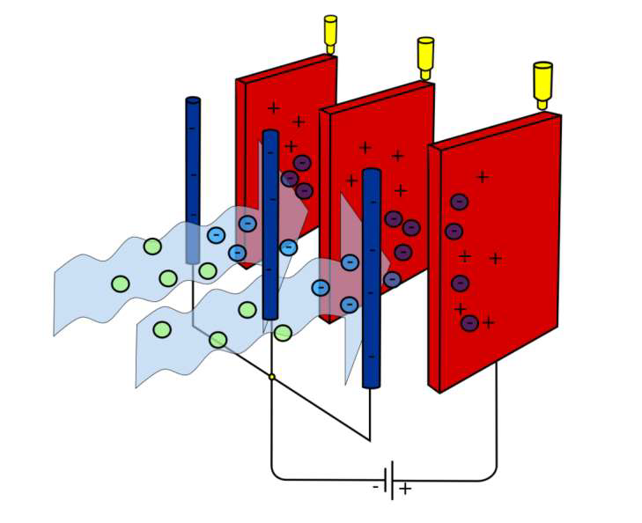
Electrostatic Precipitators
A model of an electrostatic precipitator using metal wires as the negative electrodes and
large plates as the positive electrodes

Slide 27
Continuation…
An electrostatic precipitator is a type of filter that uses static electricity to remove soot and ash from exhaust fumes before they exit the smokestacks. Unburned particles of carbon in smoke are pulled out of the smoke by using static electricity in the precipitators, leaving clean, hot air to escape the smokestacks. It is vital to remove this unreacted carbon from the smoke, as it can damage buildings and harm human health - especially respiratory health.

Slide 28
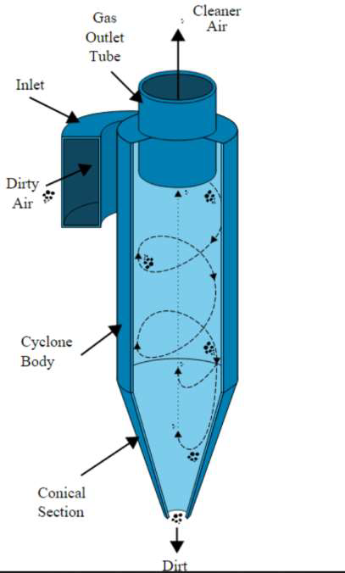
Cyclone Separators

Slide 29
Continuation…..
A cyclone separator is a separation device that uses the principle of inertia to remove particulate matter from flue gases.
In these separators, dirty flue gas enters a chamber containing a vortex, similar to a tornado. Because of the difference in inertia of gas particles and larger particulate matter, the gas particles move up the cylinder while larger particles hit the inside wall and drop down.
This separates the particulate matter from the flue gas, leaving cleaned flue gas.

Slide 30
Fabric filters
A fabric filter is basically a porous substance. When the flue gas flows through it, those particles, which are larger than the pores, are collected. Collected ash particles form a deposit. This acts as an additional separation surface. The benefit of a fabric filter is that, metals, e.g., in the flue gas can deposit on collected dust.

Slide 31
Continuation…..
Fabric filters used for controlling particulate matter operate like a vacuum cleaner. Dirty gas is blown or sucked through a fabric filter bag. The fabric bag collects the dust, which is removed periodically by shaking the bag. Fabric filters can be very efficient collectors for even submicrometer-sized particles and are widely used in industrial applications, although they may be sensitive to high temperatures and humidity.

Slide 32
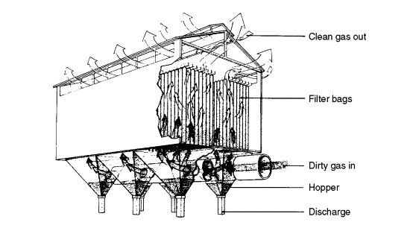
Fabric filter

Slide 33
Smoke and its control
Gas Control
More intense chemical methods of separation are generally required to separate polluting gases from the flue gas. However, this extraction is important as many acidic gases in flue gas contribute to acid rain. Below are some of the basic ways that gases can be extracted.
1. Scrubbers
2. Incineration
3. Carbon Capture

Slide 34
Scrubber
Scrubbers are devices to control air pollution and used to remove some particulates and gases from industrial exhaust streams.
Scrubbers are very efficient air pollution control devices, and can remove greater than 95 percent of the SO₂ from power plant stack emissions. In fact, SO₂ removal efficiencies sometimes are as high as 98 percent to 99 percent. Scrubbers with advanced designs routinely meet targeted efficiencies of more than 95 percent.

Slide 35
Continuation….
Types of Scrubber
The two main types of scrubbers are wet scrubbers and dry scrubbers.
Wet Scrubbers
Wet scrubbers force the polluted fumes to pass through a wet limestone slurry which traps sulfur particles. These can be used to control particulate matter less than 10 micrometers as well as inorganic gases such as SO₂, H₂S, NH₃, and various chlorides and fluorides

Slide 36
Incineration
Incineration is the destruction of something, especially waste material, by burning. Incineration is a waste treatment process that involves the combustion of organic substances contained in waste materials. Incineration of waste materials converts the waste into ash, flue gas and heat.

Slide 37
Carbon Capture
Carbon dioxide can theoretically also be captured and stored underground or in forests and oceans to prevent it from entering the atmosphere. Carbon capture and storage refers to the process of capturing this carbon dioxide and storing it below ground, pumping it into geologic layers. This process is rarely being used.

Slide 38
Ozone-O3
Ozone is a gas present naturally within Earth’s atmosphere. It is formed of three oxygen atoms (giving it the chemical formula O₃). Its structure makes it unstable: it can be easily formed and broken down through interaction with other molecules.
Ozone is most highly concentrated at two very different altitudes in the atmosphere: near the surface, and high in the atmosphere (in the stratosphere). Its function is very different in these two zones. with other compounds.

Slide 39


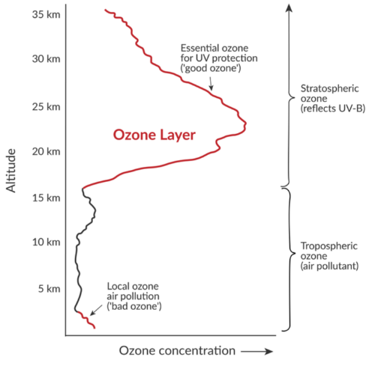

Slide 40
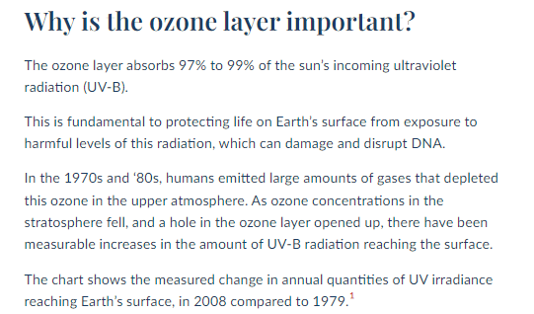

Slide 41

OZONE DEPLETION
“Ozone layer depletion is the gradual thinning of the earth’s ozone layer in the upper atmosphere caused due to the release of chemical compounds containing gaseous bromine or chlorine from industries or other human activities.”

Slide 42
Causes of Ozone Layer Depletion
Ozone layer depletion is a major concern and is associated with a number of factors. The main causes responsible for the depletion of the ozone layer are listed below:
Chlorofluorocarbons
Chlorofluorocarbons or CFCs are the main cause of ozone layer depletion. These are released by solvents, spray aerosols, refrigerators, air-conditioners, etc.
Unregulated Rocket Launches
Researches say that the unregulated launching of rockets results in much more depletion of the ozone layer than the CFCs do. If not controlled, this might result in a huge loss of the ozone layer by the year 2050.

Slide 43
Continuation…..
Nitrogenous Compounds
The nitrogenous compounds such as NO₂, NO, N₂O are highly responsible for the depletion of the ozone layer.
Natural Causes
The ozone layer has been found to be depleted by certain natural processes such as Sun-spots and stratospheric winds. But it does not cause more than 1-2% of the ozone layer depletion.

Slide 44
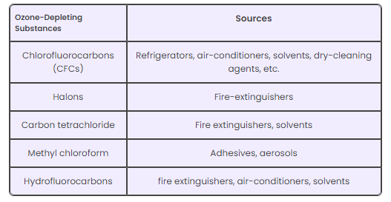

Slide 45
Effects Of Ozone Layer Depletion
Effects on Human Health
Humans will be directly exposed to the harmful ultraviolet radiation of the sun due to the depletion of the ozone layer. This might result in serious health issues among humans, such as skin diseases, cancer, sunburns, cataract, quick ageing and weak immune system.
Effects on Animals
Direct exposure to ultraviolet radiations leads to skin and eye cancer in animals.
Effects on the Environment
Strong ultraviolet rays may lead to minimal growth, flowering and photosynthesis in plants. The forests also have to bear the harmful effects of the ultraviolet rays.
Effects on Marine Life
Planktons are greatly affected by the exposure to harmful ultraviolet rays. These are higher in the aquatic food chain. If the planktons are destroyed, the organisms present in the food chain are also affected.

Slide 46
USEFUL LINKS
https://youtu.be/YhAwPFIUF_4?si=tCrPVLaomecJYjLI
https://youtu.be/D55WLFHovMY?si=he0jJ4RKMkW5IyhJ
https://youtu.be/PFV8PNnAHUU?si=ZLuYOZLURnYYb7jJ
https://youtu.be/3R41hJwbLbc?si=38CHqspTtSVhwB1l

