Slide 1

MODULE-5:Special types of concrete
Course: Concreting Techniques and Practices
Course code: BCV405C
Semester: IV
Dept. of Civil Engineering
K S SCHOOL OF ENGG. & MANAGEMENT
FACULTY HANDLED:
SHASHI PRASAD N
Asst. Professor

Slide 2
MODULE-5
Special types of concrete
self-compacting concrete, mass concrete, dry lean concrete, geopolymer concrete, pavement quality concrete, fibre reinforced concrete, composite concrete, lightweight concrete, ferrocement, shotcreteing, guniting, grouting, challenges faced at sites: plastic shrinkage cracks, plastic settlement, honey comb, bug holes, cover to concrete, do's and don’ts in concrete construction, site shoot, introduction on 3D printing.

Slide 3
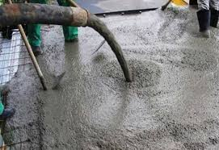
Self-Compacting Concrete
Self-compacting concrete (SCC) is a type of concrete designed to flow and settle into place and encapsulate reinforcements without the need for mechanical vibration.
It is highly flowable and can spread into place, filling formwork and achieving full compaction even in the presence of congested reinforcement.

Slide 4
Properties of Self-Compacting Concrete
High Flowability: SCC has excellent deformability, which allows it to flow easily under its own weight.
High Passing Ability: It can pass through and around obstacles like reinforcing bars without segregating.
High Segregation Resistance: Despite its fluid nature, SCC is designed to remain homogeneous and resist segregation of aggregates.
Viscosity: The concrete has a suitable viscosity to ensure it remains cohesive during the pour and retains its shape.

Slide 5
Advantages of Self-Compacting Concrete
Improved Durability: Uniform compaction reduces the presence of voids and increases the density of the concrete, leading to enhanced durability.
Enhanced Surface Finish: The high fluidity ensures better surface finishes with fewer blemishes and bug holes.
Reduced Labor and Equipment Costs: Since mechanical vibration is not needed, labor and equipment requirements are reduced.
Faster Construction: The ease of placement speeds up the construction process, particularly in complex structures.
Improved Safety: Reduced need for vibrators lowers the risk of hearing loss and other health issues associated with noise and vibration.

Slide 6
Disadvantages of Self-Compacting Concrete
The process of selection of materials is more rigorous.
Costs for building rise in comparison to traditional concrete construction.
To employ a planned mixture, numerous trial batches and laboratory tests are necessary.
For formwork design, the increased flow velocity of SCC in comparison to standard concrete might result in adynamic pressure in addition to the hydrostatic pressure of poured concrete.

Slide 7
Applications of Self-Compacting Concrete
Construction projects, including repairs, restoration, and renewal, require SCC.
With the use of SCC, retaining walls are built that are extremely sturdy and long-lasting.
SCC is used in the raft and pile foundation construction process.
Building earth retaining structures.
Drilled shafts
Columns

Slide 8
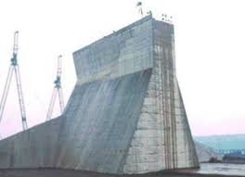
Mass Concrete
Mass concrete refers to any large volume of concrete with dimensions large enough to require measures to cope with the generation of heat from hydration and the associated volume change to minimize cracking.

Slide 9
Properties of Mass Concrete
Thermal Considerations: The main concern in mass concrete is the control of temperature rise caused by the heat of hydration of the cement.
If the temperature difference between the interior and the exterior of the mass concrete is too large, it can lead to thermal cracking.
Mix Design: The concrete mix for mass concrete structures is often designed to generate less heat. This might involve using a lower cement content, pozzolans like fly ash or slag, and aggregates with lower heat of hydration.

Slide 10
Properties of Mass Concrete
Temperature Control Methods:
Pre-cooling: Cooling the materials before mixing.
Post-cooling: Circulating chilled water through pipes embedded in the concrete.
Surface insulation: Covering the concrete with insulating blankets.
Controlled placement temperature: Using measures like chilled mixing water or ice to keep the concrete temperature low during placement.

Slide 11
Properties of Mass Concrete
Construction Practices: Proper construction practices are essential, including placing concrete in layers, controlling the rate of placement, and ensuring adequate curing.
Strength and Durability of Mass Concrete: Mass concrete structures typically exhibit high strength and durability due to the large volume of concrete used, making them suitable for heavy loads and harsh environments.
Cost-effectiveness of Mass Concrete: Since mass concrete structures require fewer joints and reinforcement compared to smaller-scale concrete construction, they can be more cost-effective in terms of material and labor and wastage of the time and loss the money.
Applications: Mass concrete is commonly used in the construction of large structures such as dams, bridge piers, large foundations, and mat slabs.

Slide 12
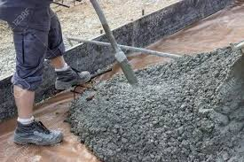
Dry Lean Concrete
It is a plain concrete with a large ratio of aggregate to cement than conventional concrete and generally used as a base/sub base of rigid pavement.

Slide 13
Properties of Dry Lean Concrete
Low Cement Content: DLC typically contains a lower percentage of cement compared to standard concrete mixes, usually around 150 to 200 kg per cubic meter.
High Aggregate Content: It has a higher aggregate-to-cement ratio. The aggregates used are often well-graded, ensuring a stable mix with good compaction properties.
Low Water-Cement Ratio: The water-cement ratio is relatively low, typically around 0.4 to 0.5. This helps in achieving a dry mix consistency, which is crucial for its application as a sub-base material.
Workability: Due to the low water content, the workability of DLC is lower than that of conventional concrete. This dry consistency is essential for its purpose as a supporting layer under pavements.
Compressive Strength: The compressive strength of DLC is generally lower than that of regular concrete, ranging from 5 to 10 MPa. However, this is sufficient for its function as a sub-base layer.

Slide 14
Properties of Dry Lean Concrete
Durability: Despite its lower strength, DLC is durable and provides a stable foundation for pavements, resisting deformation under load.
Economical: Due to the lower cement content, DLC is more economical compared to conventional concrete, making it a cost-effective solution for large-scale infrastructure projects.
Compaction: Proper compaction is crucial for DLC to ensure its effectiveness. It is typically compacted using heavy rollers to achieve the desired density and stability.
Setting Time: The setting time for DLC is faster than conventional concrete due to its lower water content. This allows for quicker progression in construction projects.
Applications: DLC is commonly used in the construction of roads, airport runways, and as a base layer for concrete pavements. It provides a strong, level, and stable platform for the subsequent layers of the pavement structure.

Slide 15
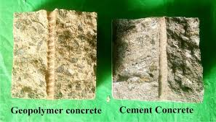
Geopolymer Concrete
Geopolymer concrete is a type of concrete that is made by reacting aluminate and silicate bearing materials with a caustic activator, such as fly ash or slag from iron and metal production.
It can be a suitable substitute for ordinary Portland cement (OPC).

Slide 16
Properties of Geopolymer Concrete
Binder Composition:
Alkali-Activated Materials: Geopolymer concrete uses aluminosilicate materials (such as fly ash, slag, or metakaolin) activated by alkaline solutions (e.g., sodium hydroxide or sodium silicate) instead of traditional Portland cement.
Reduced CO2 Emissions: The production of geopolymer concrete significantly reduces carbon dioxide emissions compared to conventional cement production, making it an environmentally friendly option.
Strength and Durability:
High Compressive Strength: Geopolymer concrete can achieve high compressive strengths, often comparable to or exceeding those of traditional concrete.
Excellent Durability: It is highly resistant to chemical attacks, such as acids and sulfates, and exhibits good performance in aggressive environments.

Slide 17
Properties of Geopolymer Concrete
Thermal Stability:
Fire Resistance: Geopolymer concrete has excellent fire resistance due to its high thermal stability and low thermal conductivity, making it suitable for applications requiring fire-resistant materials.
Shrinkage and Creep:
Low Shrinkage: Geopolymer concrete experiences lower drying shrinkage compared to traditional concrete, reducing the risk of cracking.
Reduced Creep: It exhibits lower creep under sustained loads, contributing to its structural integrity over time.
Workability:
Variable Workability: The workability of geopolymer concrete can be adjusted by modifying the mix design and the type and concentration of alkaline activators. Superplasticizers can also be used to improve workability.
Rapid Setting Time: Geopolymer concrete can have a faster setting time, which can be advantageous for certain construction applications but may require careful handling during placement.

Slide 18
Properties of Geopolymer Concrete
Environmental Benefits:
Utilization of Industrial By-Products: Geopolymer concrete makes use of industrial by-products like fly ash and slag, reducing waste and promoting resource efficiency.
Energy Efficiency: The production process of geopolymer concrete is less energy-intensive compared to Portland cement, contributing to overall energy savings.
Mechanical Properties:
Flexural and Tensile Strength: Geopolymer concrete typically has good flexural and tensile strengths, making it suitable for various structural applications.
Elastic Modulus: The elastic modulus of geopolymer concrete is comparable to that of traditional concrete, ensuring compatibility in structural designs.

Slide 19
Properties of Geopolymer Concrete
Applications:
Infrastructure Projects: Geopolymer concrete is used in a variety of infrastructure applications, including roads, bridges, and buildings.
Precast Elements: It is also used for precast concrete products such as beams, slabs, and panels due to its favorable mechanical properties and durability.
Sustainability:
Reduced Carbon Footprint: The use of geopolymer concrete contributes to a lower carbon footprint in construction projects, aligning with sustainable development goals.
Long-Term Performance: Its enhanced durability and resistance to environmental degradation ensure long-term performance and reduced maintenance costs.

Slide 20
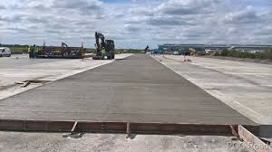
Pavement Quality Concrete
Pavement Quality Concrete (PQC) is a high-strength, high-durability concrete specifically designed for constructing pavements and other structures that experience heavy traffic loads and harsh environmental conditions.

Slide 21
Properties of Pavement Quality Concrete
High Strength:
Compressive Strength: PQC typically has a high compressive strength, often in the range of 30 to 50 MPa or higher, to withstand heavy traffic loads and prevent surface deformation.
Flexural Strength: It also possesses high flexural strength, which is crucial for resisting bending stresses induced by moving vehicles.
Durability:
Abrasion Resistance: PQC is designed to resist surface wear caused by traffic abrasion, ensuring a long service life.
Weather Resistance: It is highly resistant to freeze-thaw cycles, reducing the risk of cracking and spalling in regions with severe winters.
Low Water-Cement Ratio:
Workability: PQC typically has a low water-cement ratio, usually between 0.35 to 0.45, to achieve high strength and durability. This requires the use of water-reducing admixtures to maintain workability.

Slide 22
Properties of Pavement Quality Concrete
Aggregate Quality:
Well-Graded Aggregates: High-quality, well-graded aggregates are used to ensure good compaction, strength, and durability of the concrete.
Aggregate Size: The maximum size of coarse aggregates is usually limited to 20 mm to facilitate proper compaction and surface finish.
Consistency and Workability:
Slump: The concrete mix should have a slump in the range of 25 to 75 mm, ensuring it is workable enough for proper placement and finishing.
Admixtures: Chemical admixtures like superplasticizers are often used to enhance workability without compromising strength.

Slide 23
Properties of Pavement Quality Concrete
Curing:
Proper Curing: Adequate curing is essential for PQC to achieve its desired properties. Curing methods such as wet curing, using curing compounds, or covering with wet burlap are employed to maintain moisture and temperature conditions.
Thickness:
Design Thickness: The thickness of PQC pavements is designed based on the expected traffic loads, subgrade conditions, and environmental factors. It typically ranges from 150 mm to 300 mm or more for heavily trafficked highways and runways.
Joint Design:
Expansion and Contraction Joints: Proper design and placement of expansion and contraction joints are critical to accommodate temperature-induced movements and prevent cracking.
Dowel Bars: Dowel bars are often used at joints to transfer loads across the joints and ensure smooth vehicle movement.

Slide 24
Properties of Pavement Quality Concrete
Surface Finish:
Texturing: The surface of PQC is textured to provide adequate skid resistance and prevent vehicles from slipping. Common methods include brooming, tinning, or applying a textured finish using special tools.
Smoothness: Achieving a smooth surface finish is essential for ride quality and reducing tire wear.
Applications:
Highways and Roads: PQC is extensively used for constructing highways, arterial roads, and urban streets where heavy traffic loads are expected.
Airport Runways and Taxiways: It is used in the construction of airport runways, taxiways, and aprons due to its ability to withstand high wheel loads and jet blast effects.
Industrial Floors: PQC is also used for constructing industrial floors, ports, and container yards where heavy machinery and equipment operate.

Slide 25
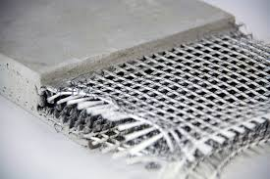
Fibre Reinforced Concrete
Fiber Reinforced Concrete (FRC) is a type of concrete that incorporates fibrous materials to enhance its structural integrity and performance.
The fibers can be made from various materials, including steel, glass, synthetic, and natural fibers.

Slide 26
Properties of Fibre Reinforced Concrete
Enhanced Mechanical Properties:
Increased Tensile Strength: The addition of fibers improves the tensile strength of the concrete, allowing it to resist cracking and deformation under tensile stresses.
Improved Flexural Strength: FRC exhibits higher flexural strength compared to conventional concrete, enhancing its ability to withstand bending stresses.
Crack Control:
Reduced Cracking: Fibers help to control and minimize the formation of cracks during the plastic and hardened stages of the concrete. They act as crack arrestors, preventing the propagation of micro-cracks.
Improved Ductility: The presence of fibers enhances the ductility of the concrete, making it more capable of deforming under load without sudden failure.

Slide 27
Properties of Fibre Reinforced Concrete
Types of Fibers:
Steel Fibers: Provide high tensile strength and stiffness, making them suitable for heavy-duty applications such as industrial floors and pavements.
Glass Fibers: Offer good resistance to corrosion and alkali, commonly used in architectural applications and repair works.
Synthetic Fibers: Include polypropylene, nylon, and polyethylene fibers, which improve impact resistance and reduce plastic shrinkage cracks.
Natural Fibers: Derived from materials like cellulose, jute, and coir, these fibers are environmentally friendly and enhance the sustainability of the concrete mix.
Durability:
Enhanced Durability: FRC exhibits improved resistance to impact, abrasion, and fatigue, making it suitable for applications subjected to dynamic and repetitive loads.
Resistance to Environmental Degradation: The fibers enhance the concrete’s resistance to environmental factors such as freeze-thaw cycles, chemical attacks, and thermal variations.

Slide 28
Properties of Fibre Reinforced Concrete
Workability:
Fiber Dispersion: Proper dispersion of fibers is crucial to ensure uniform properties throughout the concrete mix. This can be achieved through careful mixing and sometimes the use of admixtures.
Slump and Flow: The addition of fibers can affect the workability of the concrete. Superplasticizers or other chemical admixtures may be used to maintain the desired workability without compromising the performance of the concrete.
Construction Applications:
Pavements and Overlays: FRC is used in the construction of pavements, overlays, and industrial floors due to its improved load-bearing capacity and durability.
Shotcrete: Fibers are commonly used in shotcrete applications for tunnels, retaining walls, and slope stabilization to enhance the structural integrity and reduce rebound.
Precast Elements: FRC is used in precast concrete products such as pipes, panels, and architectural elements for improved performance and durability.
Repair and Rehabilitation: FRC is often used in the repair and rehabilitation of existing structures to improve their strength and extend their service life.

Slide 29
Properties of Fibre Reinforced Concrete
Environmental Benefits:
Sustainability: The use of natural and synthetic fibers can enhance the sustainability of concrete by reducing the need for traditional reinforcing materials and minimizing waste.
Energy Efficiency: FRC can reduce the overall energy consumption in construction projects by improving the durability and longevity of concrete structures, reducing the frequency of repairs and replacements.
Cost Considerations:
Material Costs: The cost of fibers can vary depending on the type and quantity used. However, the long-term benefits of improved performance and reduced maintenance can offset the initial material costs.
Labor and Equipment: The addition of fibers may require modifications to the mixing, placing, and finishing processes, which can impact labor and equipment costs.

Slide 30
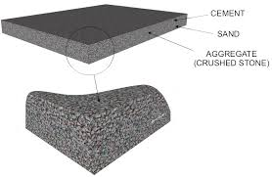
Composite Concrete
Composite concrete refers to a type of concrete that combines two or more distinct materials to leverage their individual strengths and create a material with enhanced properties.
This composite approach can significantly improve the performance of concrete in various structural applications.

Slide 31
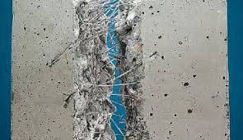
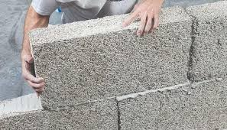
Types of Composite Concrete
Fiber Reinforced Concrete (FRC): Involves adding fibers (steel, glass, synthetic, or natural) to the concrete mix to enhance its mechanical properties and durability.
Advantages: Improved tensile strength, ductility, and resistance to cracking.
Polymer Concrete: Uses polymers (resins) as a partial or complete replacement for traditional cement binders.
Advantages: High strength, excellent chemical resistance, and rapid curing times.

Slide 32
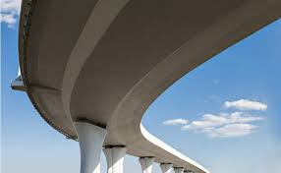

Types of Composite Concrete
High-Performance Concrete (HPC): Incorporates supplementary cementitious materials (SCMs) like fly ash, silica fume, or slag, along with superplasticizers.
Advantages: Enhanced strength, durability, and workability..
Ultra-High Performance Concrete (UHPC):A mix that includes very fine powders (such as silica fume), fibers, and a low water-cement ratio, often with high cement content.
Advantages: Exceptional strength and durability, suitable for demanding structural applications.

Slide 33
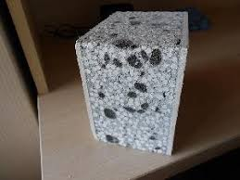
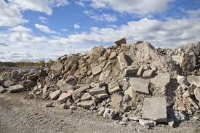
Types of Composite Concrete
Lightweight Concrete: Uses lightweight aggregates (like expanded clay, shale, or perlite) or incorporates air voids (foamed concrete).
Advantages: Reduced weight, improved thermal insulation, and easier handling.
Recycled Aggregate Concrete: Utilizes recycled materials (like crushed concrete or industrial by-products) as aggregates.
Advantages: Environmental sustainability, conservation of natural resources, and cost savings.

Slide 34
Properties of Composite Concrete
Enhanced Strength:
Improved Mechanical Properties: Composite concrete often exhibits superior compressive, tensile, and flexural strengths compared to conventional concrete, due to the synergistic effects of the combined materials.
Durability:
Increased Resistance to Environmental Factors: The incorporation of different materials can improve the concrete’s resistance to environmental degradation, such as freeze-thaw cycles, chemical attacks, and moisture penetration.
Crack Control:
Reduced Cracking: By incorporating fibers or other reinforcing materials, composite concrete can better control the formation and propagation of cracks, enhancing the overall structural integrity.
Flexibility in Design:
Customized Properties: The properties of composite concrete can be tailored to specific project requirements by selecting appropriate materials and their proportions.

Slide 35
Applications of Composite Concrete
Infrastructure Projects:
Bridges and Highways: Composite concrete is often used in the construction of bridges, highways, and other infrastructure due to its enhanced strength and durability.
Tunnels and Retaining Walls: The improved mechanical properties and crack resistance make composite concrete ideal for tunnels and retaining walls.
Commercial and Industrial Structures:
High-Rise Buildings: High-performance and ultra-high-performance composite concretes are used in high-rise buildings for their superior load-bearing capacity and durability.
Industrial Floors and Pavements: Fiber reinforced concrete is commonly used for industrial floors and pavements that are subject to heavy loads and wear.
Architectural Elements:
Precast Concrete Products: Composite concrete is used in precast elements such as panels, beams, and cladding due to its high strength and durability.
Aesthetic and Functional Components: Polymer concrete is often used for architectural elements that require intricate shapes and superior finish.
Repair and Rehabilitation:
Structural Repairs: Composite concrete is used in the repair and strengthening of existing structures to improve their load-carrying capacity and extend their service life.

Slide 36
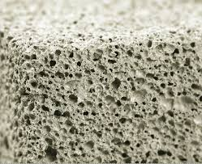
Lightweight Concrete
Lightweight concrete is a type of concrete characterized by its lower density compared to conventional concrete, achieved by incorporating lightweight aggregates or air voids into the mix.

Slide 37
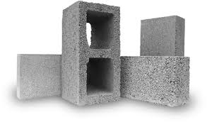
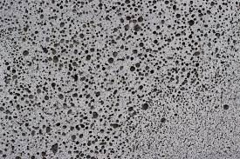
Types of Light Weight Concrete
Lightweight Aggregate Concrete:
Uses lightweight aggregates such as expanded clay, shale, pumice, perlite, or vermiculite.
Commonly used for structural applications where reduced weight is beneficial, such as high-rise buildings and long-span bridges.
Aerated (Foamed) Concrete:
Incorporates air bubbles into the mix using foaming agents or by mechanically mixing air into the slurry.
Suitable for non-structural applications like insulation, fireproofing, and lightweight blocks.

Slide 38
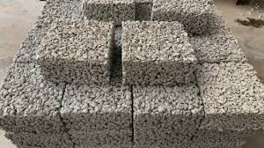
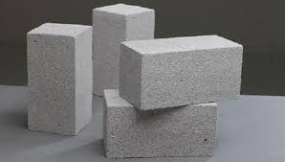
Types of Light Weight Concrete
No-Fines Concrete:
Contains coarse aggregates and cement paste with little to no fine aggregates.
Used for applications like drainage layers, partition walls, and sound barriers.
Cellular Concrete:
Made by mixing a pre-formed foam into the cement paste to create air voids.
Often used for insulation, roof screeds, and trench fills.

Slide 39
Properties of Light Weight Concrete
Density: Lightweight concrete typically has a density ranging from 800 to 2000 kg/m³, compared to conventional concrete which has a density of about 2400 kg/m³.
Strength:Although lightweight concrete generally has lower compressive strength compared to conventional concrete, it can be designed to achieve strengths suitable for structural applications, often in the range of 15 to 40 MPa.
Thermal Insulation:The lower density of lightweight concrete provides better thermal insulation properties, reducing heat transfer and improving energy efficiency in buildings.
Sound Insulation:The air voids in lightweight concrete can also enhance its sound insulation properties, making it beneficial for reducing noise transmission.
Workability:Lightweight concrete can be more workable and easier to handle due to its reduced weight, facilitating construction and reducing labor costs.
Durability:Lightweight concrete can exhibit good durability, but it may require careful mix design and curing to ensure adequate strength and resistance to environmental factors.

Slide 40
Advantages of Light Weight Concrete
Reduced Structural Load:The lower density of lightweight concrete reduces the dead load on the structure, allowing for smaller and more economical structural elements and foundations.
Improved Insulation:Provides better thermal and acoustic insulation compared to conventional concrete, contributing to energy efficiency and comfort in buildings.
Ease of Handling:Easier to transport, place, and finish due to its reduced weight, which can lead to faster construction times and lower labor costs.
Versatility:Can be tailored to suit a variety of applications, from structural elements to insulation and fireproofing materials.

Slide 41
Disadvantages of Light Weight Concrete
Lower Strength: Generally has lower compressive strength compared to conventional concrete, which may limit its use in certain structural applications.
Cost: Lightweight aggregates and foaming agents can be more expensive than conventional aggregates, potentially increasing material costs.
Quality Control: Requires careful mix design and quality control to ensure uniformity and adequate performance.

Slide 42
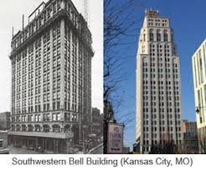
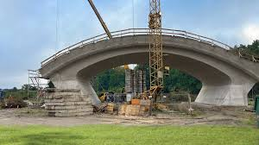
Applications of Light Weight Concrete
Building Construction:
Used in non-load bearing walls, partitions, and facades due to its light weight and insulating properties.
Suitable for high-rise buildings where reduced dead load can result in cost savings on the foundation and structural elements.
Bridge Construction:
Used in the construction of long-span bridges where reducing the weight of the structure can enhance load-bearing capacity and reduce material costs.

Slide 43
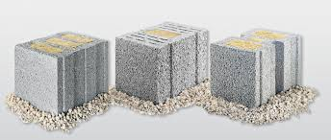
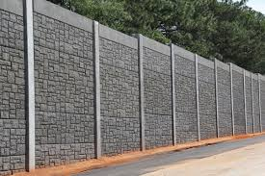
Applications of Light Weight Concrete
Insulation and Fireproofing:
Provides thermal insulation for roofs, floors, and walls.
Used as a fireproofing material for structural steel elements due to its fire-resistant properties.
Sound Barriers:
Used in the construction of sound barriers along highways and railways to reduce noise pollution.

Slide 44
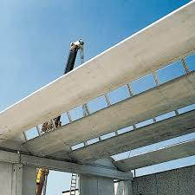
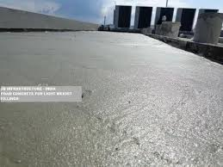
Applications of Light Weight Concrete
Precast Elements:
Suitable for producing precast concrete elements like blocks, panels, and slabs, which are easier to transport and handle due to their reduced weight.
Road Construction:
Used as a sub-base material in road construction to reduce the overall weight of the pavement structure and improve load distribution.

Slide 45
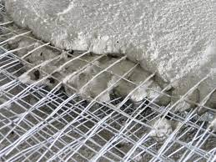
Ferrocement
Ferrocement is a versatile construction material made of a thin, strong composite of cement mortar reinforced with a mesh of steel wires.
It is known for its high strength, durability, and ability to be molded into various shapes.

Slide 46
Properties of Ferrocement
High Strength-to-Weight Ratio: Ferrocement structures are lightweight yet very strong, making them efficient for various applications where weight is a critical factor.
Durability: Ferrocement exhibits excellent resistance to cracking, impact, and weathering, providing long-lasting performance.
Flexibility in Design: Can be molded into complex shapes and thin sections, offering significant flexibility in architectural and structural design.
Crack Resistance: The fine steel mesh reinforcement provides excellent crack resistance, preventing the propagation of cracks and enhancing the durability of the structure.
Fire Resistance: Exhibits good fire resistance due to the non-combustible nature of the materials used.
Permeability: Has low permeability, reducing the risk of water penetration and damage from moisture.

Slide 47
Advantages of Ferrocement
Cost-Effectiveness: Uses less material compared to traditional concrete structures, resulting in lower material costs and reduced overall weight.
Labor costs can also be lower due to the simplicity of the construction process.
Ease of Construction: Can be constructed using relatively simple tools and techniques, making it suitable for areas with limited access to advanced construction technology.
Versatility: Suitable for a wide range of applications, from small-scale household items to large structural components.
Maintenance: Requires minimal maintenance due to its durability and resistance to environmental factors.

Slide 48
Disadvantages of Ferrocement
Skilled Labor: Requires skilled labor to handle the mesh reinforcement and ensure proper application of the mortar.
Quality Control:Ensuring uniformity and proper curing is essential to achieve the desired strength and durability.
Corrosion of Steel Mesh:Proper measures must be taken to protect the steel mesh from corrosion, especially in harsh environments.

Slide 49
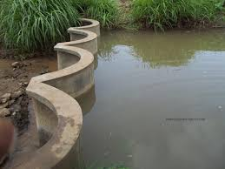
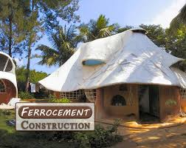
Applications of Ferrocement
Marine Structures:
Used in the construction of boats, barges, and floating structures due to its resistance to water and marine environments.
Building Components:
Employed in roofing, wall panels, floor slabs, and precast elements for buildings.

Slide 50
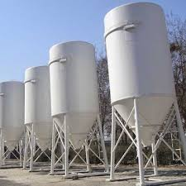
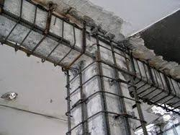
Applications of Ferrocement
Water Tanks and Silos:
Ideal for constructing water tanks, silos, and other storage structures due to its impermeability and strength.
Retrofitting and Repairs:
Used for strengthening and repairing existing structures, such as bridges, buildings, and tunnels.

Slide 51
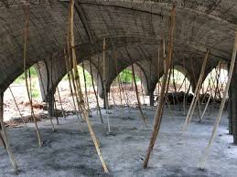
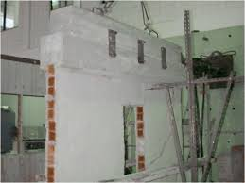
Applications of Ferrocement
Architectural Features:
Allows for the creation of intricate architectural elements, such as domes, arches, and sculptures.
Disaster-Resistant Structures:
Suitable for constructing earthquake-resistant and cyclone-resistant buildings due to its high strength and flexibility.

Slide 52
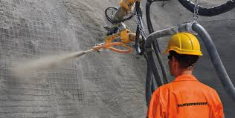
Shotcreteing
Shotcreteing, also known as shotcrete, is a method of applying concrete or mortar that is conveyed through a hose and pneumatically projected at high velocity onto a surface.
It is typically reinforced by conventional steel rods, steel mesh, or fibers.

Slide 53
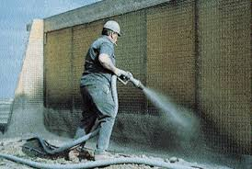
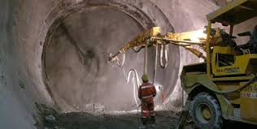
Types of Shotcreteing
Dry-mix shotcrete:
The dry ingredients are mixed before being conveyed through the hose. Water is added at the nozzle just before application
Wet-mix shotcrete:
The ingredients, including water, are mixed before being conveyed through the hose.

Slide 54
Shotcreteing: Applications
Construction: Used for structural concrete in buildings, bridges, tunnels, retaining walls, and swimming pools.
Repair: Applied to restore damaged or deteriorated concrete structures.
Reinforcement: Commonly used in underground excavations, such as mines and tunnels, to stabilize rock surfaces.

Slide 55
Shotcreteing: Advantages
Versatility: Can be applied to complex shapes and difficult-to-access areas.
Adhesion: Strong bond to various substrates like concrete, rock, and steel.
Strength: High compressive and shear strength.

Slide 56
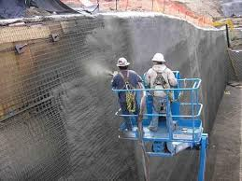
Guniting
Guniting is a term often used interchangeably with shotcreting, but it traditionally refers specifically to the dry-mix process.

Slide 57
Guniting- Process
Preparation:
The surface to be gunned is cleaned and prepared.
Any necessary reinforcing steel or mesh is installed.
Dry-Mix Application:
Dry cement and aggregate are combined in a hopper.
The mixture is pneumatically conveyed through a hose to a nozzle.
Water is introduced at the nozzle, mixing with the dry materials just before being sprayed onto the surface.
Application:
The material is sprayed at high velocity onto the surface.
The operator controls the mixture consistency and the placement of the material.

Slide 58
Guniting: Applications
Structural Repairs: Restoration of damaged concrete structures such as bridges, buildings, and tunnels.
Protective Coatings: Application of protective layers to surfaces like tanks, pipes, and retaining walls.
Slope Stabilization: Reinforcement of unstable rock and soil slopes to prevent erosion and landslides.
Architectural Formations: Creation of complex shapes and designs in construction projects, including swimming pools and decorative facades.

Slide 59
Guniting: Advantages
Flexibility: Can be applied to a wide range of surfaces and shapes.
Efficiency: Quick application and curing times compared to traditional concrete methods.
Strength: Produces a dense, high-strength concrete with excellent bonding properties.
Minimal Formwork: Often requires less formwork, reducing costs and time.

Slide 60
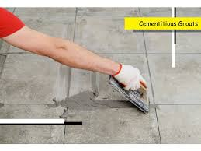
Grouting
Grouting is a construction process that involves injecting a fluid material into voids or cracks in concrete, masonry, soil, or rock to enhance their structural integrity, reduce permeability, or both. Grouts can be composed of a variety of materials including cement, resins, and other additives to suit specific needs.

Slide 61
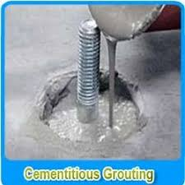
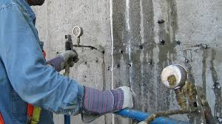
Types of Grouting
Cementitious Grouting:
Cement Grout: Made of cement and water, sometimes with sand and other additives. It is commonly used to fill gaps and voids in concrete and masonry structures.
Non-Shrink Grout: Specially formulated to avoid shrinking as it cures, ensuring that it maintains its volume and fills the intended space completely.
Chemical Grouting:
Polyurethane Grout: Expands upon contact with water, sealing leaks and filling voids in structures like tunnels and basements.
Epoxy Grout: Known for its high strength and chemical resistance, used in industrial settings and for structural repairs.

Slide 62
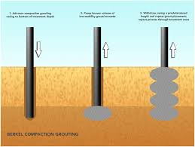
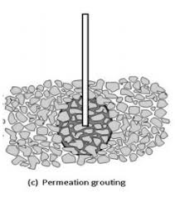
Types of Grouting
Compaction Grouting:
Used to improve the load-bearing capacity of the ground by injecting a thick grout mixture that compacts the surrounding soil.
Permeation Grouting:
Used to improve the load-bearing capacity of the ground by injecting a thick grout mixture that compacts the surrounding soil.

Slide 63
Grouting: Applications
Structural Repairs: Filling cracks and voids in concrete structures to restore integrity and prevent further damage.
Waterproofing: Sealing leaks in basements, tunnels, and other underground structures.
Soil Stabilization: Strengthening soil under foundations, roadways, and embankments to prevent settlement and landslides.
Anchoring: Fixing anchor bolts and reinforcing bars in place within concrete or rock.
Tile Installation: Filling gaps between tiles to secure them in place and prevent water infiltration.

Slide 64
Grouting: Advantages
Versatility: Can be used in a wide range of applications, from structural repairs to soil stabilization.
Durability: Provides long-lasting solutions for strengthening and waterproofing structures.
Cost-Effectiveness: Often more economical than complete replacement or reconstruction of damaged structures.
Improved Performance: Enhances the load-bearing capacity and durability of treated areas.

Slide 65
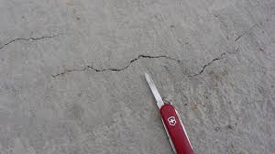
Plastic Shrinkage Cracks
Plastic shrinkage cracks are a type of crack that occurs in the surface of fresh concrete soon after it is placed and while it is still in its plastic state (before it has hardened).
These cracks are typically caused by rapid evaporation of water from the surface of the concrete, leading to shrinkage that the concrete cannot accommodate due to its low tensile strength at this stage

Slide 66
Plastic Shrinkage Cracks: Characteristics
Appearance: Typically appear as shallow, irregular, and fine cracks on the surface of the concrete.
Timing: Usually develop within a few hours after the concrete is placed, before it has hardened.
Pattern: Often appear in a pattern that resembles a spider web or parallel lines.

Slide 67
Plastic Shrinkage Cracks: Causes
Rapid Evaporation: High ambient temperatures, low humidity, and strong winds can cause the surface water to evaporate quickly, leading to plastic shrinkage.
Improper Curing: Insufficient curing practices that fail to maintain adequate moisture on the concrete surface.
High Water-Cement Ratio: Excess water in the concrete mix can increase the risk of plastic shrinkage.
Large Surface Area: Concrete slabs with large surface areas are more susceptible to rapid moisture loss.

Slide 68
Plastic Shrinkage Cracks: Prevention
Control Evaporation: Use windbreaks or sunshades to reduce the impact of wind and direct sunlight on the concrete surface. Apply evaporation retardants that form a temporary film on the surface to reduce moisture loss.
Proper Curing: Start curing the concrete as soon as possible after finishing. This can include methods such as wet curing, using curing compounds, or covering the surface with wet burlap or plastic sheets.
Mix Design Adjustments: Use admixtures like water-reducing agents or superplasticizers to reduce the water-cement ratio without compromising workability. Include fibers in the concrete mix to help control shrinkage and reduce crack formation.

Slide 69
Plastic Shrinkage Cracks: Prevention
Placement and Finishing: Avoid overworking the concrete surface, which can increase the risk of plastic shrinkage cracks. Ensure uniform and continuous placement of concrete to minimize differential drying.
Environmental Control: Plan concrete placement during cooler parts of the day when evaporation rates are lower. Monitor weather conditions and be prepared to take preventive measures if rapid drying conditions are expected.

Slide 70
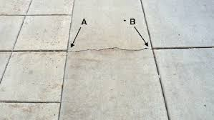
Plastic Settlement
Plastic settlement is another type of crack that can occur in fresh concrete while it is still in its plastic state.
These cracks form due to the differential settlement of the concrete as it begins to harden and lose its plasticity.

Slide 71
Plastic Settlement: Characteristics
Appearance: Typically appear as straight, parallel cracks that align with the reinforcement bars or embedded items within the concrete.
Depth: Cracks can extend from the surface down to the depth of the obstruction causing the settlement.
Timing: Develop within a few hours after the concrete is placed, during the initial setting period.

Slide 72
Plastic Settlement: Causes
Differential Settlement: The settlement of the heavier components of the concrete mix (aggregate) relative to the lighter components (cement paste) can create stress within the material.
Obstructions: Reinforcement bars, embedded items, or sudden changes in section thickness can impede the natural settlement of concrete, leading to stress concentrations and cracking.
Improper Compaction: Insufficient compaction of concrete can lead to uneven settlement and cracking.
Excessive Water Content: High water content in the concrete mix increases the likelihood of settlement and subsequent cracking.

Slide 73
Plastic Settlement: Prevention
Mix Design: Use a well-graded mix with an appropriate water-cement ratio to minimize excess water.
Include admixtures such as plasticizers to improve the workability without increasing water content.
Proper Placement: Ensure even and continuous placement of concrete to avoid differential settlement.
Use appropriate methods for compacting the concrete, such as vibration, to remove air pockets and ensure uniformity.

Slide 74
Plastic Settlement: Prevention
.Reinforcement Detailing: Properly design and place reinforcement to minimize obstruction to settlement. Use chairs or spacers to support reinforcement bars and prevent them from moving during placement.
Curing Practices: Implement adequate curing methods to maintain moisture content and support even hydration of the concrete.
Surface Finishing: Avoid over-finishing the concrete surface, which can draw excessive water to the surface and increase the risk of settlement cracks.

Slide 75
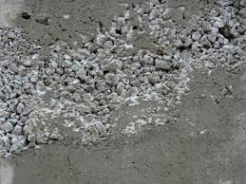
Honey Comb
Plastic settlement is another type of crack that can occur in fresh concrete while it is still in its plastic state.
These cracks form due to the differential settlement of the concrete as it begins to harden and lose its plasticity.

Slide 76
Honey Comb: Characteristics
Appearance: Honeycombing manifests as visible voids or cavities on the surface of hardened concrete.
Depth: The texture can be rough and irregular, with exposed aggregate.
Location: Often found around heavily reinforced areas or along vertical surfaces where compaction is more challenging.

Slide 77
Honey Comb: Causes
Improper Compaction: Inadequate vibration or compaction of the concrete mix can lead to the formation of voids.
Poor Mix Design: A mix with inappropriate proportions of cement, water, and aggregate can cause segregation and honeycombing.
High Workability: Overly stiff concrete with low workability may not flow adequately into all parts of the formwork.
Inadequate Formwork: Leaky or poorly designed formwork can result in concrete escaping or not filling all voids completely.
Placement Techniques: Incorrect placement methods, such as dropping concrete from excessive heights, can lead to segregation and honeycombing.
Congested Reinforcement: Dense reinforcement can obstruct the proper flow of concrete, leading to voids around the bars..

Slide 78
Honey Comb: Prevention
Proper Mix Design: Ensure the concrete mix has the right proportions of water, cement, and aggregate to promote good workability and flow.
Adequate Compaction: Use mechanical vibrators to adequately compact the concrete and eliminate air pockets.
Formwork: Ensure formwork is well-sealed and designed to prevent leakage of the cement paste. Apply form-release agents to facilitate easy removal of formwork without damaging the concrete.

Slide 79
Honey Comb: Prevention
Placement Techniques: Place concrete in layers and avoid dropping it from excessive heights. Use tremie pipes or chutes to guide concrete into place, especially in deep sections.
Reinforcement Design: Ensure proper spacing and alignment of reinforcement bars to allow concrete to flow around them without obstruction.

Slide 80
Honey Comb: Repair
Surface Patching: For minor honeycombing, surface patching with a repair mortar can be sufficient. Clean the area, remove any loose material, and apply a bonding agent before patching.
Grouting: For deeper voids, pressure grouting with a cementitious or epoxy grout can fill the cavities and restore structural integrity.
Epoxy Injection: Use epoxy resins to inject into the voids, particularly in cases where structural strength is a concern.
Recasting: In severe cases where honeycombing compromises the structural integrity, partial or full recasting of the affected section may be necessary.

Slide 81
Honey Comb: Effects
Structural Integrity: Reduces the strength and durability of the concrete, potentially leading to structural failures.
Durability: Increases the permeability of the concrete, making it more susceptible to water ingress, freeze-thaw cycles, and chemical attacks.
Aesthetics: Negatively impacts the visual appearance of the concrete surface.

Slide 82
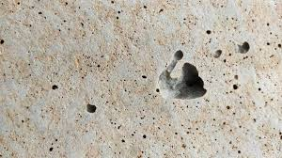
Bug Holes
Bug holes, also known as blowholes, are small, rounded cavities found on the surface of cast concrete.
They are typically formed by trapped air or water bubbles that fail to escape during the concrete placement and compaction process.
These surface defects are generally considered a cosmetic issue but can sometimes indicate underlying problems with the concrete mix or placement techniques.

Slide 83
Bug Holes: Characteristics
Appearance: Small, rounded voids on the surface of the concrete, usually 1 to 5 mm in diameter, though they can be larger.
Distribution: Often randomly distributed across the concrete surface, with higher concentrations near the formwork.

Slide 84
Bug Holes: Causes
Air Entrainment: Air bubbles trapped in the concrete mix can rise to the surface and get trapped under the formwork, causing bug holes.
High Slump Concrete: Overly wet concrete mixes tend to trap more air, leading to an increased likelihood of bug holes.
Improper Vibration: Inadequate or improper vibration can fail to release entrapped air, leaving voids on the surface.
Formwork Conditions: Poorly designed or sealed formwork can prevent air from escaping properly. Rough or absorbent form surfaces can also contribute to bug hole formation.
Admixtures: The use of certain chemical admixtures can increase the viscosity of the concrete mix, trapping more air.
Placement Techniques: Rapid or uneven placement of concrete can lead to air entrapment.

Slide 85
Bug Holes: Prevention
Proper Mix Design: Adjust the mix design to reduce the water-cement ratio and optimize the aggregate grading to minimize air entrainment. Use admixtures judiciously to avoid increasing the viscosity excessively.
Adequate Vibration: Ensure proper and thorough vibration of the concrete to release trapped air. Use internal or external vibrators as needed. Avoid over-vibration, which can cause segregation and further air entrapment.
Formwork Preparation: Ensure formwork is smooth, clean, and well-sealed to allow air to escape easily.Apply a suitable form-release agent to reduce the surface tension and facilitate air movement.
Placement Techniques: Place concrete in layers to allow for proper compaction and air release. Avoid dropping concrete from excessive heights, which can trap air.
Slow Pouring: Pouring concrete slowly and steadily helps prevent air from becoming trapped against the formwork.

Slide 86
Bug Holes: Repair
Surface Finishing: Minor bug holes can be filled with a surface rubbing or sacking process using a cement paste or slurry.
Patching Compounds: For larger or more numerous bug holes, use cementitious or polymer-based patching compounds to fill the voids.
Grouting: Apply a grout mixture to the surface to fill and seal the bug holes, improving the aesthetic finish.
Epoxy Injection: For deeper voids, an epoxy injection can be used to fill the holes and restore surface integrity.

Slide 87
Bug Holes: Effects
Aesthetics: Primarily affect the visual appearance of the concrete, making the surface look pitted and uneven.
Surface Quality: Can impact the surface smoothness and finish, which may be critical in architectural concrete.
Durability: While generally a cosmetic issue, extensive bug holes could potentially provide pathways for moisture ingress, affecting durability.

Slide 88
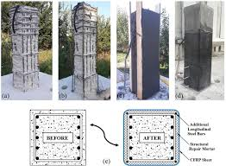
Cover to Concrete
Bug holes, also known as blowholes, are small, rounded cavities found on the surface of cast concrete.
They are typically formed by trapped air or water bubbles that fail to escape during the concrete placement and compaction process.
These surface defects are generally considered a cosmetic issue but can sometimes indicate underlying problems with the concrete mix or placement techniques.

Slide 89
Cover to Concrete: Importance
Corrosion Protection: Adequate concrete cover protects the reinforcement from moisture and chloride ingress, which can cause corrosion.
Fire Resistance: The cover provides thermal insulation to the reinforcement during a fire, maintaining structural integrity for longer.
Mechanical Protection: Protects the reinforcement from physical damage and ensures that the bars do not become exposed due to abrasion or impact.
Bond Strength: Ensures proper bonding between the concrete and the reinforcement, crucial for structural performance.

Slide 90
Concrete Cover Recommended
Structural Elements:
Footings and foundations: 50 mm to 75 mm
Slabs, beams, and columns (interior exposure): 20 mm to 40 mm
Slabs, beams, and columns (exterior exposure): 40 mm to 50 mm
Environmental Conditions:
Mild environment: 20 mm to 30 mm
Moderate environment: 30 mm to 40 mm
Severe environment (e.g., marine): 50 mm to 75 mm

Slide 91
Cover to Concrete : Factors Affecting
Concrete Mix Design: A denser and higher-quality concrete mix provides better protection to the reinforcement.
.Construction Practices: Proper placement and compaction of concrete ensure that the cover is maintained without voids or honeycombing. Use of spacers and chairs to maintain consistent cover depth.
Environmental Exposure: Structures exposed to aggressive environments (e.g., marine or industrial areas) require greater cover to protect against corrosion and chemical attack.

Slide 92
Methods to Ensure Proper Concrete Cover
Use of Spacers and Chairs: Plastic or concrete spacers and chairs are used to maintain the specified cover distance between the reinforcement and the formwork.
Quality Control: Regular checks and inspections during construction to ensure that the specified cover is achieved. Use of cover meters or rebar locators to verify the cover depth after concrete placement.
Formwork Design: Formwork should be designed and constructed to provide accurate placement of reinforcement and maintain the specified cover.
Documentation and Planning: Detailed construction drawings and specifications should clearly indicate the required cover for all reinforced concrete elements. Proper planning and coordination among the construction team to adhere to these requirements.

Slide 93
Consequences of Inadequate Concrete Cover
Corrosion of Reinforcement: Insufficient cover can lead to early onset of corrosion, reducing the lifespan and safety of the structure.
Reduced Fire Resistance: Inadequate cover diminishes the fire resistance of the structure, making it vulnerable to fire damage.
Structural Integrity: Poor cover can affect the bond strength between the concrete and reinforcement, compromising the structural performance.
Aesthetic Issues: Exposed reinforcement can lead to unsightly rust stains and spalling of concrete.

Slide 94
Do's in Concrete Construction
Plan Thoroughly: Ensure detailed design and planning, including material specifications, mix design, and construction methods.
Use Quality Materials: source high-quality cement, aggregates, and water. Ensure materials are free from impurities.
Proper Mixing: Follow the mix design accurately. Use appropriate water-cement ratio and ensure thorough mixing to achieve uniform consistency.
Site Preparation: Prepare the site properly, including formwork setup, reinforcement placement, and ensuring a clean and stable foundation.
Curing: Cure the concrete properly to maintain moisture, typically for at least 7 days, to achieve optimal strength and durability.

Slide 95
Do's in Concrete Construction
Temperature Control: Monitor and control the temperature during mixing, placing, and curing, especially in extreme weather conditions.
Proper Placement: Place concrete efficiently and promptly after mixing. Use suitable tools to avoid segregation and achieve the desired compaction.
Vibration and Compaction: Use mechanical vibrators to compact the concrete and eliminate air pockets, ensuring a dense and solid structure.
Joint Planning: Plan and execute construction joints properly to accommodate structural movement and avoid cracking.
Safety Measures: Follow all safety protocols, including wearing protective gear, securing the site, and using equipment safely.

Slide 96
Don’t in Concrete Construction
Avoid Poor Quality Materials: Do not use substandard or contaminated materials, as they can compromise the concrete's strength and durability.
Do Not Overwater: Avoid adding excess water to the mix, as it can weaken the concrete and lead to shrinkage and cracking.
Do Not Delay Placement: Do not delay placing the concrete after mixing, as it can start to set, leading to poor workability and strength.
Avoid Inadequate Curing: Do not neglect curing; improper curing can cause surface cracks, reduce strength, and shorten the lifespan of the structure.
Do Not Overload Forms: Avoid overloading formwork beyond its designed capacity, which can lead to formwork failure and structural issues.

Slide 97
Don’t in Concrete Construction
Do Not Use Improper Formwork: Do not use damaged or improper formwork, as it can lead to uneven surfaces and structural defects.
Avoid Ignoring Weather Conditions: Do not ignore the impact of weather conditions on concrete placement and curing. Take necessary precautions for hot, cold, or wet weather.
Do Not Skip Testing: Avoid skipping quality control tests for concrete strength and consistency. Regular testing ensures compliance with specifications.
Avoid Rapid Drying: Do not allow concrete to dry too quickly, which can cause surface cracks. Maintain proper moisture levels during curing.
Do Not Neglect Safety: Do not compromise on safety standards. Ensure all workers are trained and adhere to safety protocols to prevent accidents and injuries.

Slide 98

Site Shoot
A site shoot, often referred to as a site survey or site visit, is an essential part of the construction planning process.
It involves visiting the construction site to gather crucial information, assess existing conditions, and identify potential challenges.

Slide 99
Do's in Site Shoot
Preparation:
Review all available site plans, drawings, and documents beforehand to understand the scope and context of the project.
Bring necessary equipment such as measuring tapes, cameras, notepads, and personal protective equipment (PPE).
Team Coordination:
Ensure that key team members are present, including architects, engineers, and contractors, to address all aspects of the project.
Communicate the objectives and schedule of the site visit to all participants.
Documentation:
Take detailed notes and photographs of the site, including existing structures, utilities, topography, vegetation, and any obstacles.
Record precise measurements and locations of significant features to assist in planning and design.

Slide 100
Do's in Site Shoot
Assessment:
Assess access routes, logistics, and site boundaries.
valuate soil conditions, drainage patterns, and environmental considerations. Identify any potential hazards or safety concerns.
Compliance:
Check for any regulatory requirements or restrictions that may affect the project.
Ensure that the site shoot complies with local zoning laws, environmental regulations, and safety standards.
Stakeholder Engagement:
Engage with local stakeholders, including neighboring property owners and community members, to understand any concerns or insights they may have.
Follow-Up:
Compile and distribute a comprehensive report of the site shoot findings to all relevant parties. Use the gathered information to refine project plans and address any identified issues.

Slide 101
Don’t in Site Shoot
Do Not Rush:
Avoid rushing through the site visit. Take the necessary time to thoroughly assess and document all relevant aspects.
Do Not Overlook Details:
Do not overlook small details that could have significant implications for the project, such as underground utilities or minor elevation changes.
Do Not Ignore Safety:
Do not neglect safety protocols. Ensure that everyone wears appropriate PPE and follows safety guidelines during the site visit.
Do Not Assume:
Avoid making assumptions about site conditions. Verify all information through direct observation and measurement.

Slide 102
Don’t in Site Shoot
Do Not Skip Communication:
Do not skip communicating with all stakeholders. Ensure that everyone is informed and involved in the process.
Do Not Disregard Weather:
Do not disregard weather conditions. Plan the site visit considering weather forecasts to avoid complications such as mud, flooding, or extreme heat.
Do Not Forget Documentation:
Do not forget to document everything thoroughly. Incomplete or inaccurate documentation can lead to issues later in the project.

Slide 103
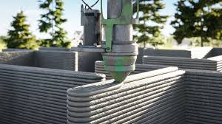
INTRODUCTION ON 3D PRINTING
3D printing, also known as additive manufacturing, is a revolutionary technology that has transformed various industries by enabling the creation of three-dimensional objects from digital models.
This process builds objects layer by layer, allowing for unprecedented design flexibility and efficiency.

Slide 104
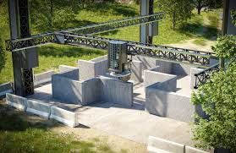
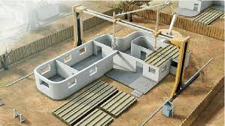
Types of 3D Printing Technologies in Construction
Concrete Printing: Uses specially formulated concrete mixtures that can be extruded and cured quickly, enabling the construction of durable and complex structures.
Contour Crafting: Involves the use of a robotic arm to extrude and shape concrete or other materials, ideal for constructing large-scale structures like walls and buildings.

Slide 105
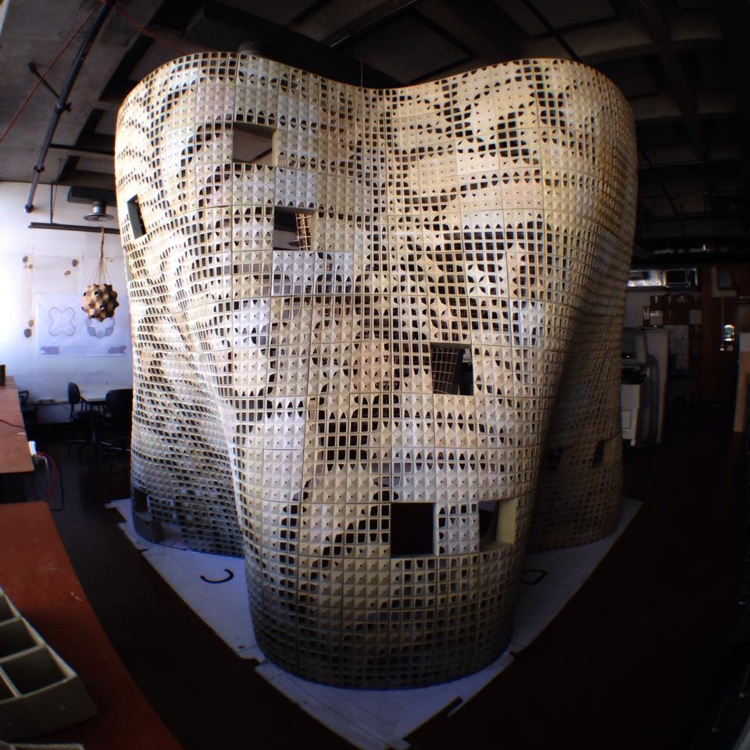
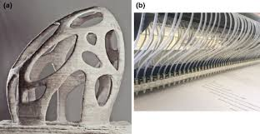
Types of 3D Printing Technologies in Construction
Powder-Based Printing: Utilizes powdered materials, which are selectively bound together using a binding agent, suitable for creating detailed architectural elements and components..
Binder Jetting:This method involves depositing a binder onto a bed of powder, layer by layer, to form solid structures, allowing for the use of various materials.

Slide 106
How 3D Printing Works in Construction?
Digital Model Creation:
The process starts with creating a digital 3D model using Computer-Aided Design (CAD) software. This model serves as the blueprint for the construction project.
Slicing:
The digital model is sliced into horizontal layers, which are then translated into machine instructions that guide the 3D printer.
Material Extrusion:
In construction 3D printing, materials such as concrete, geopolymers, or other composite materials are extruded through a nozzle, building the structure layer by layer according to the digital blueprint.
Automated Construction:
The 3D printer, often a large robotic arm or gantry system, follows the predefined path, depositing material precisely to form walls, columns, and other structural elements.

Slide 107
Advantages of 3D Printing in Construction
Design Flexibility: Enables the creation of complex and customized designs that are difficult or impossible to achieve with traditional construction methods.
Reduced Labor Costs: Automates much of the construction process, reducing the need for manual labor and associated costs.
Faster Construction: Speeds up the construction process significantly, allowing for quicker project completion.
Material Efficiency: Minimizes material waste by precisely depositing the required amount of material for each layer.
Sustainability: Uses eco-friendly materials and reduces the carbon footprint of construction projects.
Cost-Effective: Reduces overall construction costs by combining material efficiency, reduced labor, and faster build times.

Slide 108
Disadvantages of 3D Printing in Construction
Material Limitations: The range of printable construction materials is currently limited, although ongoing research is expanding this range.
Regulatory Approval: Obtaining building permits and meeting regulatory standards can be challenging for 3D-printed structures.
Structural Integrity: Ensuring the structural integrity and durability of 3D-printed buildings requires rigorous testing and validation.
Initial Investment: The initial cost of acquiring and setting up 3D printing equipment can be high, although it is expected to decrease over time.

Slide 109
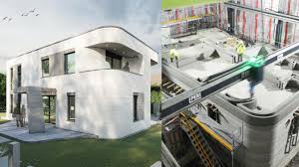

Applications of 3D Printing in Construction
ResidentialBuildings: Construction of affordable, customized homes with reduced labor costs and faster build times.
Commercial Buildings:
Creation of complex commercial structures with unique architectural designs and efficient use of materials.

Slide 110


Applications of 3D Printing in Construction
Infrastructure
Construction of bridges, roads, and other infrastructure elements with enhanced design flexibility and reduced construction time.
Disaster Relief:
Rapid deployment of emergency shelters and housing solutions in disaster-stricken areas.

Slide 111


Applications of 3D Printing in Construction
Sustainable Construction:
Use of eco-friendly materials and optimized designs to minimize waste and reduce the environmental impact of construction projects.

Slide 112
USEFUL LINKS
https://youtu.be/YhAwPFIUF_4?si=tCrPVLaomecJYjLI
https://youtu.be/D55WLFHovMY?si=he0jJ4RKMkW5IyhJ
https://youtu.be/PFV8PNnAHUU?si=ZLuYOZLURnYYb7jJ
https://youtu.be/3R41hJwbLbc?si=38CHqspTtSVhwB1l

