Slide 1
RESEARCH METHODOLOGY & INTELLECTUAL PROPERTY RIGHTS
Harshitha H S Asst. Professor AI & DS KSSEM

Slide 2
Module -1
  Introduction
Module -2
  Literature review and Technical reading
  Attributions and citations
Module -3
  Introduction to Intellectual property
  Patents
  Process of Patenting
Module -4
  Copyrights and related rights
  Trademarks
Module -5
  Industrial Designs
  Geographical Indications
  Case studies on patents

Slide 3
MODULE 1
Introduction
Meaning of Research
Objectives of Engineering Research
Motivation in Engineering Research
Types of Engineering Research
Finding and Solving a Worthwhile Problem
Ethics in Engineering Research Practice
Types of Research Misconduct
Ethical Issues Related to Authorship ..

Slide 4
Research refers to a careful, well-defined (or redefined), objective, and systematic method of search for knowledge, or formulation of a theory that is driven by inquisitiveness for that which is unknown and useful on a particular aspect so as to make an original contribution to expand the existing knowledge base.
Research involves formulation of hypothesis or proposition of solutions, data analysis, and deductions; and ascertaining whether the conclusions fit the hypothesis.
Research is a process of creating, or formulating knowledge that does not yet exist.

Slide 5
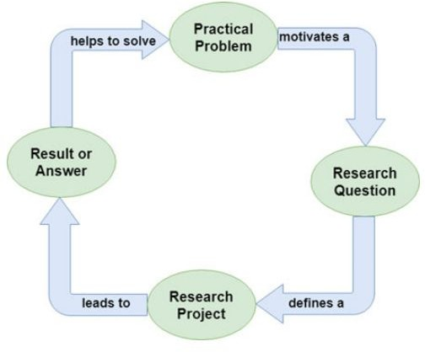
Fig: The research flow diagram

Slide 6
The ways of developing and accessing knowledge come in three, somewhat overlapping, broad categories:
(i) Observation is the most fundamental way of obtaining information from a source, and it could be significant in itself if the thing that we are trying to observe is really strange or exciting, or is difficult to observe.
Models are approximated, often simplified ways of describing sometimes very complex interactions in the form of a statistical relationship, a figure, or a set of mathematical equations. The final category is a way of arranging or doing things through processes, algorithms, procedures, arrangements, or reference designs, to get a certain desired result
(ii)

Slide 7
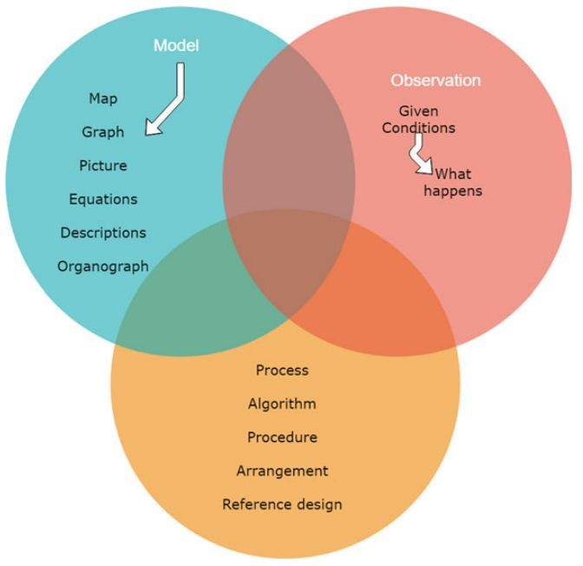
Fig: The categories of knowledge in research

Slide 8
The categories of knowledge as enumerated above are shown in Figure
Good research involves systematic collection and analysis of information and is followed by an attempt to infer a little bit beyond the already known information in a way that is a significant value addition.
Usually, engineering research is a journey that traverses from a research area (example: Control Systems), to the topic (example: Control of Microbial Fuel Cells) and finally onto the problem (example: Adaptive Control of Single Chamber Microbial Fuel Cells) (Area → Topic → Problem). Getting a good problem to solve is more than half the work done

Slide 9
Objectives of Engineering Research
The objective of engineering research is to solve new and important problems, and since the conclusion at the end of one’s research outcome has to be new, but when one starts, the conclusion is unknown.
So, the start itself is tricky, one may say. The answer is, based on “circumstantial evidence”, intuition, and imagination, one guesses what may be a possible conclusion.
The objectives of engineering research should be to develop new theoretical or applied knowledge and not necessarily limited to obtaining abilities to obtain the desired result.
The objectives should be framed such that in the event of not being able to achieve the desired result that is being sought, one can fall back to understanding why it is not possible, because that is also a contribution toward ongoing research in solving that problem

Slide 10
Motivation in Engineering Research
The possible motives may be the result of one or more of the following desires:
(i) Studies have shown that intrinsic motivations like interest, challenge, learning, meaning, purpose, are linked to strong creative performance;
Extrinsic motivating factors like rewards for good work include money, fame, awards, praise, and status are very strong motivators, but may block creativity. For example: Research outcome may enable obtaining a patent which is a good way to become rich and famous.
(ii)

Slide 11
(iii) Influences from others like competition, collaboration, commitment, and
encouragement doing research better.
are also motivating factors in research. For example: my friends are all and so should I, or, a person that I dislike is doing well and I want to do
(iv) Personal motivation in solving unsolved problems, intellectual joy, service to community, and respectability are all driving factors.
The following factors would be a mix of extrinsic and intrinsic aspects:
(i)
(ii)
(iii)
(iv)
Wanting to do better than what has been achieved in the world, improve the state of the art in technology,
Contribute to the improvement of society,
Fulfillment of the historical legacy in the immediate sociocultural context

Slide 12
Types of Engineering Research
The different types of research are
Descriptive versus Analytical: Descriptive research includes comparative and correlational methods, and fact-finding inquiries, to effectively describe the present state of art. The researcher holds no control over the variables; rather only reports as it is.
  Descriptive research also includes attempts to determine causes even though the variables cannot be controlled. O
  n the contrary, in analytical research, already available facts for analysis and critical evaluation are utilized. Some research studies can be both descriptive and analytical.

Slide 13
Applied versus Fundamental: Research can either be applied research or fundamental (basic or pure) research. Applied research seeks to solve an immediate problem facing the organization, whereas fundamental research is concerned with generalizations and formulation of a theory.
  Research concerning natural phenomena or relating to pure mathematics are examples of fundamental research.
  Research to identify social or economic trends, or those that find out whether certain communications will be read and understood are examples of applied research.
  The primary objective of applied research is to determine a solution for compelling problems in actual practice, while basic research is aimed at seeking information which could have a broad base of applications in the medium to long term.

Slide 14
(iii) Quantitative versus Qualitative: Quantitative research uses statistical observations of a sufficiently large number of representative cases to draw any conclusions, while qualitative researchers rely on a few nonrepresentative cases or verbal narrative in behavioral studies such as clustering effect in intersections in Transportation engineering to make a proposition.

Slide 15
Finding and solving a worthwhile problems
Research problem: refers to some difficulty which a researcher experiences in the context of either a theoretical or practice situation and wants to obtain solution for the same.
Need of defining a problem
The definition of a problem serves the following purposes:
  The definition of a problem sets the direction of the study.
  The definition reveals the methodology or procedure of the study.
  The definition helps the researcher to control subjectivity or biases of the researcher.
  The definition of the problem suggests and specifies the variables to be taken up into the investigation through a problem involved into so many variables.
  The-definition makes the research work practicable.

Slide 16
(b) Precautions are to be taken in identifying the problem
The following precautions should be taken into consideration for identifying problem.
The words used for defining a problem should have a single meaning.
The statement of the problem must be brief but comprehensive.
The assumptions are to be recognised for the study.
The problem should have practical importance in the field of Education.
The definition or the statement of the problem should have certain rationale.

Slide 17
Steps in defining a problem
The following steps are to be followed in defining a problem
  Researcher should have to develop a conceptual framework of the problem.
The conceptual framework should be such that it can be stated into verbal form.
  Delimiting the elements of the problem.
  Classifying the elements in the homogeneous group.
  Locating the key-points in the conceptual framework.
  Evaluating the theoretical security of the problem.
  The final form of the statement can be given into verbal form to a conceptual framework of the problem.
  Deciding the practical difficulty in conducting the study.

Slide 18
(d) Ways to Define the Problem
The following are various ways of defining a problem:
Analyse the major problems or problems in terms of subordinate problems.
Statement delimits the scope of the study.
Orientation of the problem in a unique direction:
  A historical account, remote or recent.
  A survey of previous study or related studies.
  An analysis of previous studies or related subjects.
  Preliminary survey.
Description of the general nature of the problem.
  Type.
  Source.
  Procedure.
Statement of limitations of the technique employed.
Recognitions of assumptions and Implications.
Importance-value or significance of the study of education.
Definition of terms.

Slide 19
Ethics in Engineering Research
Engineering ethics is a system of moral principles that apply to the practice of engineering.
It's a scholarly discipline that's closely related to subjects like the philosophy of science and the ethics of technology.
Ethics in engineering includes:
  Respecting others
  Keeping promises
  Avoiding unnecessary problems
  Avoiding cheating and dishonesty
  Showing gratitude
  Being guided by the highest standards of honesty and integrity
  Acknowledging errors
  Advising clients or employers when a project won't be successful

Slide 20
Ethics in engineering research practice
Engineering ethics are the moral principles and values that guide engineering practices. They include:
Honesty
Integrity
Accountability
Respect for life and property
Concern for public safety and welfare

Slide 21
Researchers make many choices that matter from an ethical perspective and influence the effects of technology in many different ways:
(i) By setting the ethically right requirements at the very outset, engineering researchers can ultimately influence the effects of the developed technology.
Influence may also be applied by researchers through design (a process that translates the requirements into a blueprint to fulfill those requirements). During the design process, decision is to be made about the priority in importance of the requirements taking ethical aspects into consideration.
Thirdly, engineering researchers have to choose between different alternatives fulfilling similar functions
(ii)
(iii)

Slide 22
Types of research misconduct
According to the Office of Research Integrity, research misconduct is defined as plagiarism, fabrication, or falsification in the planning, conducting, reviewing, or reporting of research.
Here are some types of research misconduct:
Plagiarism: Using another person's ideas, processes, results, or words without giving credit.
Fabrication: Making up data or results and recording or reporting them.
Falsification: Manipulating research materials, equipment, or processes, or changing or omitting data or results.

Slide 23
How are supervisors, reviewers or editors alerted to plagiarism?
(i)
(ii)
(iii)
Original author comes to know and informs everyone concerned. Sometimes a reviewer finds out about it during the review process. Or, readers who come across the article or book, while doing research.

Slide 24
Ethical issues related to authorship
Authors should not use, without attribution, text, concepts, data, figures, or tables from another work published either by others or by themselves.
Plagiarism of others' works and self-plagiarism are serious breaches of ethics and are not tolerated.
Some ethical issues related to authorship in research methodology include:
  Scientific misconduct
This is a violation of the standard codes of scholarly conduct and ethical behavior in the publication of scientific research.

Slide 25
Data fabrication and falsification
These are considered to be the worst forms of publication misconduct.
Authorship
This includes etiquette, fraudulent publication, plagiarism, duplicate publication, and potential for conflict of interest.
Confidentiality
This is a primary ethical concern that ensures participants' personal information will not be passed on to another individual outside the research.
Respect for intellectual property
This is an important principle of ethics that leads to deterring or avoiding plagiarism and maintaining the veracity of the data and analysis.

Slide 26
WEBLINK
https://www.youtube.com/watch?v=H1l-Ww3l6dM

Slide 27


