Slide 1

Introduction to Power Electronics
Module 1
Subject Name: Power Electronics Subject Code:15EC73
Arun Kumar M
Assistant Professor
K.S. SCHOOL OF ENGINEERING AND MANAGEMENT, BANGALORE - 560109
DEPARTMENT OF ELETRONICS AND COMMUNICATION ENGINEERING

Slide 2
REFERENCES
Gopal K.Dubey : Fundamental of Electrical Drives,
2nd Edition, Alpha Science, 2001
2. Rahid H. Muhammad : Power Electronics-Devices, Circuits and Applications, 3rd Edition, Pearson-Prentice Hall, 2004
3. Subrahmanyam Vedam : Electric Drives, Concepts and Application, Tata McGraw-Hill, 2001

Slide 3
INTRODUCTION TO
POWER ELECTRONICS SISTEM
• Definition and concepts
• Application
• Power semiconductor switches
• Gate/base drivers
• Losses
• Snubbers

Slide 4

What Is POWER ELECTRONICS ?
DEFINITION :
Power Electronics combine :
Power static and rotating power equipment for generation, transmission and distribution of electric power
Electronics solid state devices and circuit for signal processing to meet the desired control objectives
Control steady state and dynamic characteristics of closed-loop system
Power Electronics : the applications of solid-state electronics for the control and conversion of electric power.

Slide 5
What Is INDUSTRIAL ELECTRONICS ?
Industrial electronics can be defined as the control of industrial machinery and processes through the use of electronic circuits and systems

Slide 6
POWER
Control
Analog / Digital
Electronics
Devices / Circuit
Power
Equipment
Static / Rotating
ELECTRONICS
Relationship of PE to power, electronics and control

Slide 7
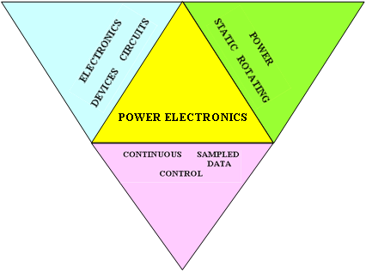

Slide 8
Task of Power Electronics :
To convert or to process and control the flow of electric power by supplying voltages and currents in a form that is optimally suited for user loads
Basic Block Diagram
Power
Input
Power
Output
Source
V_{i}, i_{i}
V_{o}, i_{o}
Load
Power
Processor
Building Blocks :
Input Power, Output Power
Power Processor
Contoller
measurement
Conroller
reference

Slide 9
Power Electronics (PE) Systems
The goal of PE is to control the flow of energy from an electrical source to an electrical load with :
  high efficiency
  high availability
  high reliability
  small size
  light (least) weight
  low cost
Static applications
Involves non-rotating or moving mechanical components.
Examples :
DC Power supply, un-interruptible power supply, power generation and transmission (HVDC), electroplating, welding, heating, cooling, electronic ballast.

Slide 10
Power Electronics (PE) Systems
Drive applications
Intimately contains moving or rotating components such as motors
Examples :
Electric trains, electric vehicles, air conditioning system, pumps, compressor, conveyer belt (factory automation).

Slide 11

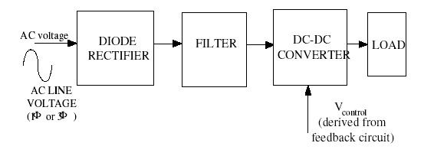
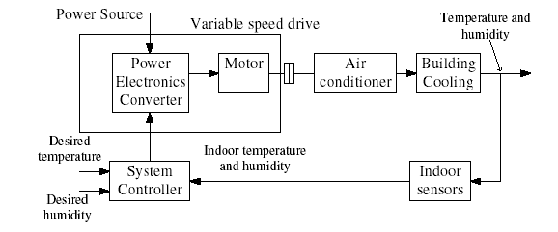

Application examples
Static Application : DC Power Supply
Drive Application : Air-Conditioning System

Slide 12

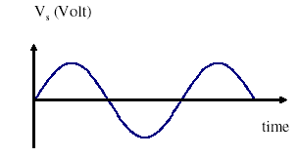
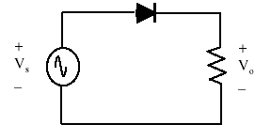
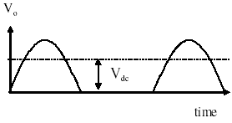
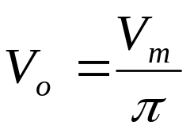
Power Conversion Concept
example
• Supply from TNB: 50Hz, 240V RMS
(340V peak). Customer need DC
voltage for welding purpose, say.
• TNB sine-wave supply gives zero DC
component!
• We can use simple half-wave rectifier.
A fixed DC voltage is now obtained. This is a simple PE system.
Average output voltage :

Slide 13
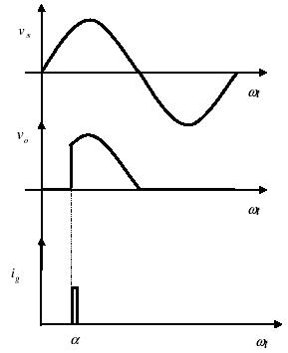
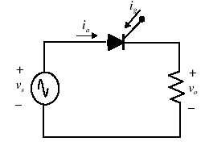

Power Conversion Concept
How if customer wants variable DC voltage?
More complex circuit using SCR is required.
Average output voltage :
By controlling the firing angle α, the output DC voltage (after conversion) can be varied.
Obviously this needs a complicated electronic
system to set the firing current pulses for the SCR.

Slide 14
PE GROWTH
PE rapid growth due to:
Advances in power (semiconductor) switches
Advances in microelectronics (DSP,VLSI,
microprocessor/microcontroller, ASIC)
New ideas in control algorithms
Demand for new applications

Slide 15
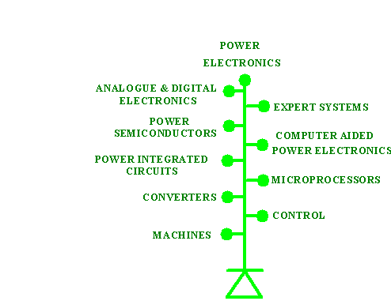
Interdisciplinary

Slide 16
1. Energy scenario
Need to reduce dependence on fossil fuel: coal, natural gas, oil, and nuclear power resource.
Depletion of these sources is expected.
Tap renewable energy resources :
solar, wind, fuel-cell, ocean-wave
Energy saving by PE applications. Examples :
- variable speed compressor air-conditioning system :
30% saving compared to thermostat-controlled system.
- Lighting using electronics ballast boost efficiency of
fluorescent lamp by 20%.

Slide 17
Current issues
2. Environtment issues
Nuclear safety : nuclear plant remain radioactive for thousands of years.
Burning of fossil fuel
Emits gases such as SO₂, CO (oil burning), SO₂, NO_{x} (coal burning), etc
Create global warming (green house effect), acid rain and urban pollution from smokes.
Possible Solution by application of PE. Examples:
Renewable energy resources
Centralization of power stations to remote non-urban area (mitigation)
Electric vehicles

Slide 18
Conversion scheme from electric to electric by static switch
control information
PROCESSED OUTPUT POWER
POWER PROCESSOR
INPUT
POWER
dc-dc conversion
dc-ac
conv.
ac-dc
conv.
ac-ac conversion

Slide 19
Power Electronics Circuits Symbol
Rectifier : AC-DC Converter
AC input
DC output
DC CHOPPER : DC-DC Converter
DC input
DC output
INVERTER : DC-AC Converter
DC input
AC output

Slide 20

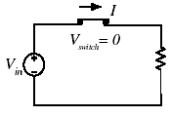
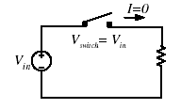
Power Semiconductor devices
Power switches:
work-horses of PE
systems.
(Power Switches)
Power switch
Operates in two states :
– Fully off , i.e.
switch opened.
– Blocking state
– Fully on. i.e.
switch closed.
– Conducting state
Switch ON (fully closed)
Power switch never operates in linear mode.
Switch OFF (fully opened)
Can be categorised into three groups:
– Uncontrolled: Diode :
– Semi-controlled: Thyristor (SCR).
– Fully controlled: Power transistors: e.g. BJT,
MOSFET, IGBT, GTO, IGCT

Slide 21
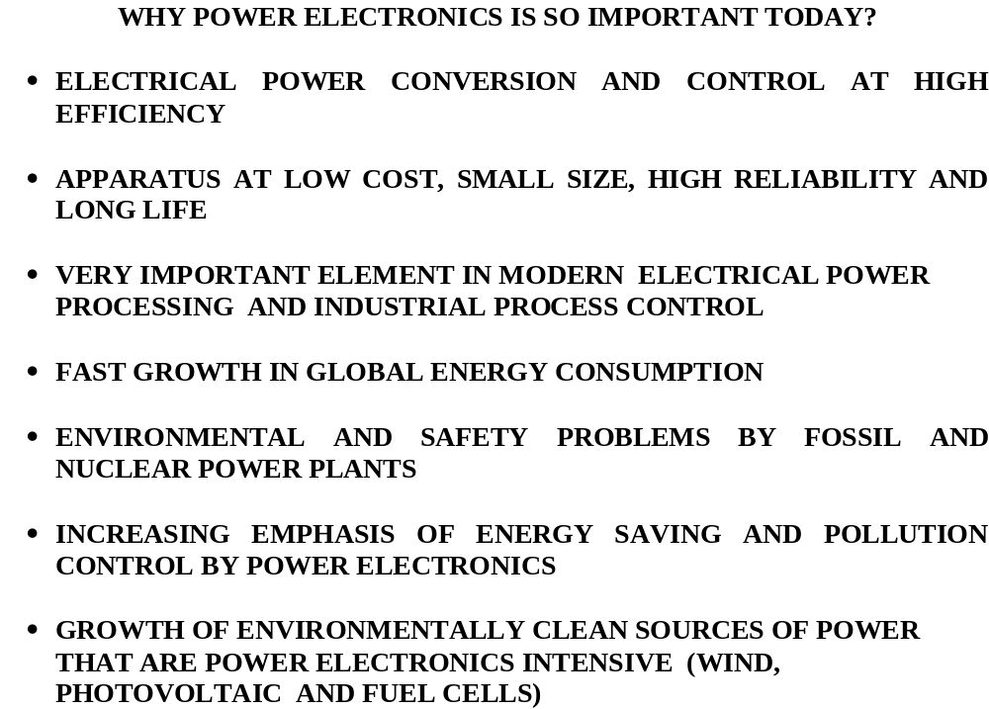
Fig.3

Slide 22
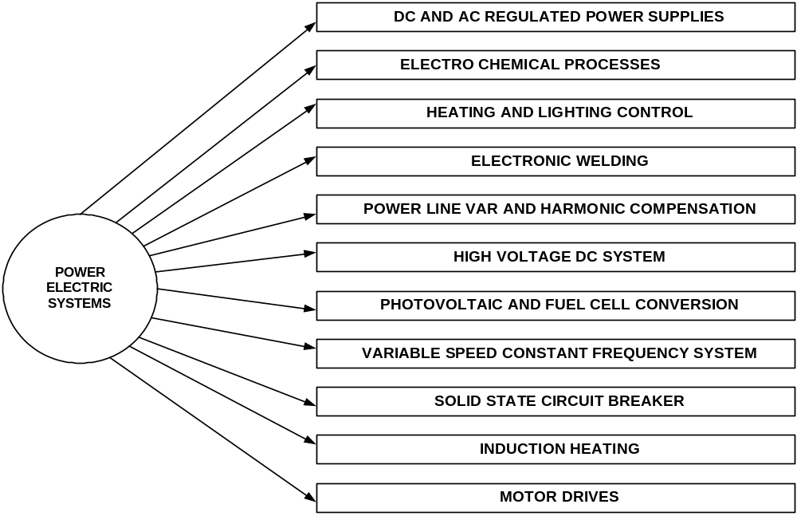
POWER ELECTRONICS APPLICATIONS
Fig.4

Slide 23
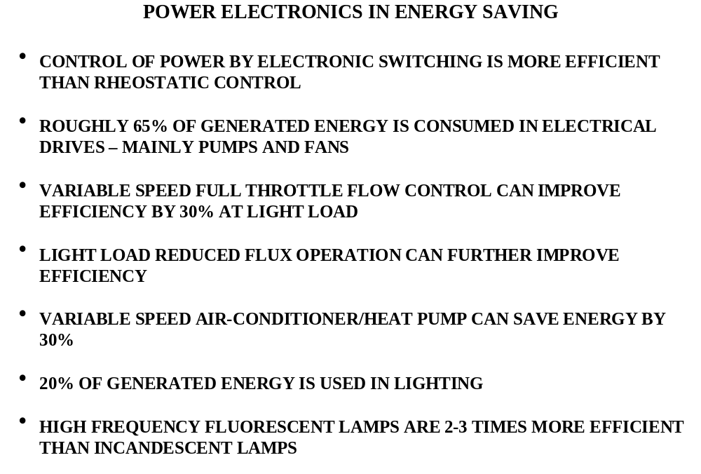
Fig.5

Slide 24
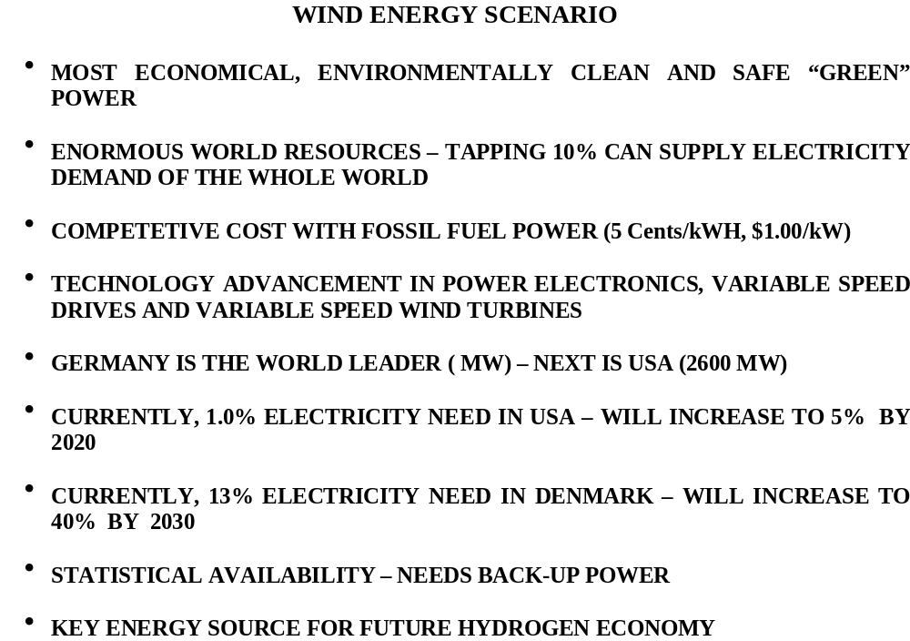
Fig.6

Slide 25
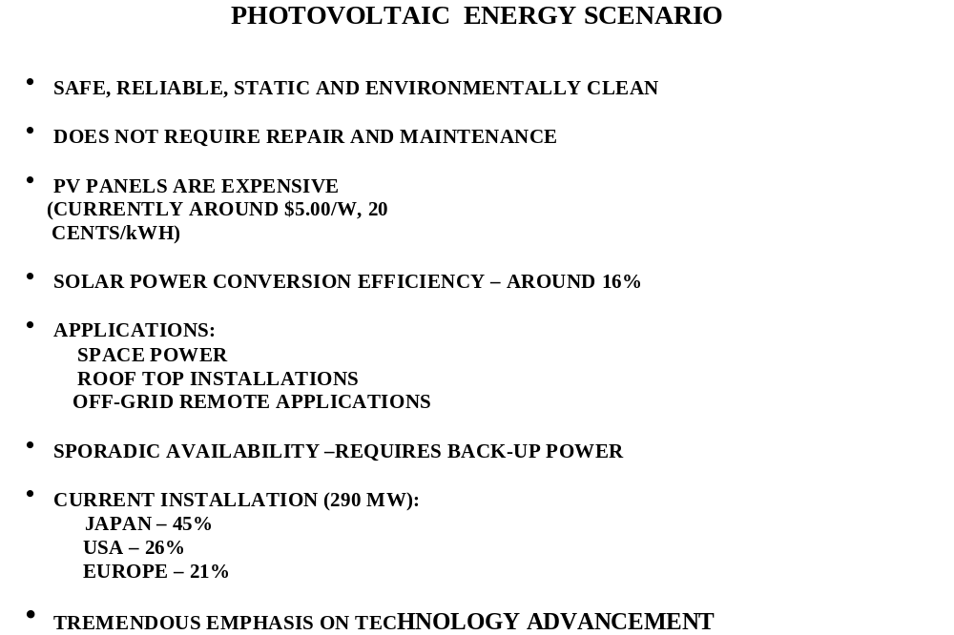
Fig.7

Slide 26
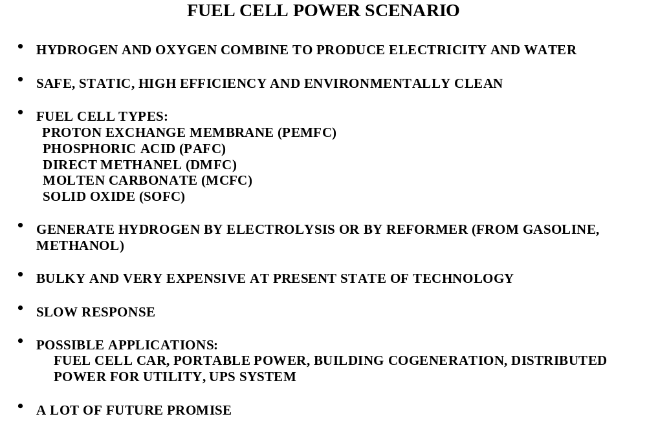
Fig.9

Slide 27
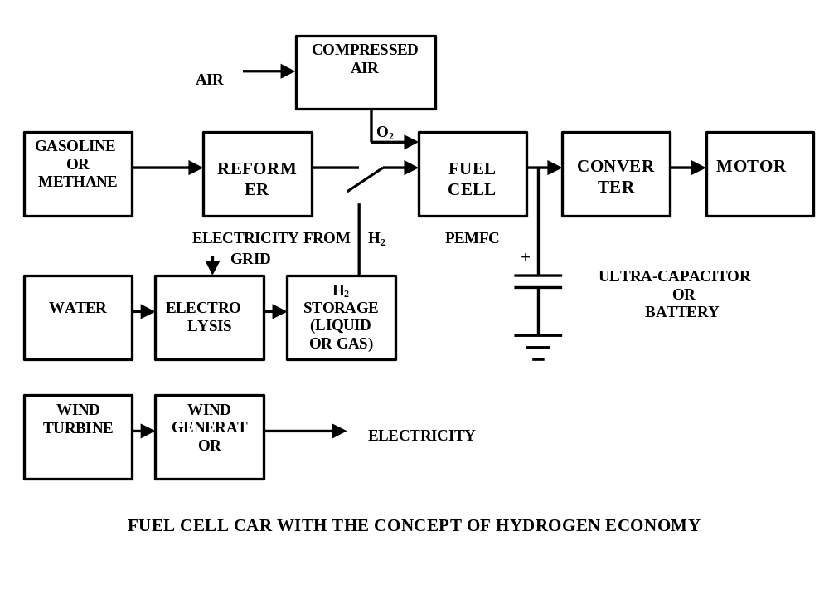
Fig.10

Slide 28
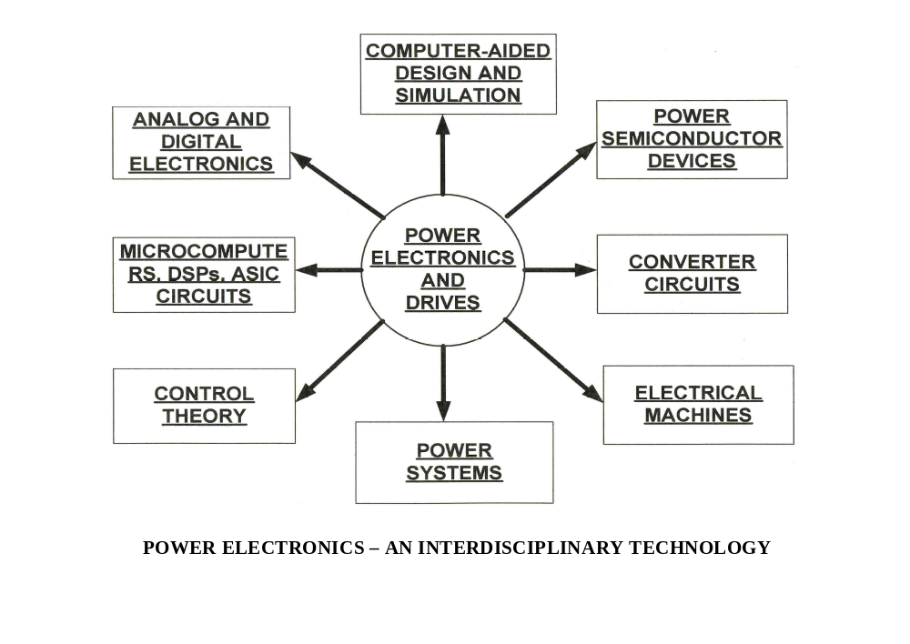
Fig.11

Slide 29
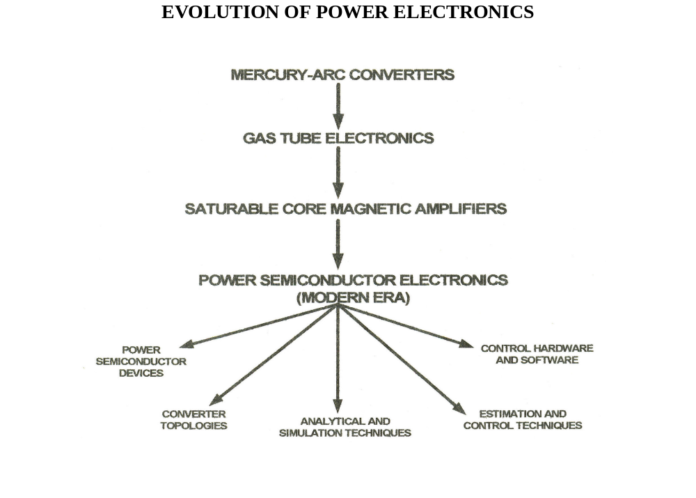
Fig.12

Slide 30
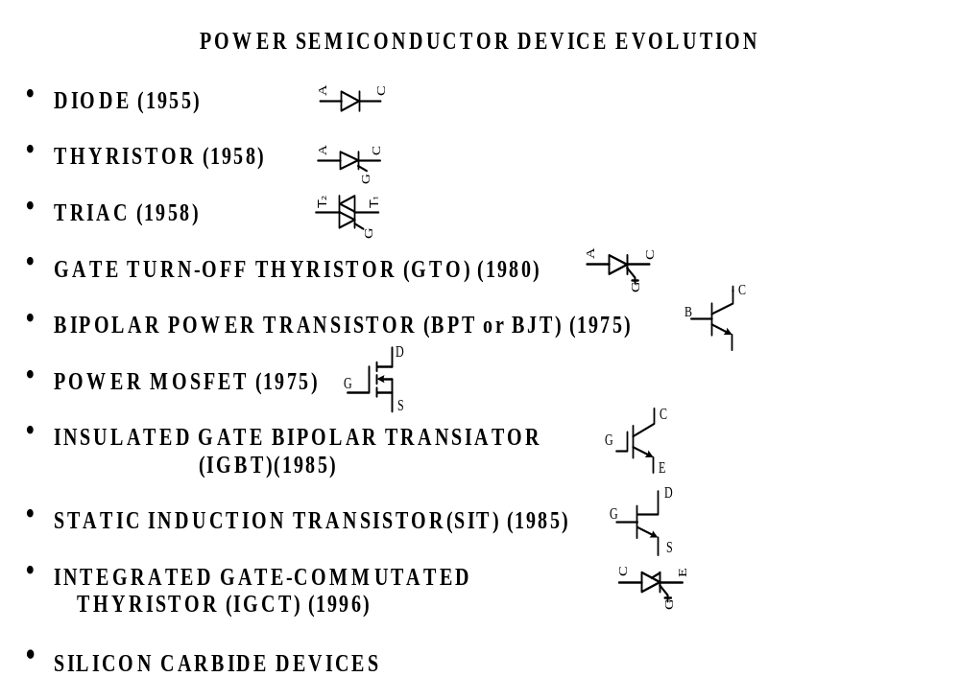
Fig.13

Slide 31
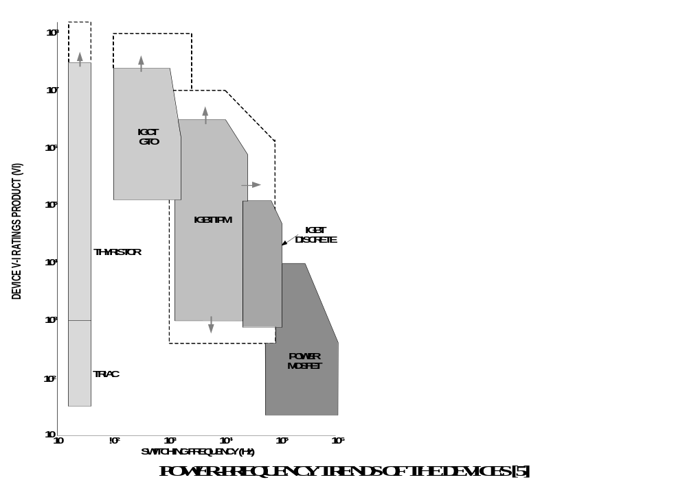

Slide 32
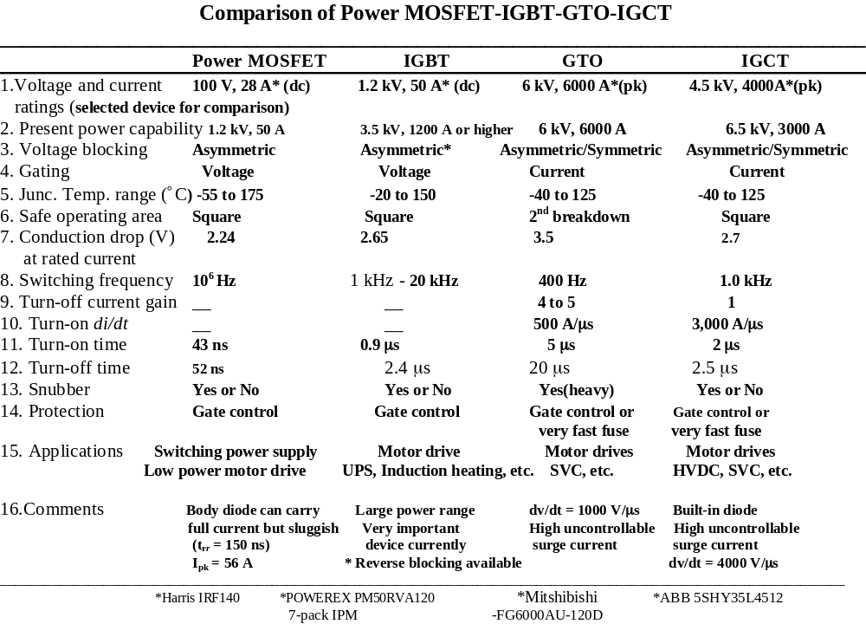

Slide 33
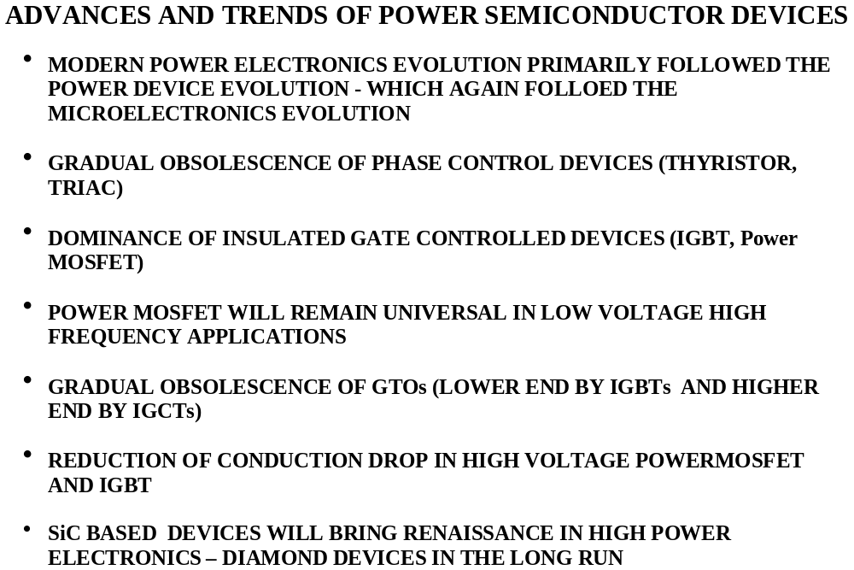

Slide 34
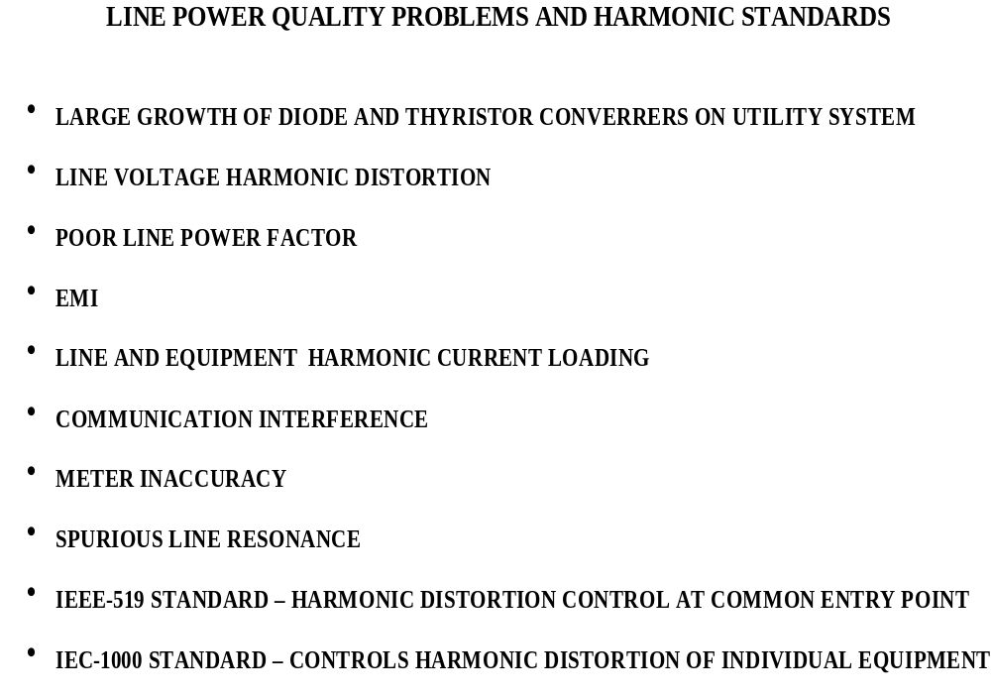

Slide 35
Web links
https://www.youtube.com/watch?v=djbJm-xWo2w
https://www.youtube.com/watch?v=XKpBkVmYlNk
https://www.youtube.com/watch?v=dVvS9OJEhig
The above web links gives an introduction to power electronics and its various application areas. The videos also gives information relating to major manufacturers of power electronics components and systems.

Slide 36
Useful Web Resources
https://nptel.ac.in/courses/108/102/108102145/
https://en.wikipedia.org/wiki/Power_electronics
https://ieeexplore.ieee.org/xpl/RecentIssue.jsp?punumber=63

