Slide 1

Inverters
Module 3
Subject Name: Power Electronics and Instrumentation Subject Code:18EC36
C R Gopalakrishna Murthy
Associate Professor
K.S. SCHOOL OF ENGINEERING AND MANAGEMENT, BANGALORE - 560109
DEPARTMENT OF ELETRONICS AND COMMUNICATION ENGINEERING

Slide 2
What is an Inverter?
A static device that converts DC power into AC power at desired output voltage and frequency is called an Inverter.
Applications
  Adjustable – speed AC drives,
  Induction Heating,
  Aircraft power supplies,
  UPS etc….

Slide 3
Classification of Inverters
According to the method of Commutation
  Line Commutated Inverter
  Force Commutated Inverter
    According to the method of Connections
      Series Inverter
      Parallel Inverter
      Bridge Type Inverter
    According to the nature of DC source feeding the Inverter
      Voltage source Inverter
      Current Source Inverter

Slide 4
Voltage Source Inverters
VSI has a constant voltage at its input terminals.
Its output voltage does not depend on load.
Its output current depends on the type of load.

Slide 5
Current Source Inverters
CSI has a constant current at its input terminals.
Its output current does not depend on load.
Its output voltage depends on the type of load.

Slide 6
Voltage Source Inverters
Single phase Inverter
Half Bridge Inverter
Full Bridge Inverter
Three phase voltage source inverter
180 degree mode
120 degree mode

Slide 7
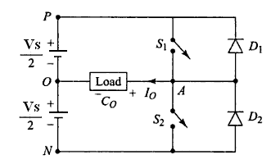
Single Phase Half Bridge Inverter

Slide 8
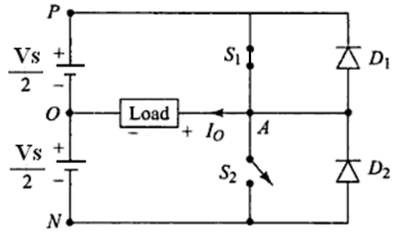
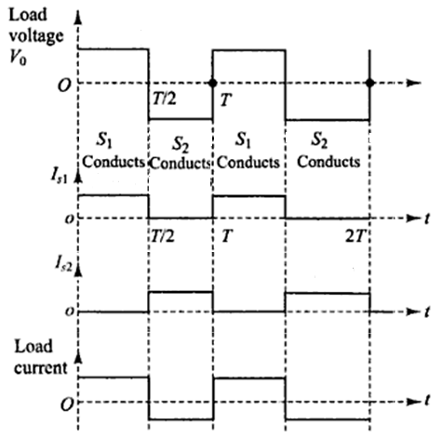

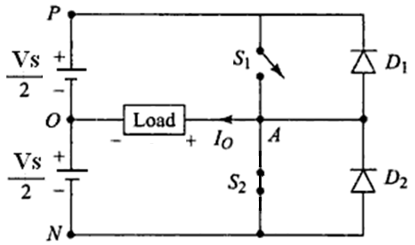


Slide 9
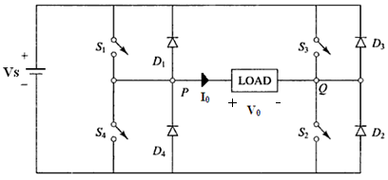
Single Phase Full Bridge Inverter

Slide 10
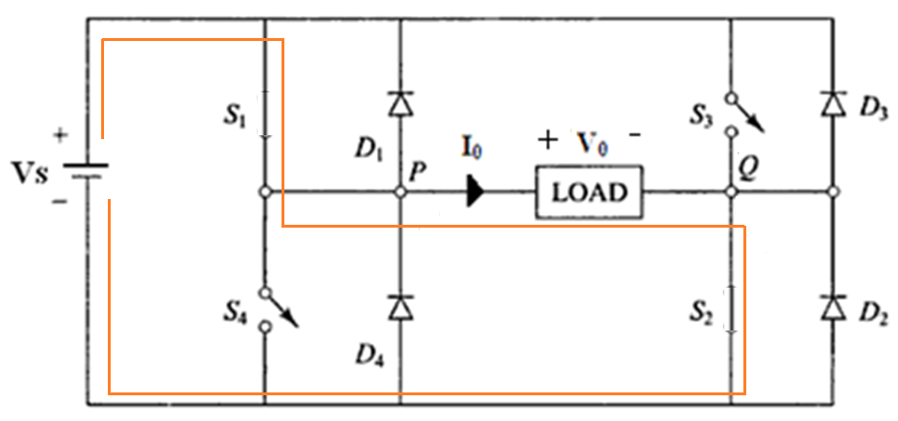
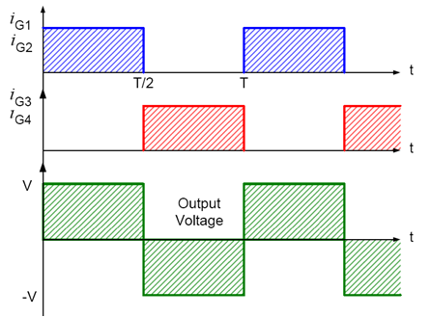
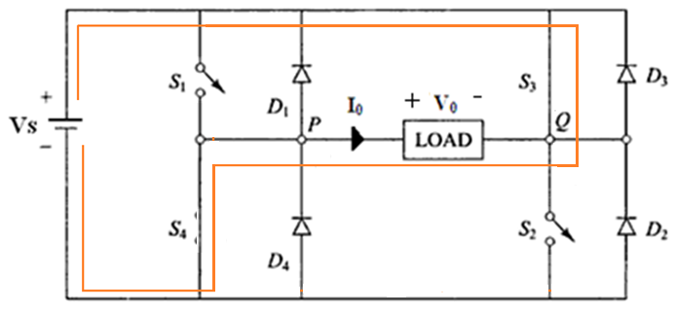

Slide 11
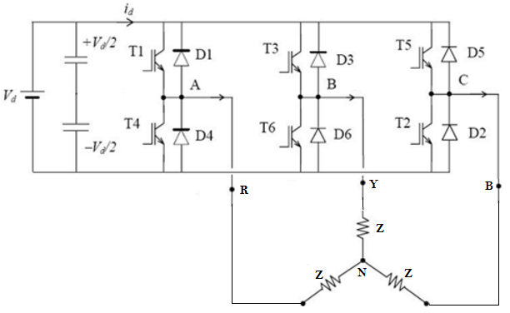
Three Phase VSI (180 Degree Mode)

Slide 12
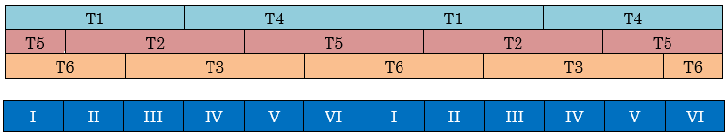
Step | Devices Conducting
I | T1, T5 & T6
II | T1, T2 & T6
III | T1, T2 & T3
IV | T4, T2 & T3
V | T4, T5 & T3
VI | T4, T5 & T6

Slide 13
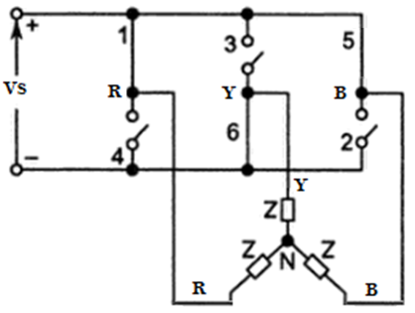
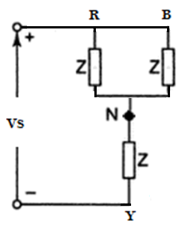

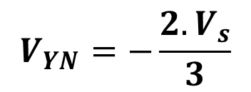

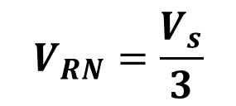


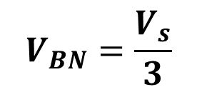
Step I
$$V_{RN}=\frac{V_{s}}{3}$$
$$V_{RY}=V_{s}$$
$$V_{YN}=−\frac{{2.V}_{s}}{3}$$
$$V_{YB}=−V_{s}$$
$$V_{BN}=\frac{V_{s}}{3}$$
$$V_{BR}=0$$

Slide 14
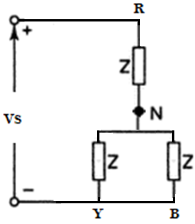


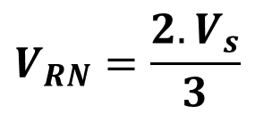

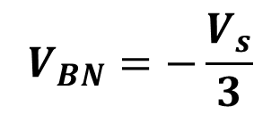
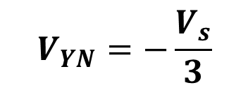
Step II
$$V_{RN}=\frac{{2.V}_{s}}{3}$$
$$V_{RY}=V_{s}$$
$$V_{YN}=−\frac{V_{s}}{3}$$
$$V_{YB}=0$$
$$V_{BN}=−\frac{V_{s}}{3}$$
$$V_{BR}=−V_{s}$$

Slide 15
Step | Phase Voltage |  |  | Line Voltage
 | V_{RN} | V_{YN} | V_{BN} | V_{RY} | V_{YB} | V_{BR}
I | Vs/3 | -2Vs/3 | Vs/3 | Vs | - Vs | 0
II | 2Vs/3 | -Vs/3 | -Vs/3 | Vs | 0 | - Vs
III | Vs/3 | Vs/3 | -2Vs/3 | 0 | Vs | - Vs
IV | -Vs/3 | 2Vs/3 | -Vs/3 | - Vs | Vs | 0
V | -2Vs/3 | Vs/3 | Vs/3 | - Vs | 0 | Vs
VI | -Vs/3 | -Vs/3 | 2Vs/3 | 0 | - Vs | Vs

Slide 16
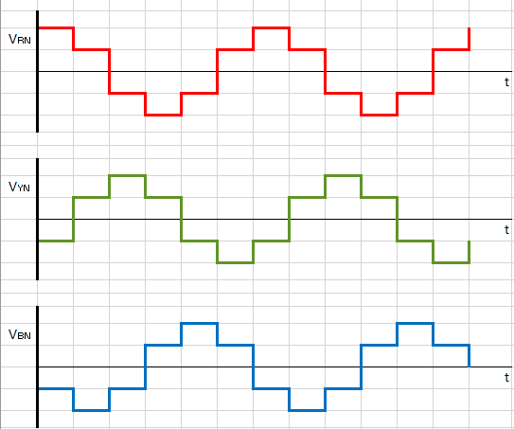

Slide 17
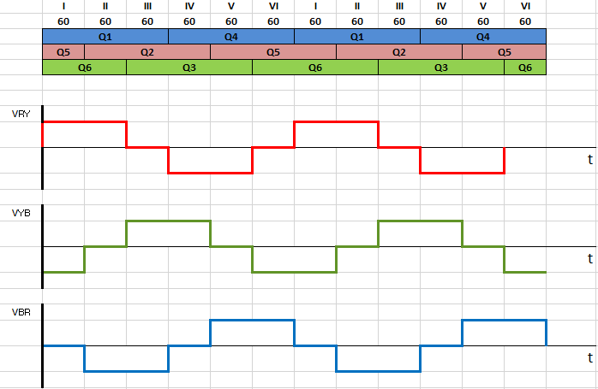

Slide 18
Three Phase VSI (120 Degree Mode)

Slide 19
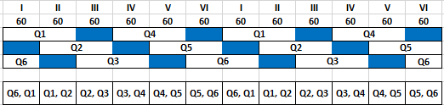
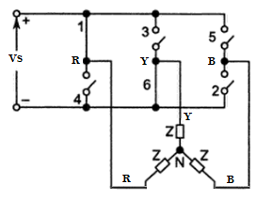
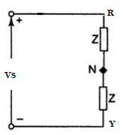
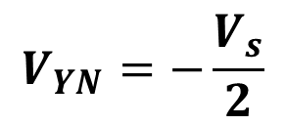
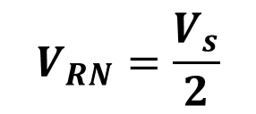
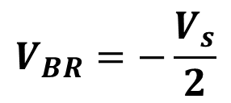

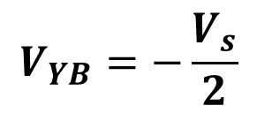


Step I
$$V_{RN}=\frac{V_{s}}{2}$$
$$V_{RY}=V_{s}$$
$$\frac{V_{s}}{2}$$
$$V_{YN}=−\frac{V_{s}}{2}$$
$$V_{YB}=−\frac{V_{s}}{2}$$
$$\frac{V_{s}}{2}$$
$$V_{BN}=0$$
$$V_{BR}=−\frac{V_{s}}{2}$$

Slide 20
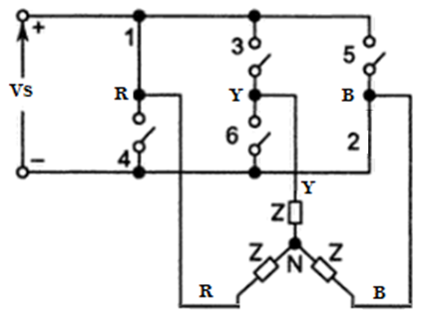
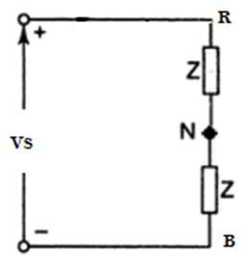
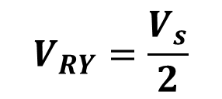
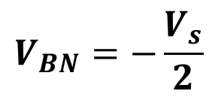


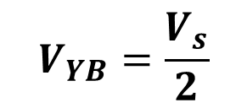
Step II
$$V_{RN}=\frac{V_{s}}{2}$$
$$V_{RY}=\frac{V_{s}}{2}$$
$$\frac{V_{s}}{2}$$
$$V_{YB}=\frac{V_{s}}{2}$$
$$V_{YN}=0$$
$$\frac{V_{s}}{2}$$
$$V_{BN}=−\frac{V_{s}}{2}$$
$$V_{BR}=−V_{s}$$

Slide 21
Step | Phase Voltage |  |  | Line Voltage
 | V_{RN} | V_{YN} | V_{BN} | V_{RY} | V_{YB} | V_{BR}
I | Vs/2 | -Vs/2 | 0 | Vs | -Vs/2 | -Vs/2
II | Vs/2 | 0 | -Vs/2 | Vs/2 | Vs/2 | - Vs
III | 0 | Vs/2 | -Vs/2 | -Vs/2 | Vs | -Vs/2
IV | -Vs/2 | Vs/2 | 0 | - Vs | Vs/2 | Vs/2
V | -Vs/2 | 0 | Vs/2 | -Vs/2 | -Vs/2 | Vs
VI | 0 | -Vs/2 | Vs/2 | Vs/2 | - Vs | Vs/2

Slide 22
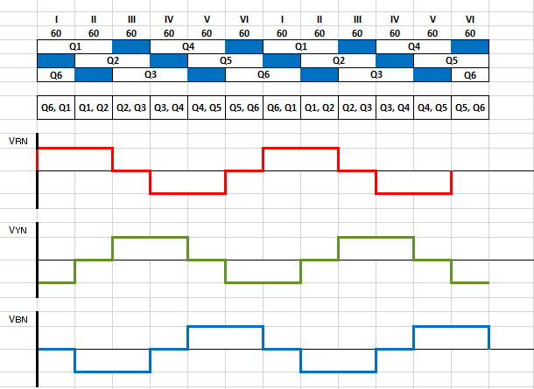

Slide 23
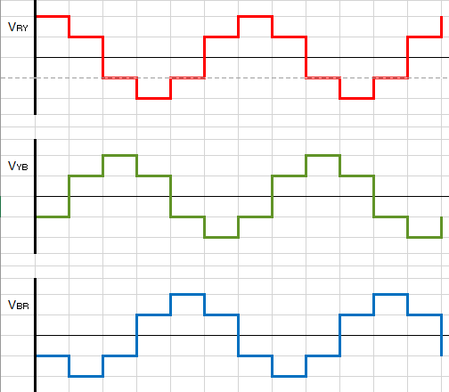
Line Voltages

Slide 24
Voltage Control in Single Phase Inverters
AC loads may require a constant or variable voltage at their input terminals.
Methods of controlling the output voltage are,
    External control of AC output voltage
    External control of DC input voltage
    Internal control of inverter
    The first two methods require additional components. But third method requires no additional components.
Inverter
DC
AC

Slide 25
External Control of AC Output Voltage
AC Voltage Control
The output voltage of the inverter is controlled by using an AC voltage controller.
The output contains more harmonics when the output voltage is low.
Hence it is rarely used.
Constant DC voltage
Inverter
Constant AC voltage
AC Voltage Controller
Controlled AC voltage
AC Load

Slide 26
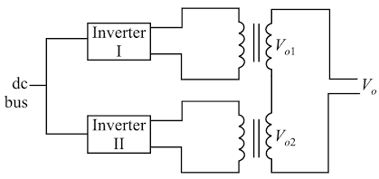
External Control of AC Output Voltage
Series Inverter Control
Two or more inverters are connected in parallel.
Output of inverters are connected to transformers whose secondary windings are connected in series.
Frequency of output voltages V₀₁ & V₀₂ must be same.
V₀₂
V_{O}
ϴ
V₀₁

Slide 27
External Control of DC Input Voltage
Constant AC voltage
Fully Controlled Rectifier
Filter
Controlled
DC voltage
Inverter
Controlled AC voltage
Constant AC voltage
Uncontrolled Rectifier
Chopper
Filter
Controlled
DC voltage
Inverter
Controlled AC voltage
Constant AC voltage
AC Voltage Controller
Uncontrolled Rectifier
Filter
Controlled DC voltage
Inverter
Controlled AC voltage
Controlled DC voltage
Chopper
Filter
Controlled DC voltage
Inverter
Controlled AC voltage

Slide 28
Internal Control of Inverter
Output voltage of inverter is adjusted by controlling the inverter itself.
This method of controlling the output voltage is called Pulse Width Modulation.
It is obtained by adjusting the ON and OFF periods of the inverter components.
Advantages
No additional components are required.
Lower order harmonics can be eliminated along with voltage control.
Filter requirements are minimized.

Slide 29
Pulse Width Modulated Inverters
These inverters can produce ac voltages of variable magnitude as well as variable frequency.
The quality of output voltage can also be greatly enhanced, when compared with those of square wave inverters.
Pulse Width Modulation is the process of modifying the width of the pulses to obtain variation in the o/p voltage with reduced harmonic content.
The main aim of using different PWM techniques is to generate a sinusoidal output voltage of desired fundamental frequency and magnitude.

Slide 30
Different types of PWM inverters
Single pulse modulation
Multiple pulse modulation
Sinusoidal pulse modulation
Modified sinusoidal pulse modulation
Space vector pulse width modulation

Slide 31
Single Pulse Width Modulation
In single pulse modulation, there is only one pulse exists per half cycle.
The width of this pulse is varied to control the inverter output voltage.

Slide 32
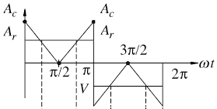
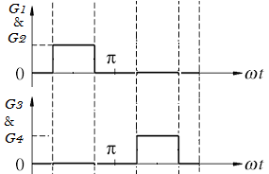
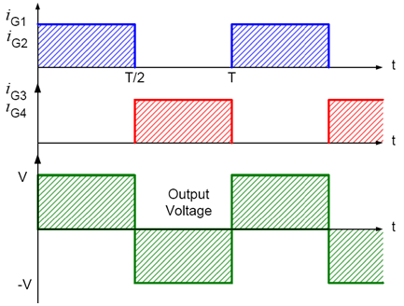
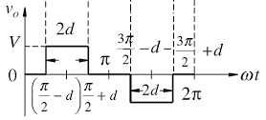
A_{r} > A_{C}
A_{r} < A_{C}
Frequency of the reference signal determines the frequency of output voltage.
The ratio of A_{r} to A_{C,} called modulation index, controls the output voltage.

Slide 33
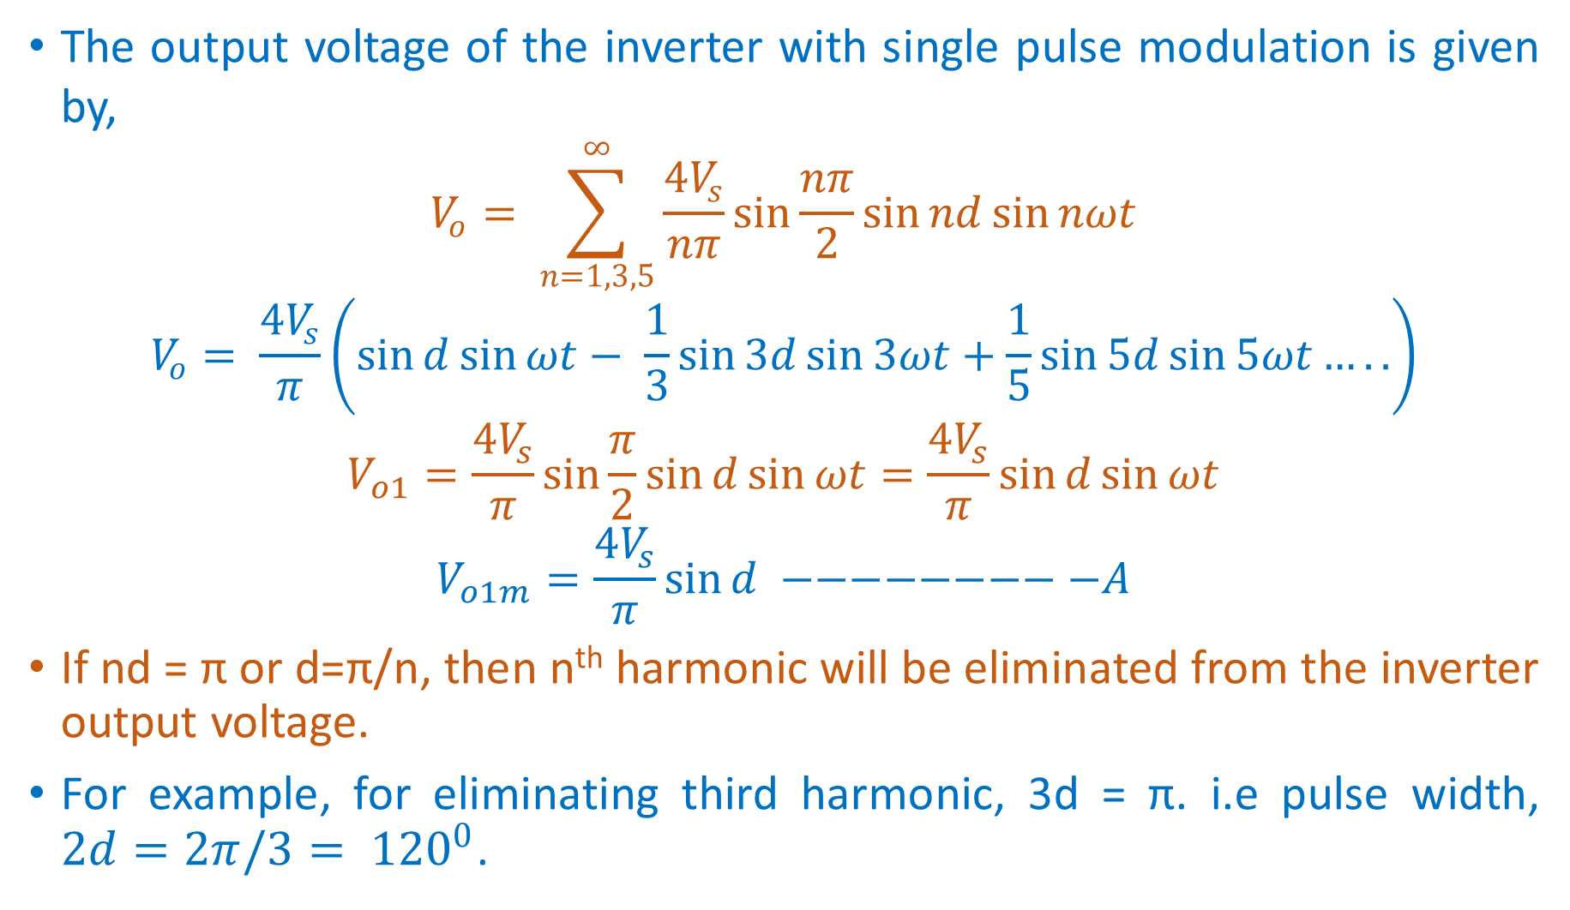
The output voltage of the inverter with single pulse modulation is given by,
$$V_{o}= \sum_{n=1,3,5}^{∞}{\frac{4V_{s}}{nπ}\sin{\frac{nπ}{2}\sin{nd\sin{nωt}}}}$$
$$V_{o}= \frac{4V_{s}}{π}\left(\sin{d}\sin{ωt}− \frac{1}{3}\sin{3d}\sin{3ωt}+\frac{1}{5}\sin{5d}\sin{5ωt…..}\right)$$
$$V_{o1}=\frac{4V_{s}}{π}\sin{\frac{π}{2}\sin{d\sin{ωt}}}=\frac{4V_{s}}{π}\sin{d\sin{ωt}}$$
$$V_{o1m}=\frac{4V_{s}}{π}\sin{d} −−−−−−−−−A$$
If nd = π or d=π/n, then n^{th} harmonic will be eliminated from the inverter output voltage.
For example, for eliminating third harmonic, 3d = π. i.e pulse width, $2d=2π/3= {120}^{0}$.

Slide 34
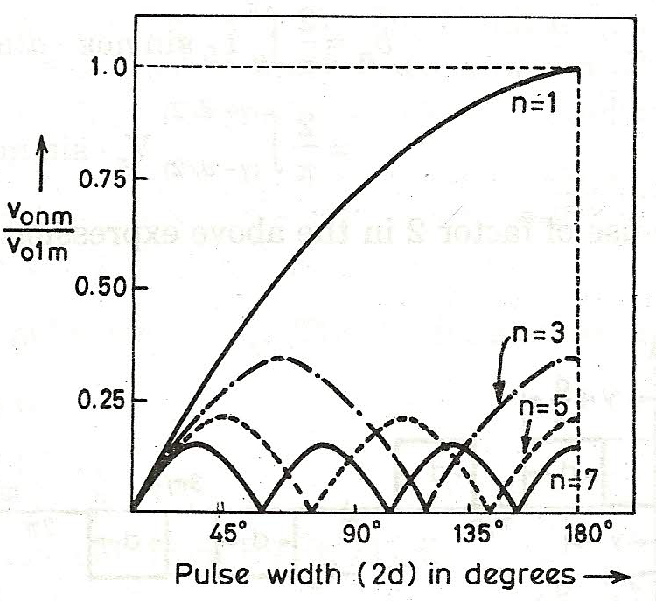
Inference from Single PWM
3rd, 5th & 7th harmonics dominate when the voltage is reduced.
A large amount of harmonics is introduced at lower output voltages.
Harmonic content can be reduced by having many pulses in each half cycle of output voltage.

Slide 35
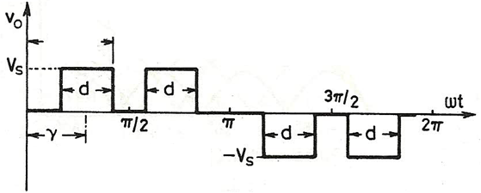
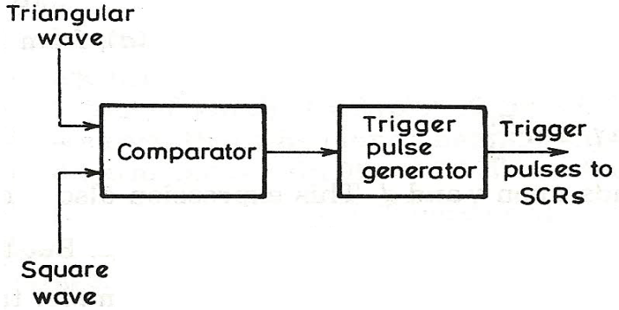
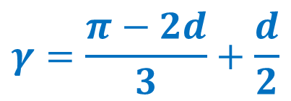
Multiple Pulse Modulation
In this method, many pulses having equal widths are produced per every half cycle.
The gating signals are produced by comparing reference signal with triangular carrier wave.
$$γ=\frac{π−2d}{3}+\frac{d}{2}$$

Slide 36
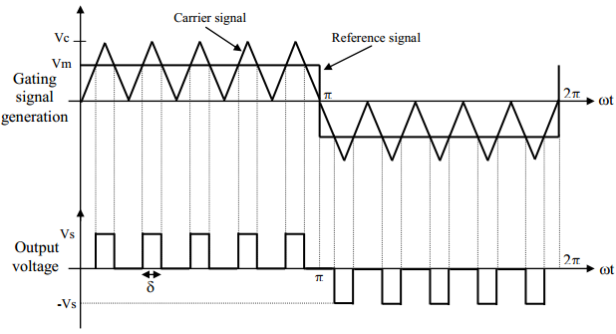
Multiple Pulse Modulation
Frequency of the reference signal determines the frequency of output voltage.
The ratio of A_{r} to A_{C,} called modulation index, controls the output voltage.

Slide 37
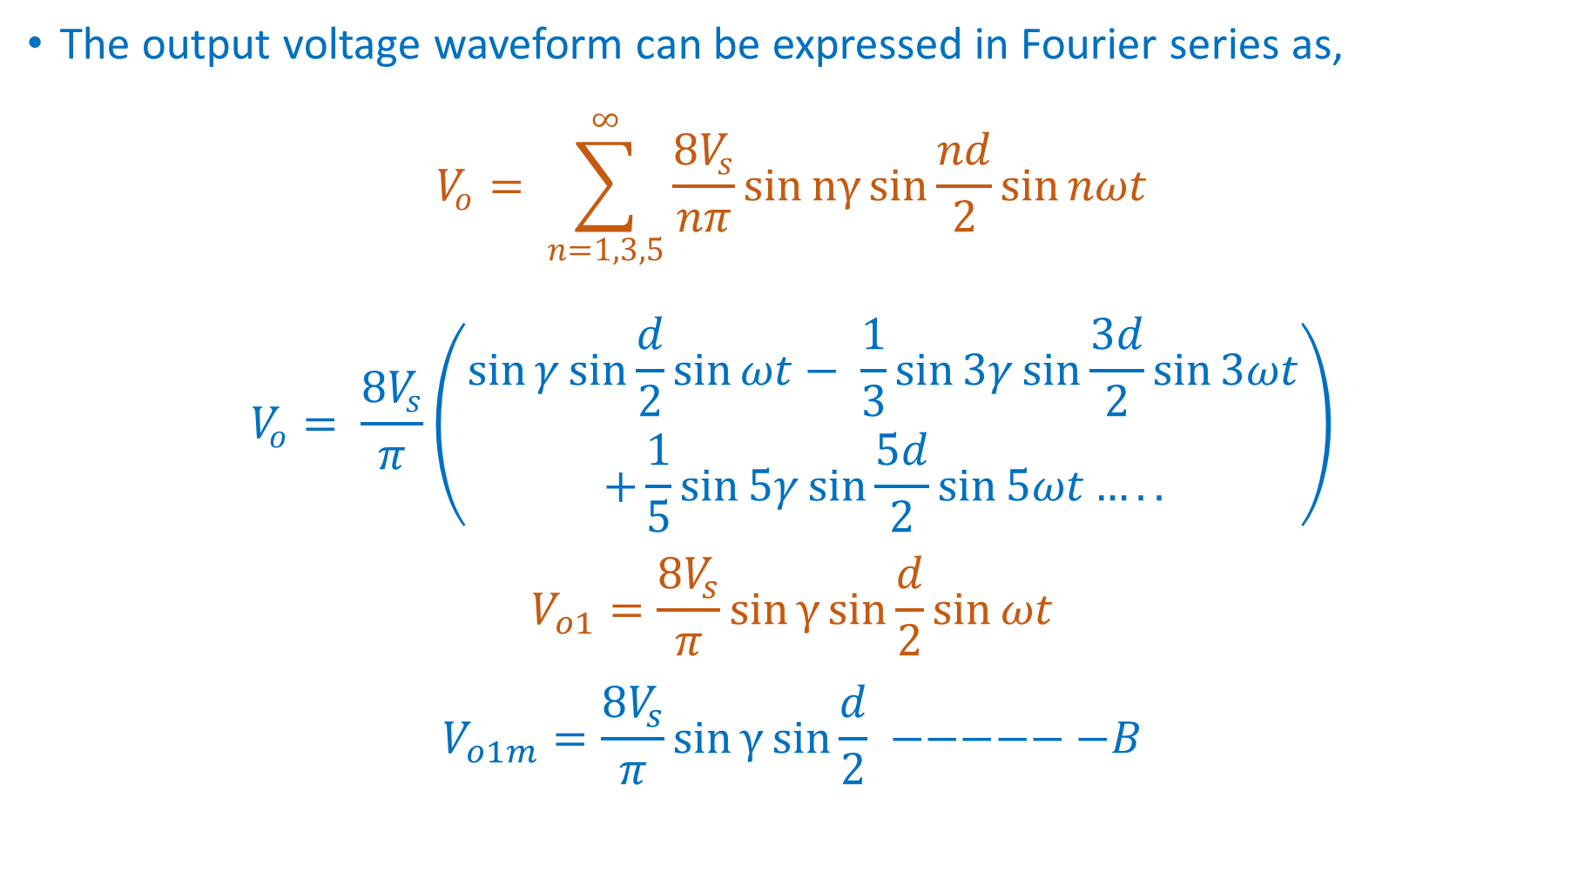
The output voltage waveform can be expressed in Fourier series as,
$$V_{o}= \sum_{n=1,3,5}^{∞}{\frac{8V_{s}}{nπ}\sin{nγ}sin{\frac{nd}{2}\sin{nωt}}}$$
$$V_{o}= \frac{8V_{s}}{π}\left(\begin{aligned}\sin{γ}\sin{\frac{d}{2}}\sin{ωt}− \frac{1}{3}\sin{3γ}\sin{\frac{3d}{2}}sin{3ωt} \\ +\frac{1}{5}\sin{5γ}\sin{\frac{5d}{2}}sin{5ωt…..}\end{aligned}\right)$$
$$V_{o1}=\frac{8V_{s}}{π}\sin{γ}sin{\frac{d}{2}\sin{ωt}}$$
$$V_{o1m}=\frac{8V_{s}}{π}\sin{γ}sin{\frac{d}{2}} −−−−−−B$$

Slide 38
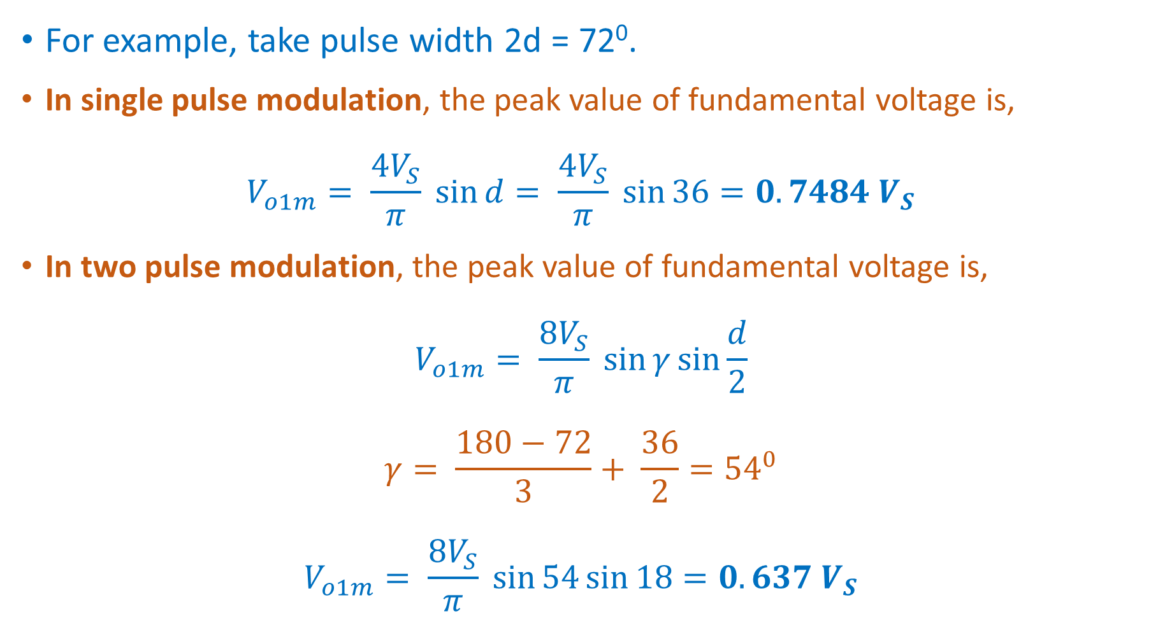
For example, take pulse width 2d = 72⁰.
In single pulse modulation, the peak value of fundamental voltage is,
$$V_{o1m}= \frac{4V_{S}}{π} \sin{d}= \frac{4V_{S}}{π} \sin{36}=0.7484 V_{S}$$
In two pulse modulation, the peak value of fundamental voltage is,
$$V_{o1m}= \frac{8V_{S}}{π} \sin{γ}\sin{\frac{d}{2}}$$
$$γ= \frac{180−72}{3}+ \frac{36}{2}={54}^{0}$$
$$V_{o1m}= \frac{8V_{S}}{π} \sin{54}\sin{18}=0.637 V_{S}$$

Slide 39
Multiple Pulse Modulation
It is seen from the above that the fundamental component of output voltage is low for two pulse modulation than it is for single pulse modulation.
But lower order harmonics are eliminated and higher order harmonics are increased. But higher order harmonics can be filtered easily.
This scheme is advantageous than single pulse modulation.
But large number of pulses per half cycle requires frequent turn on and turn off thyristors.
This will increase switching losses.

Slide 40
Sinusoidal Pulse Modulation
In this method, several pulses per half cycle are used as in the case of multiple pulse modulation.
But width of each pulse is modulated proportional to the amplitude of sine wave.
Gate pulses are generated by comparing sinusoidal reference signal with triangular carrier signal.
Frequency of reference signal (f_{r}) decides the frequency of output voltage.
The ratio of V_{r}/V_{c} is called the modulation index which controls the output voltage.
Number of pulses per half cycle depends on the carrier frequency (f_{c}).

Slide 41
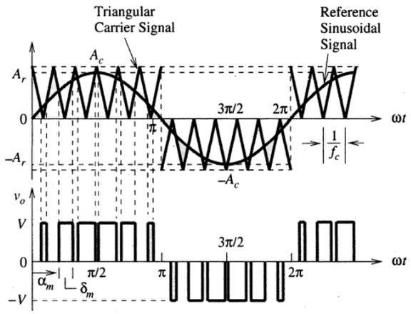
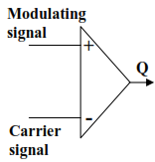
Sinusoidal Pulse Modulation

Slide 42

Sinusoidal Pulse Modulation
What is Modulation Index?
Modulation index is the ratio of peak magnitudes of the modulating waveform and the carrier waveform.
$$m=\frac{V_{m}}{V_{c}}$$
MI controls the harmonic content in the output voltage.

Slide 43
Summary
By increasing the number of pulses (N) per half cycle, the lower order harmonics get cancelled. But higher order harmonics will get increased.
Higher order harmonics can be filtered out easily.
Higher value of N results in more switching losses and leads to reduction of efficiency of inverter.

Slide 44
Sinusoidal Pulse Modulation
What is Over Modulation?
When the peak magnitude of modulating signal exceeds the peak magnitude of carrier signal, the PWM inverter operates under over-modulation.
During over-modulation the output voltage increases slightly.

Slide 45
Reduction of Harmonics in the Inverter O/P
Harmonics of 5% is allowable in an inverter output voltage.
But inverter output voltage contains more than 5% of harmonics.
Filters can be used to reduce the harmonic content.
Small size filter is enough for reducing higher order harmonics.
But a bigger size filter is required for reducing lower order harmonics.
This makes the system costlier and leads to poor performance.
Hence a system without filter is needed to suppress the harmonics.

Slide 46



Harmonic Reduction by PWM
Several pulses per half cycle reduces the lower order harmonics.
As the waveform is symmetrical during every quarter cycle, a_{n}=0.

Slide 47





If 3rd and 5th harmonics are to be eliminated,
Using α₁ and α₂, voltages of 7th, 9th and 11th harmonics are found as,

Slide 48


The amplitude of the fundamental component for these values of α₁ and α₂ is,
The amplitude of the fundamental component of un modulated output voltage wave is,
The amplitude of the fundamental voltage is 83.91% of the un modulated wave. So inverter is de-rated by 16.09%.
Additional eight commutation per cycle increases switching losses.

Slide 49


Harmonic Reduction by Transformer Connections
The output of two or more inverters are combined using transformers to get a net voltage with reduced harmonic content.
The voltage waveform should be similar but phase shifted from each other.

Slide 50




Harmonic Reduction by Transformer Connections
The Fourier analysis of V₀₁ and V₀₂ gives,
The amplitude of the fundamental output voltage with phase shift,
The amplitude of the fundamental output voltage with no phase shift,
In this method, the inverters are de-rated by 13% but this is less compared to the previous method

Slide 51


Harmonic Reduction by Stepped Wave Inverters
In this method, pulses of different widths and heights are super imposed to get a resultant stepped wave with reduced harmonic content.

Slide 52
Voltage Source Inverters
Input voltage is constant
Output voltage does not depend on load
Current Source Inverters
Input current is constant
Output current does not depend on load
Magnitude of load current & its shape depends on load
Magnitude of load voltage & its shape depends on load

Slide 53





Single Phase Current Source Inverter

Slide 54
REFERENCES
Gopal K.Dubey : Fundamental of Electrical Drives,
2nd Edition, Alpha Science, 2001
2. Rahid H. Muhammad : Power Electronics-Devices, Circuits and Applications, 3rd Edition, Pearson-Prentice Hall, 2004
3. Subrahmanyam Vedam : Electric Drives, Concepts and Application, Tata McGraw-Hill, 2001

Slide 55
Web links
https://nptel.ac.in/courses/108/102/108102145/
https://www.youtube.com/watch?v=QNyoak45MSY
https://www.youtube.com/watch?v=pAtPUeyHDZI
  The links gives video presentations on Inverters, its operating principles and applications

Slide 56
Useful links
https://en.wikipedia.org/wiki/Power_electronics
https://ieeexplore.ieee.org/xpl/RecentIssue.jsp?punumber=63

Slide 57
Thank You

